Slide 1
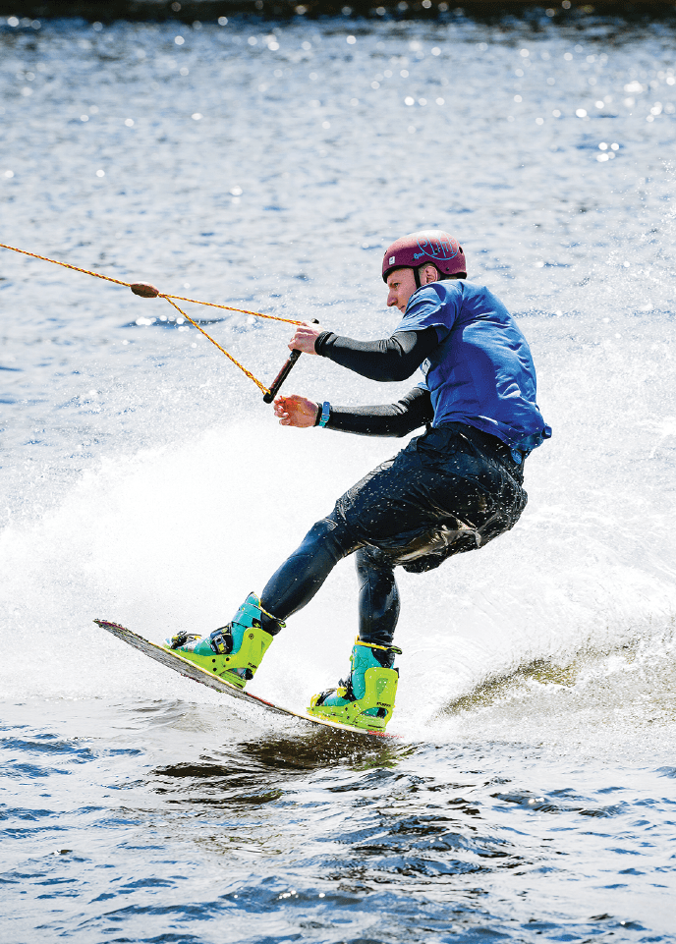




Slide 2









Slide 3



Slide 4




Slide 5
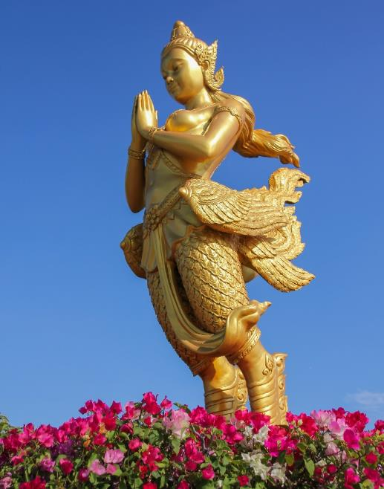


Slide 6




Slide 7
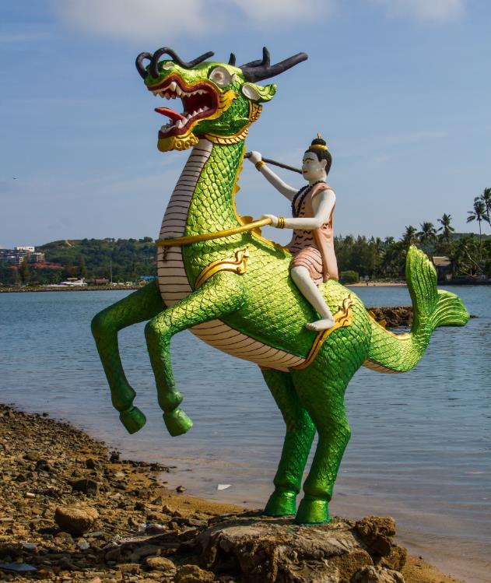


Slide 8




Slide 9
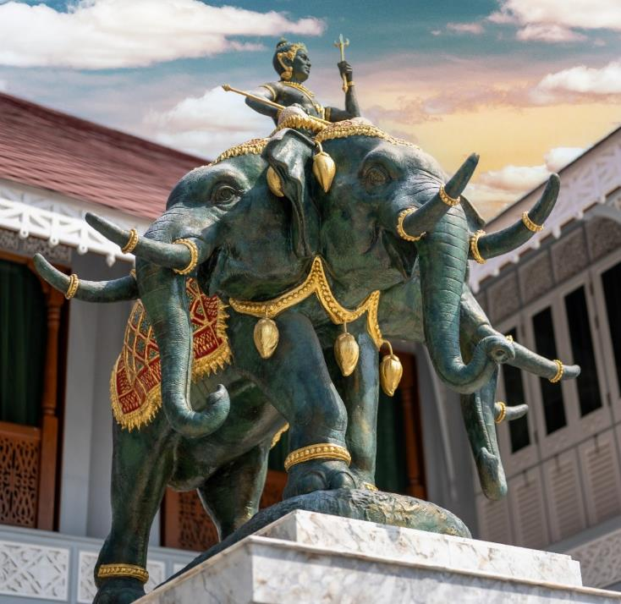


Slide 10




Slide 11
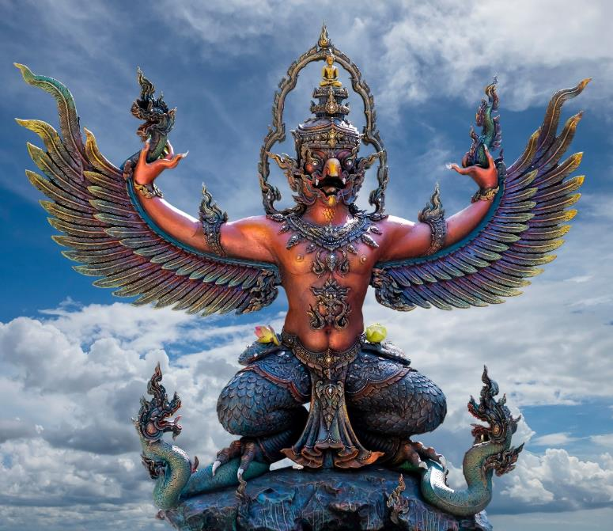


Slide 12










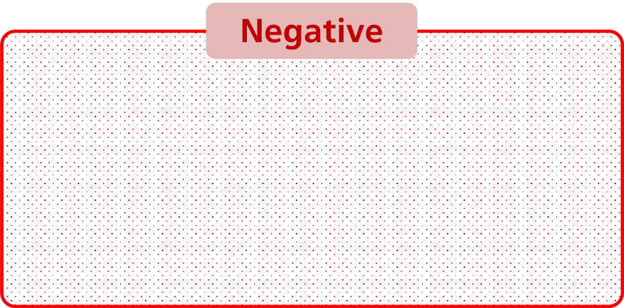

Slide 13















Slide 14

















Slide 15










Slide 16








Slide 17







Slide 18

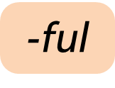
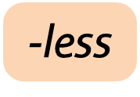

Slide 19
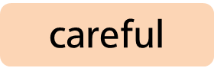

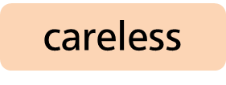














Slide 20


Slide 21




Slide 22


Slide 23



Slide 24



Slide 25



Slide 26


Slide 27


Slide 28



Slide 29




Slide 30




Slide 31

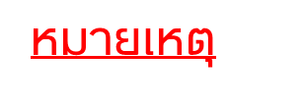

Slide 32





Slide 33
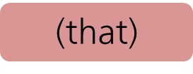
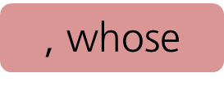

Slide 34

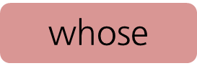

Slide 35
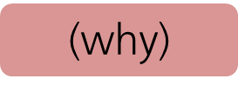


Slide 36



Slide 37




Slide 38



Slide 39






Slide 40





Slide 41





Slide 42
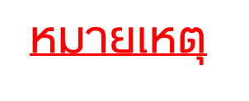







Slide 43




Slide 44





Slide 45





Slide 46







Slide 47








Slide 48






Slide 49








Slide 50





Slide 51






Slide 52






Slide 53





Slide 54




Slide 55


Slide 56



Slide 57



Slide 58







Slide 59







Slide 60



Slide 61
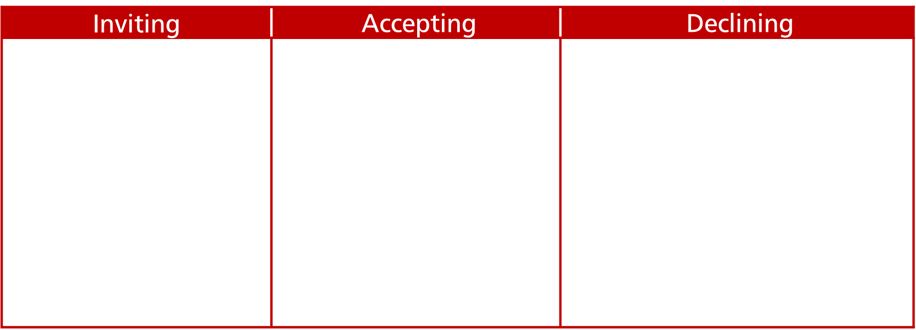
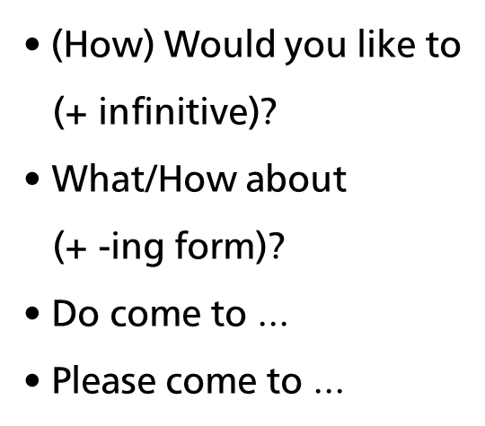
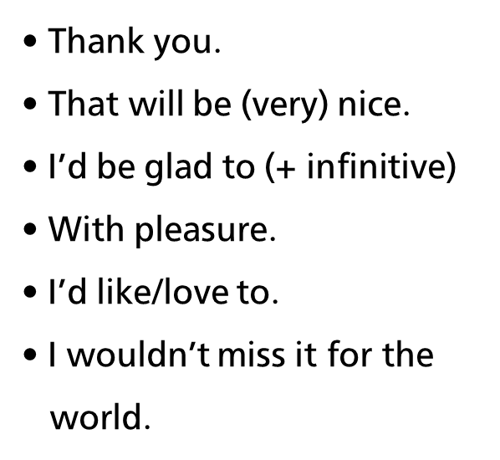
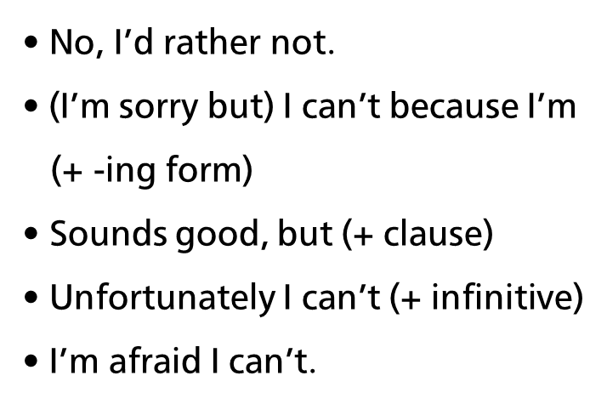

Slide 62



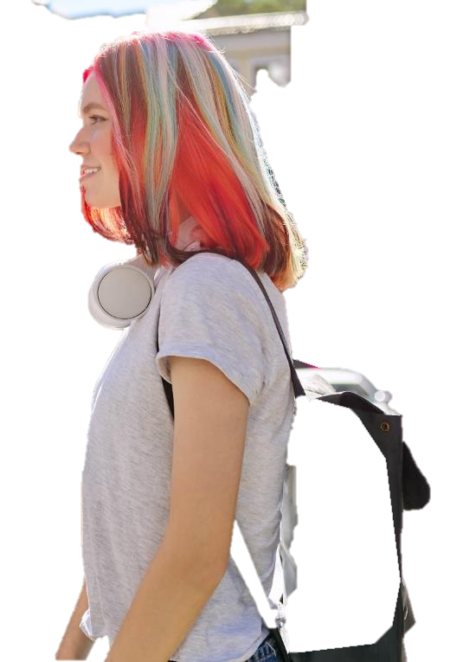


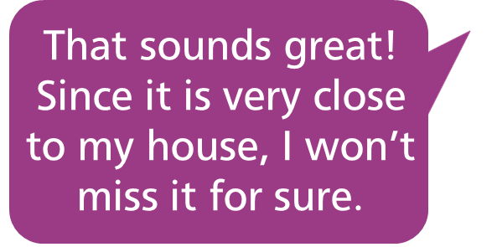
Accepting
Declining

Slide 63
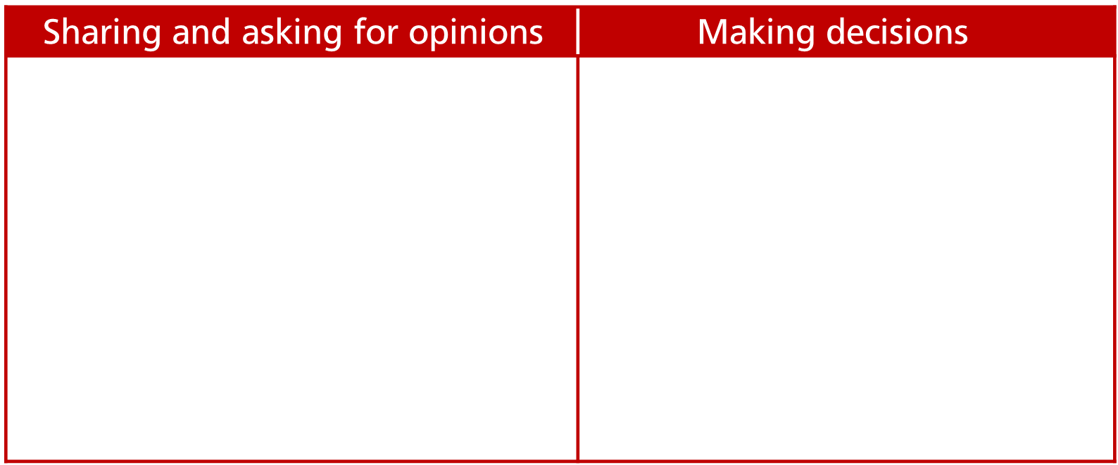
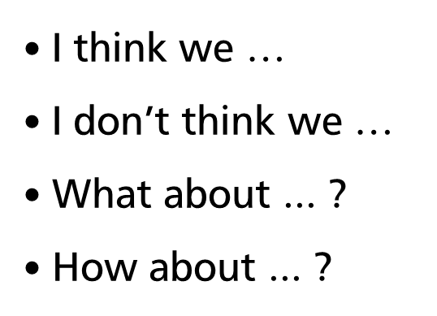


Slide 64


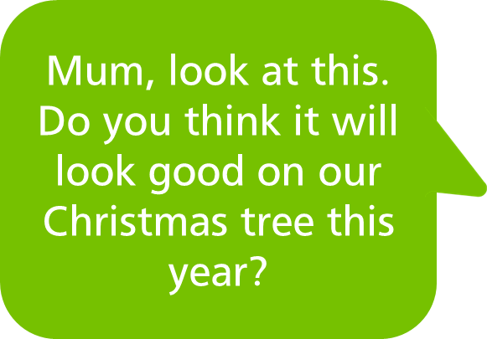


Declining

Slide 65


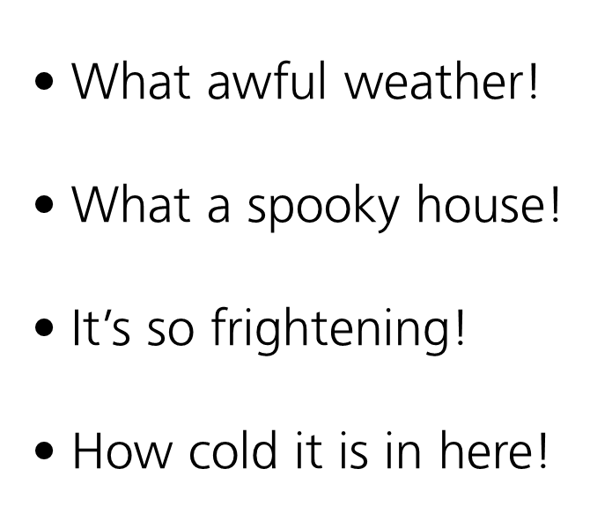


Slide 66


Slide 67
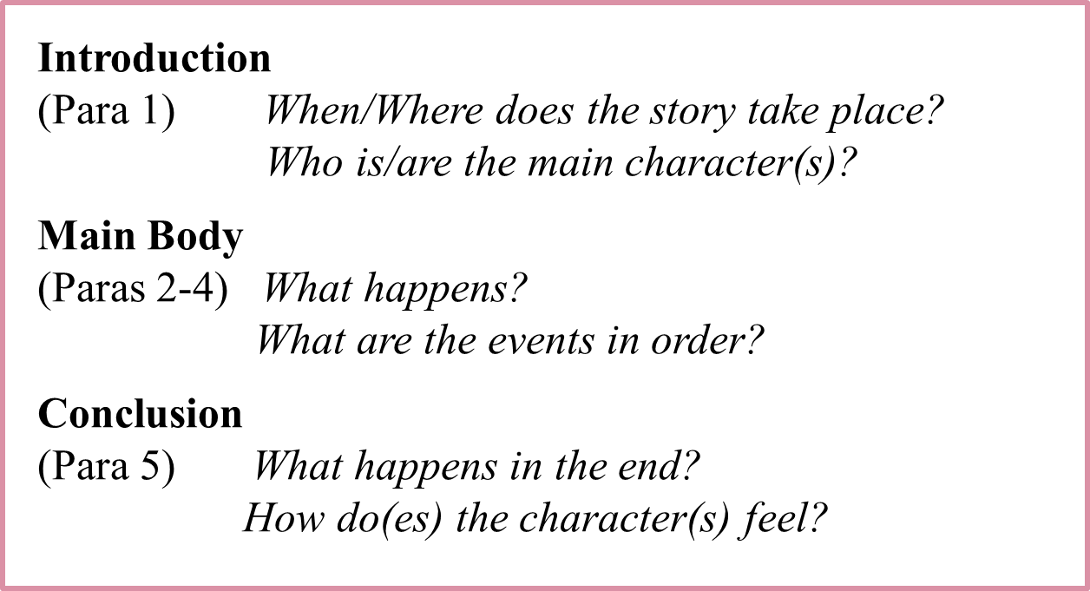

Slide 68


