Slide 1



Slide 2
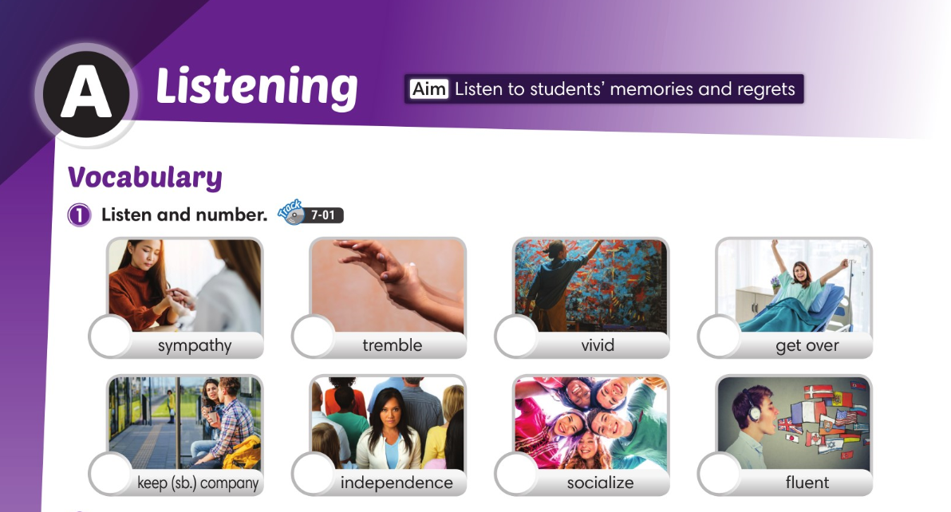

8
6
1
7
4
5
2
3

Slide 3
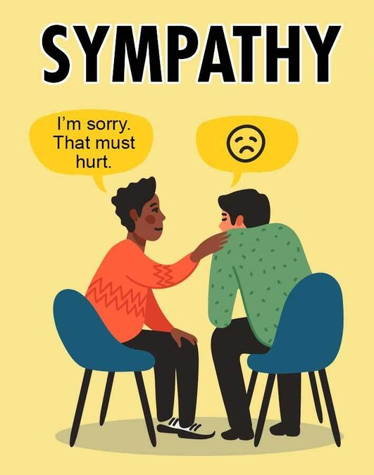
sympathy (n.)
/ˈsɪm.pə.θi/
ความเห็นอกเห็นใจ

Slide 4
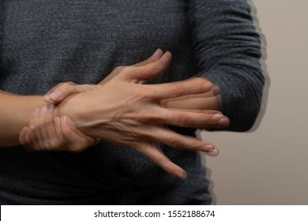
tremble (v.)
/ˈtrem.bəl/
สั่น, กระเทือน

Slide 5

vivid (adj.)
/ˈvɪv.ɪd/
เจิดจ้า, ที่ชัดเจน

Slide 6

get over (phrv.)
/ɡet ˈoʊ.vɚ/
หายดี, ฟื้นตัว

Slide 7

keep (sb.) company (phrase)
อยู่เป็นเพื่อน รอเป็นเพื่อน

Slide 8

independence (n.)
/ˌɪn.dɪˈpen.dəns/
ความเป็นอิสระ

Slide 9

socialize (v.)
/ˈsoʊ.ʃə.laɪz/
เข้าสังคม

Slide 10

fluent (adj.)
/ˈfluː.ənt/
พูดหรือเขียนได้อย่างคล่องแคล่ว

Slide 11
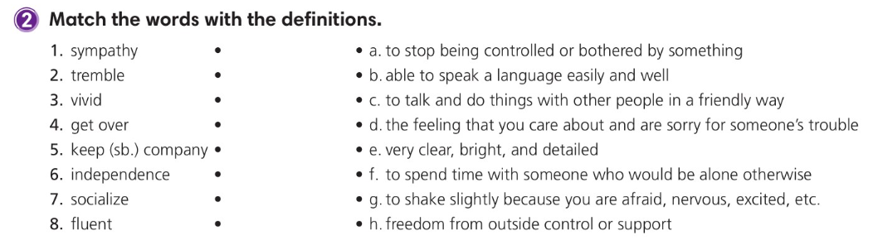

Slide 12
Who do you go to when you need sympathy? Why?

Slide 13
memory
wish
ปรารถนา
ความทรงจำ
regret
ความเสียใจ

Slide 14
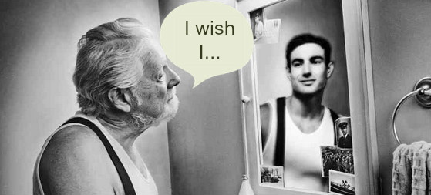

Slide 15
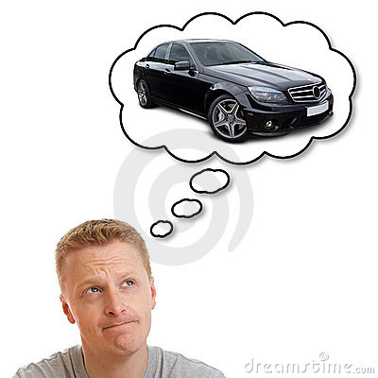
He wishes he had a car.

Slide 16
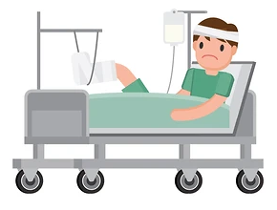
I drove very fast.
I wish I had not driven very fast.

Slide 17
I drove very fast.
I wish I had not driven very fast.
I wish I had a car.

Slide 18
If only = I wish
ถ้าเพียงแต่ …...
ฉันปรารถนา ..…. / ฉันอยากที่จะ …...

Slide 19
Wish
You can express how you’d like something to be different by using I wish… or… If only… Wishes about the present use the past tense.
Wishes about the past use the past perfect tense.
If only
=
I wish

Slide 20
Wish
Wish about the present
wish + past simple
She doesn’t have confidence.
She wishes she had confidence.
If only she had confidence.
Wish about the past
wish + past perfect
He didn’t join the club.
He wishes he had joined the club.
If only he had joined the club.

Slide 21
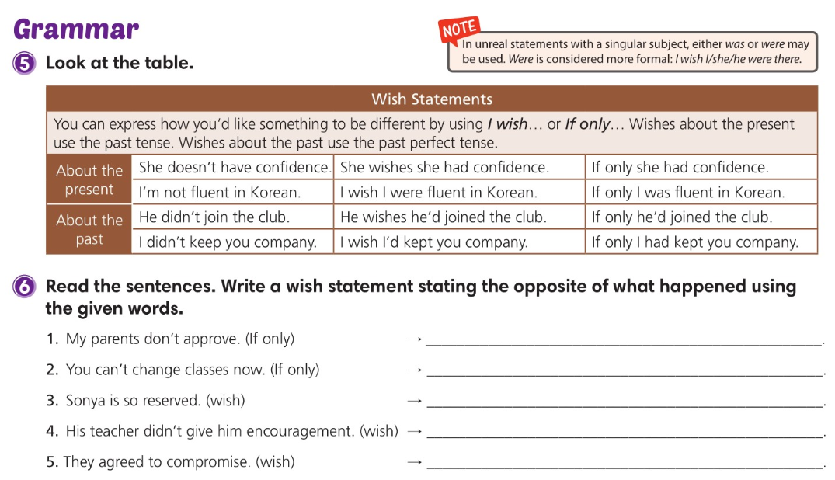
If only my parents approved
If only you could change classes now
I wish Sonya weren’t / wasn’t so reserved
I wish his teacher had given him encouragement
I wish they hadn’t agreed to compromise

Slide 22
Read the sentences. Write a wish statement stating the opposite of what happened using the given words.
My parents don’t approve. (If only)
If only ________________________________
my parents approved.

Slide 23
Read the sentences. Write a wish statement stating the opposite of what happened using the given words.
2. You can’t change classes now. (If only)
If only ____________________________
you could change classes now.

Slide 24
Read the sentences. Write a wish statement stating the opposite of what happened using the given words.
3. Sonya is so reserved. (wish)
I wish _______________________________
Sonya weren’t/wasn’t so reserved.

Slide 25
Read the sentences. Write a wish statement stating the opposite of what happened using the given words.
4. His teacher didn’t give him encouragement. (wish)
I wish __________________________________________
his teacher had given him encouragement.

Slide 26
Read the sentences. Write a wish statement stating the opposite of what happened using the given words.
5. They agreed to compromise. (wish)
I wish _____________________________
they hadn’t agreed to compromise.

Slide 27
Make four wish statements about yourself. Two wish statements should be about the present and two about the past.
Wishes about the present.
If only _____________________________________________________________
I wish ______________________________________________________________
I could remember the homework assignment.
I had more money to buy these shoes.
2. Wishes about the past.
If only ____________________________________________________________
I wish ______________________________________________________________
I had gone to summer camp last year.
I hadn’t lost my dog in the park last month.

Slide 28
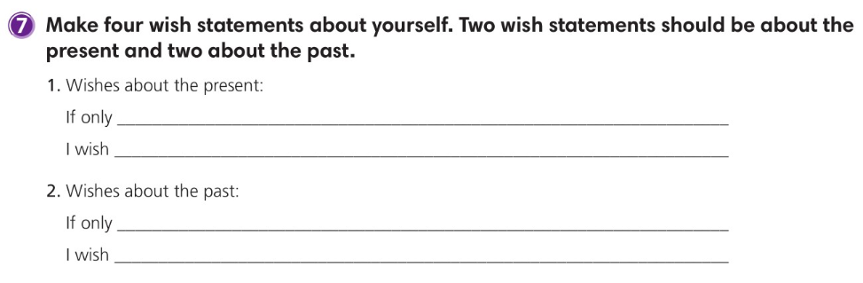
I could remember the homework assignment.
I had more money to buy these shoes.
I had gone to summer camp last year.
I hadn’t lost my dog in the park last month.

Slide 29
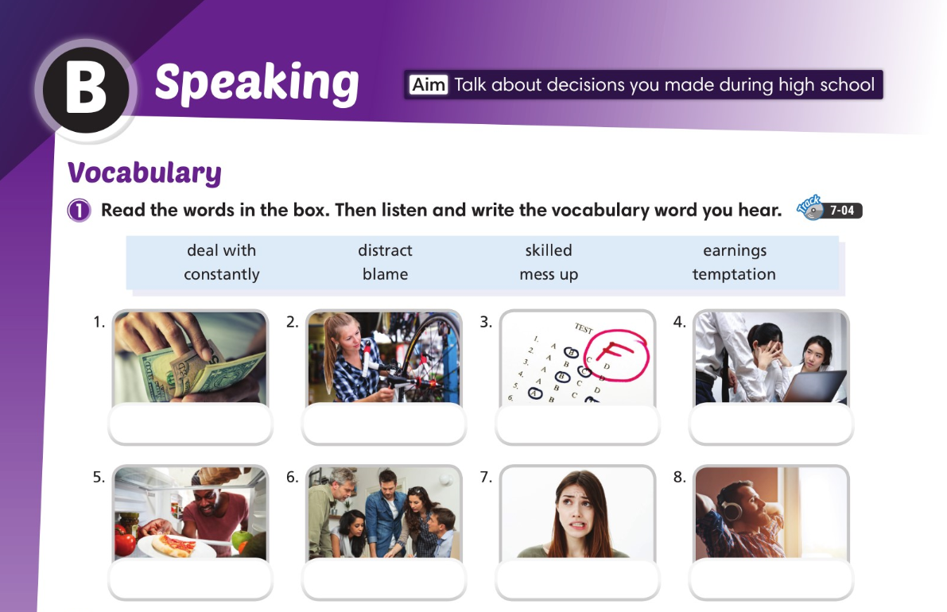
earnings
skilled
mess up
blame
temptation
deal with
constantly
distract

Slide 30
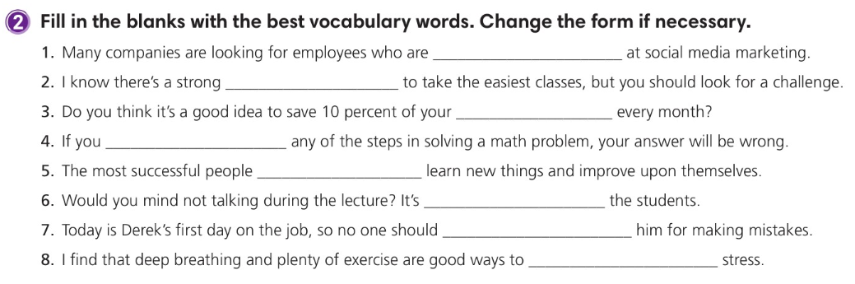
skilled
temptation
earnings
mess up
constantly
distracting
blame
deal with

Slide 31
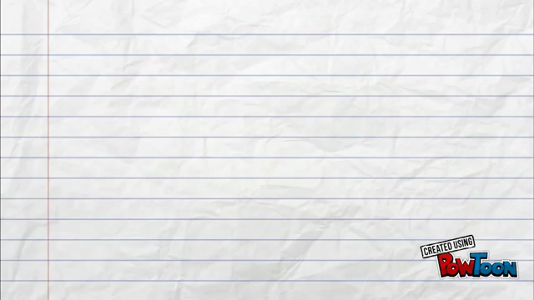

Slide 32
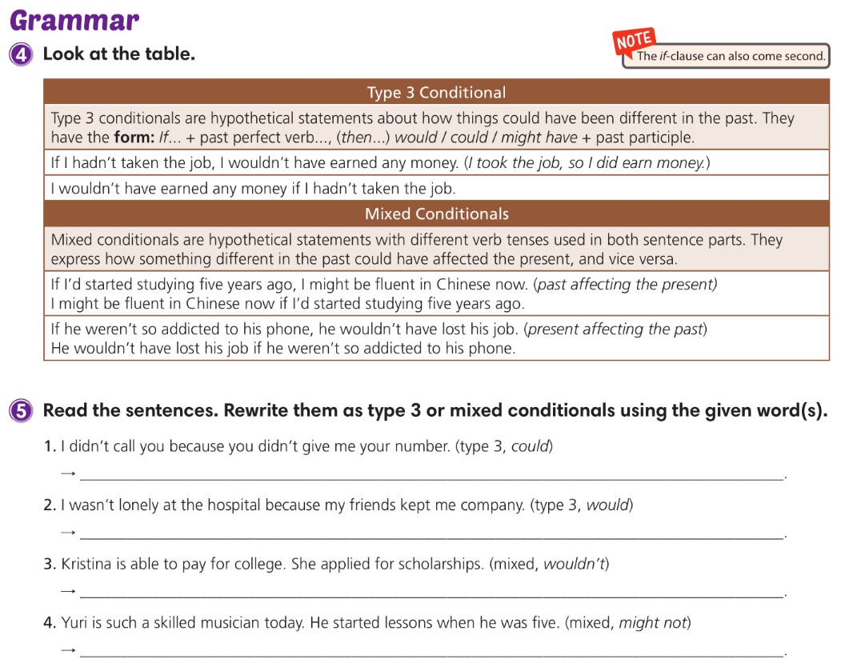
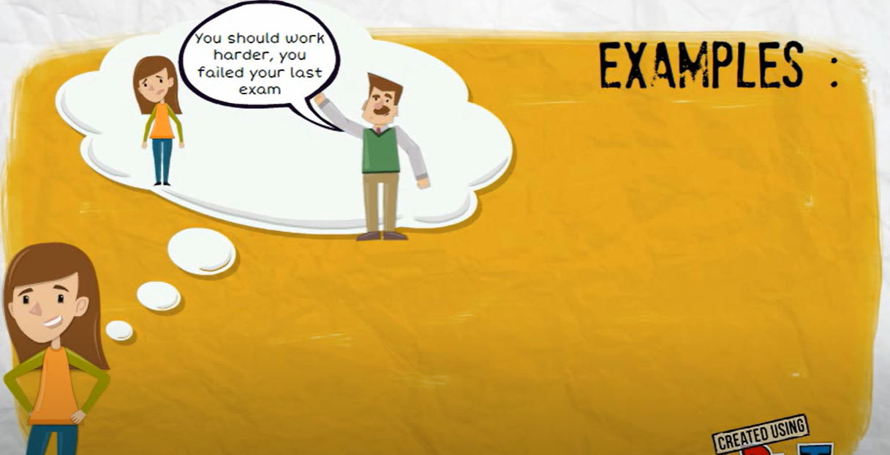
If + past perfect , would have + past participle
If you had worked harder, you wouldn’t have failed the exam.

Slide 33


Slide 34
1) past affecting the present
If + past perfect , present conditional
If I’d started studying five years ago, I might be fluent in Chinese now.
Fact: I didn’t study Chinese and now I am not fluent. (I can’t speak Chinese now.)
2) present affecting the past
If + simple past, perfect conditional
If he weren’t so addicted to his phone, he wouldn’t have lost his job.
Fact: He is addicted to his phone and he lost his job.

Slide 35
I could have called you if you’d given me your number.
If my friends hadn’t kept me company, I would have been lonely at the hospital.
If she hadn’t applied for scholarships, Kristina wouldn’t be able to pay for college.
If he hadn’t started lessons when he was five, Yuri might not be such a skilled musician today.

Slide 36
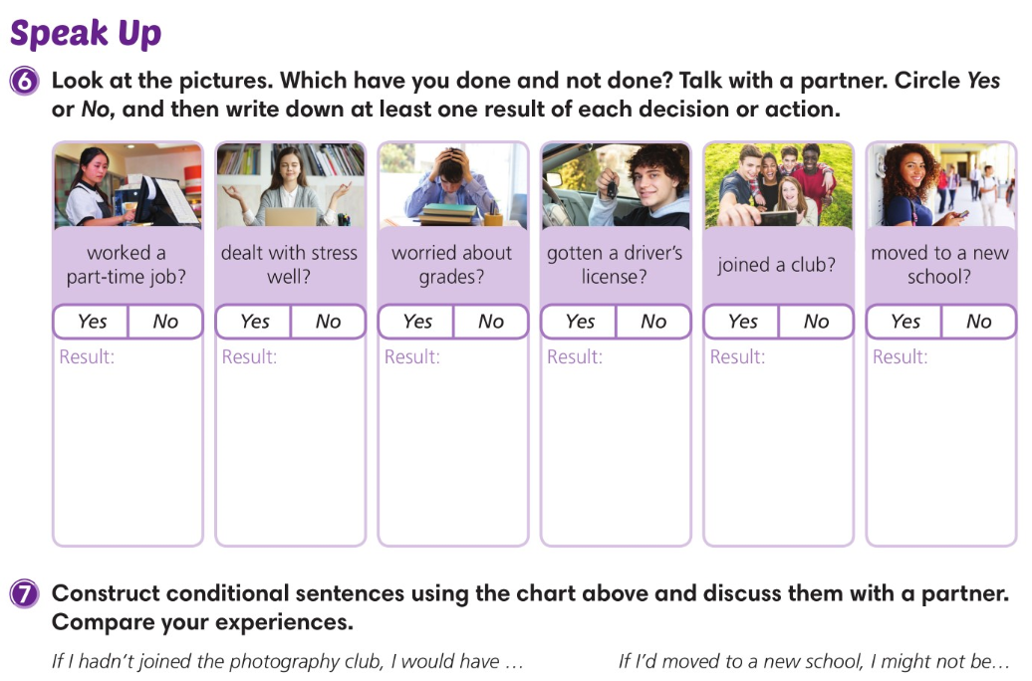

Slide 37
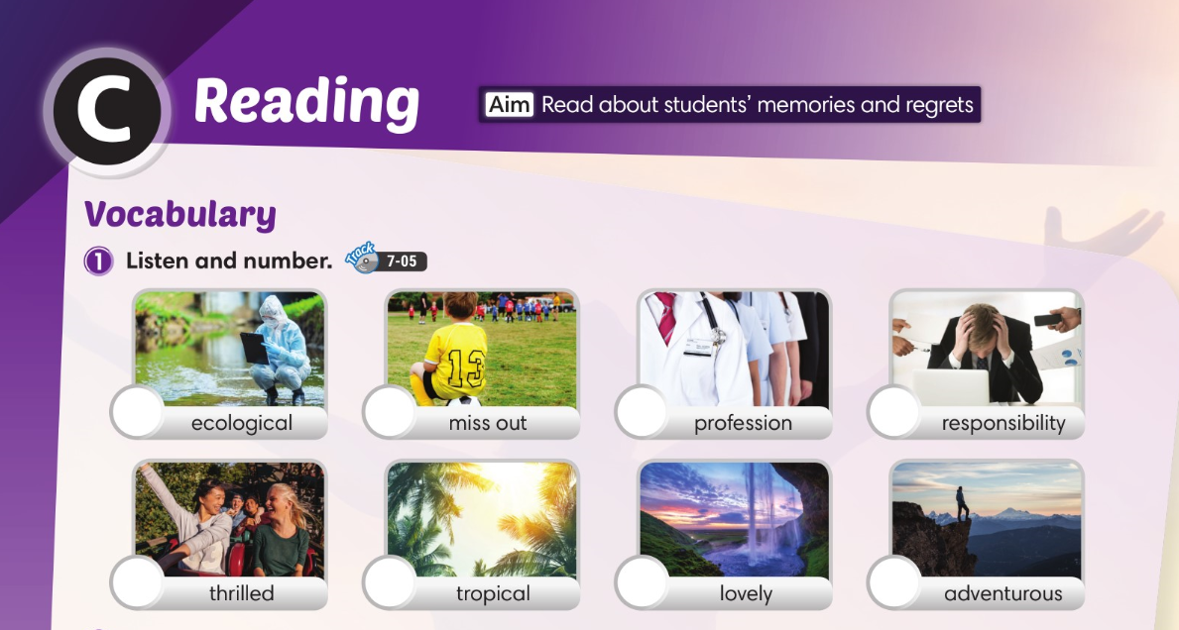
7
6
3
4
8
2
1
5

Slide 38
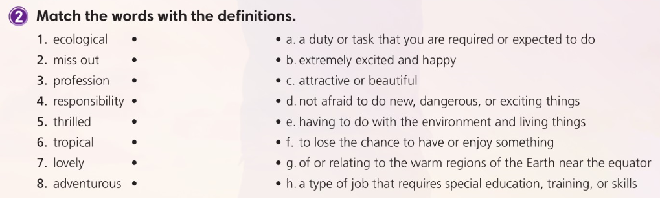

Slide 39

Summer vacation activities

Slide 40
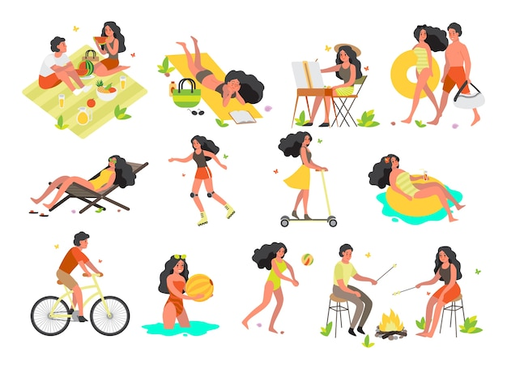
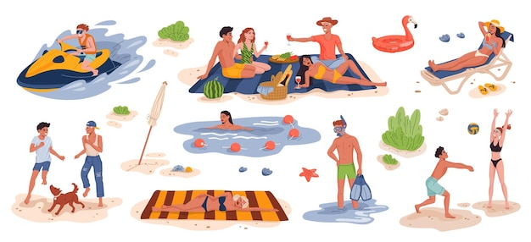

Summer vacation activities

Slide 41
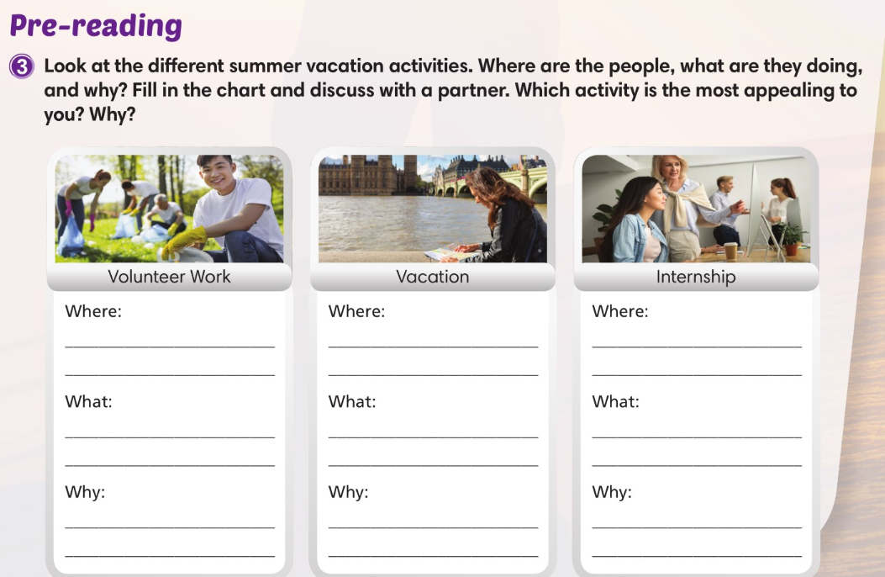

Slide 42
Summer vacation activities

Slide 43
picture
name activity
Where
____________________________________________________________________________
What
____________________________________________________________________________
Why
____________________________________________________________________________

Slide 44
picture
name activity
Where
__________________________________________________________________________________
What
__________________________________________________________________________________
Why
__________________________________________________________________________________

Slide 45
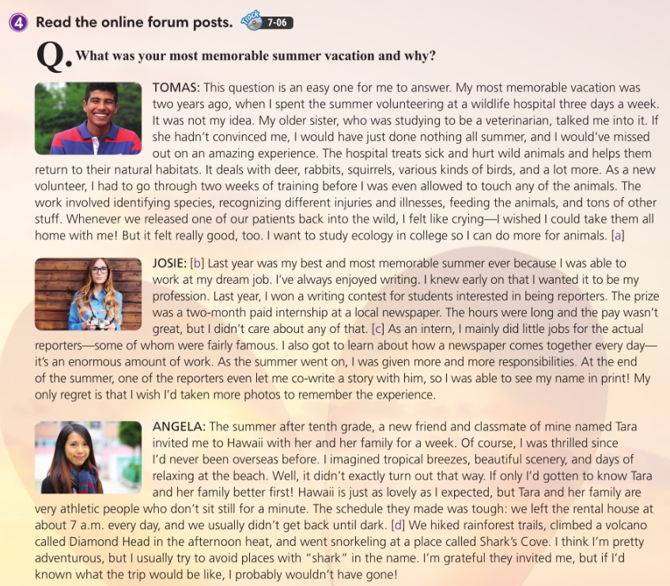

Slide 46
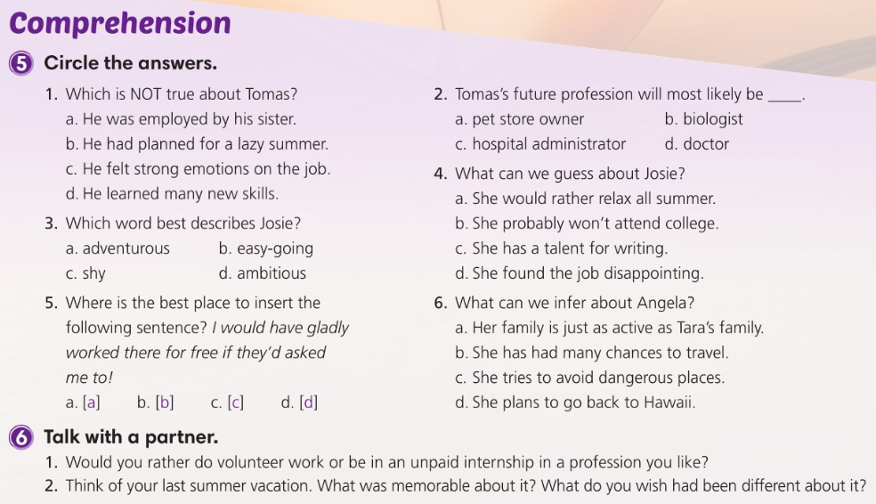

Slide 47
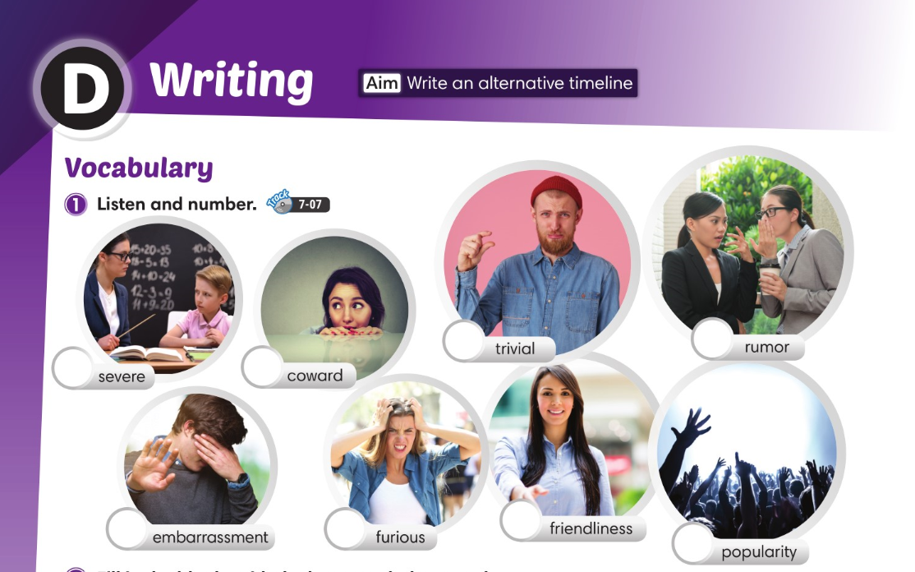
7
5
6
8
3
2
1
4

Slide 48
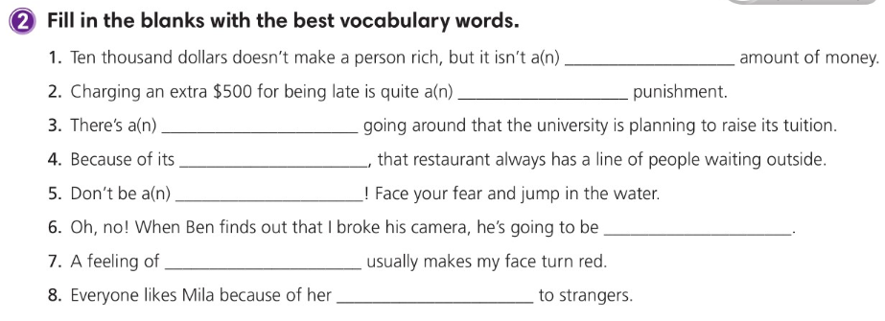
trivial
severe
rumor
popularity
coward
furious
embarrassment
friendliness

Slide 49
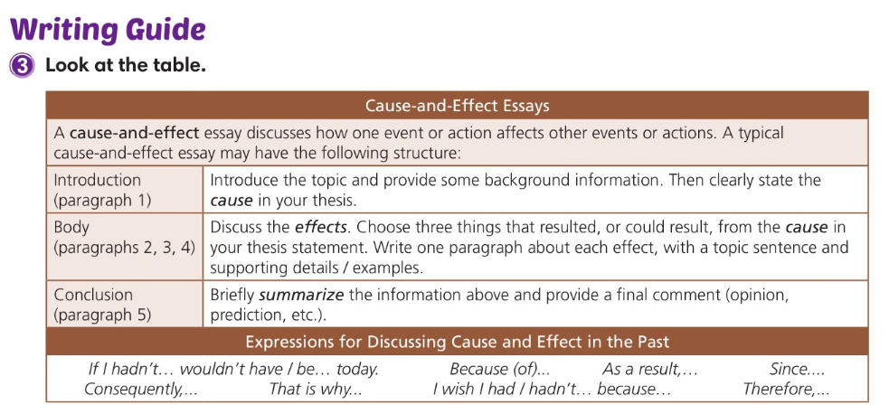

Slide 50
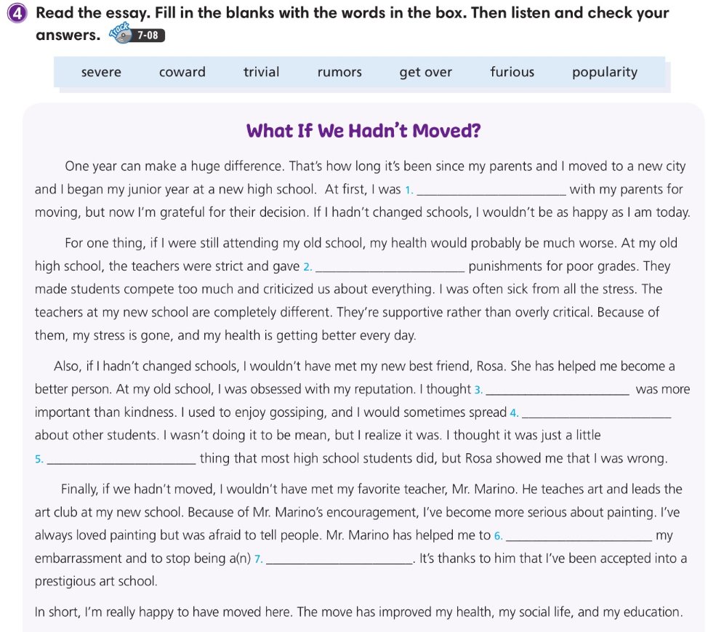
furious
severe
popularity
rumors
trivial
get over
coward

Slide 51
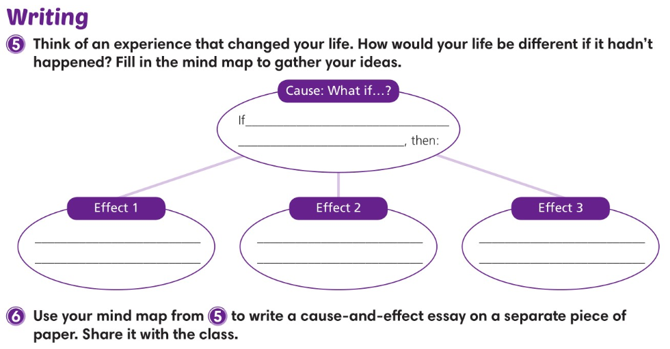

Slide 52
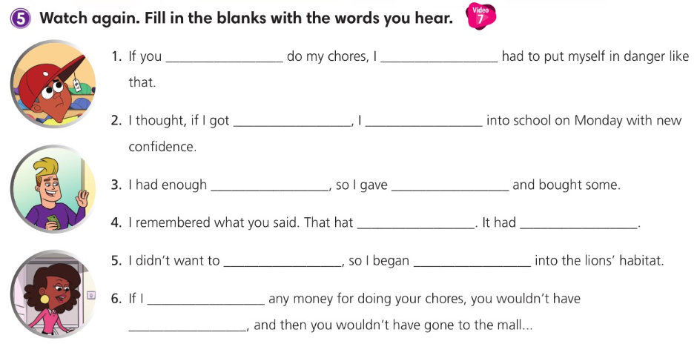
hadn't made me
wouldn't have
a new haircut
could walk
money left over
into temptation
was my
responsibility
cost me $7
be a coward
to climb down
hadn't given you
gotten a haircut

Slide 53
TENSE TABLE
 | SIMPLE | CONTINUOUS | PERFECT | PERFECT CONTINUOUS
PRESENT
PAST
FUTURE

