Slide 1
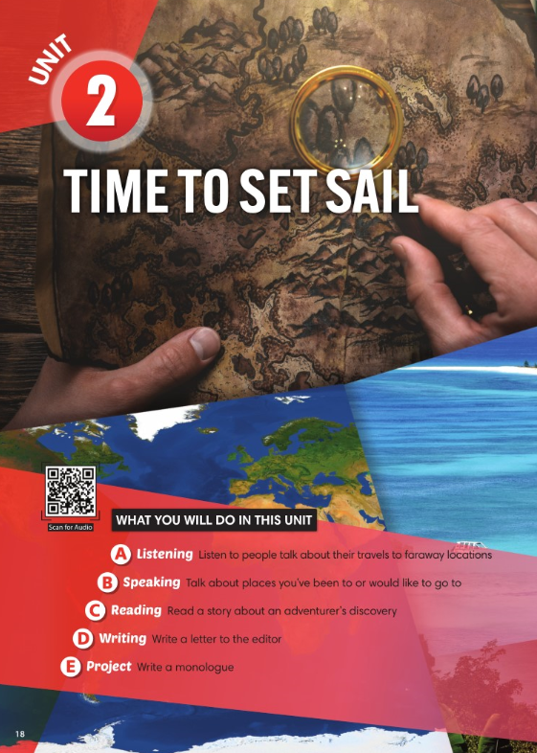
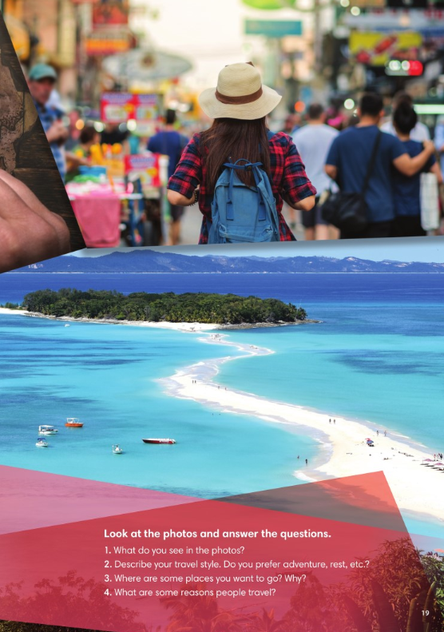

Slide 2
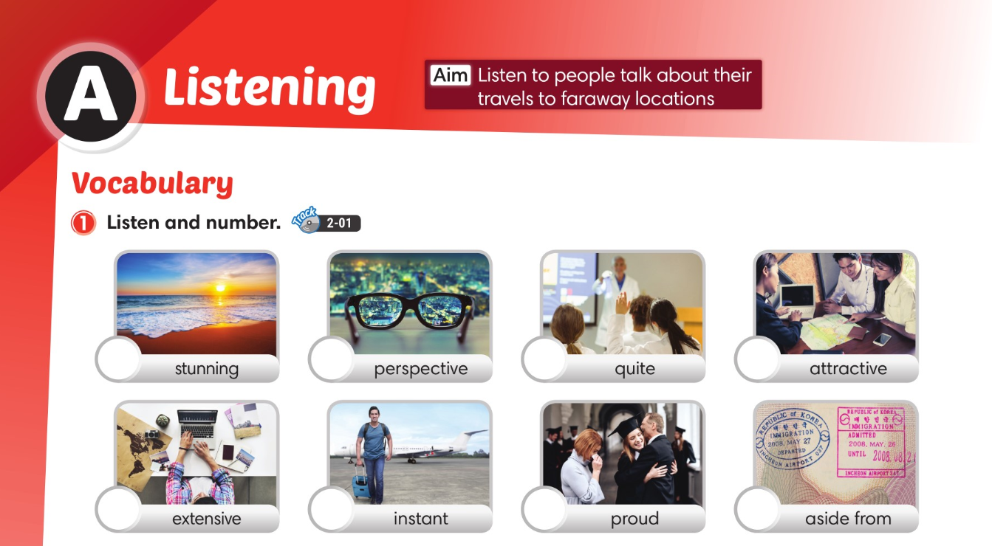

6
3
2
4
7
8
1
5

Slide 3
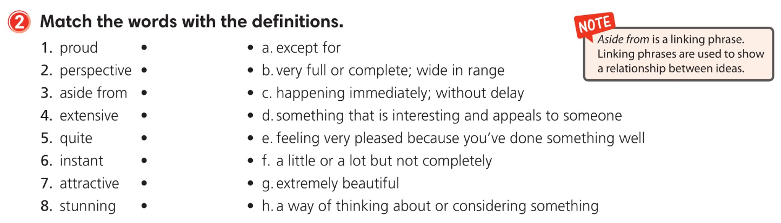

Slide 4
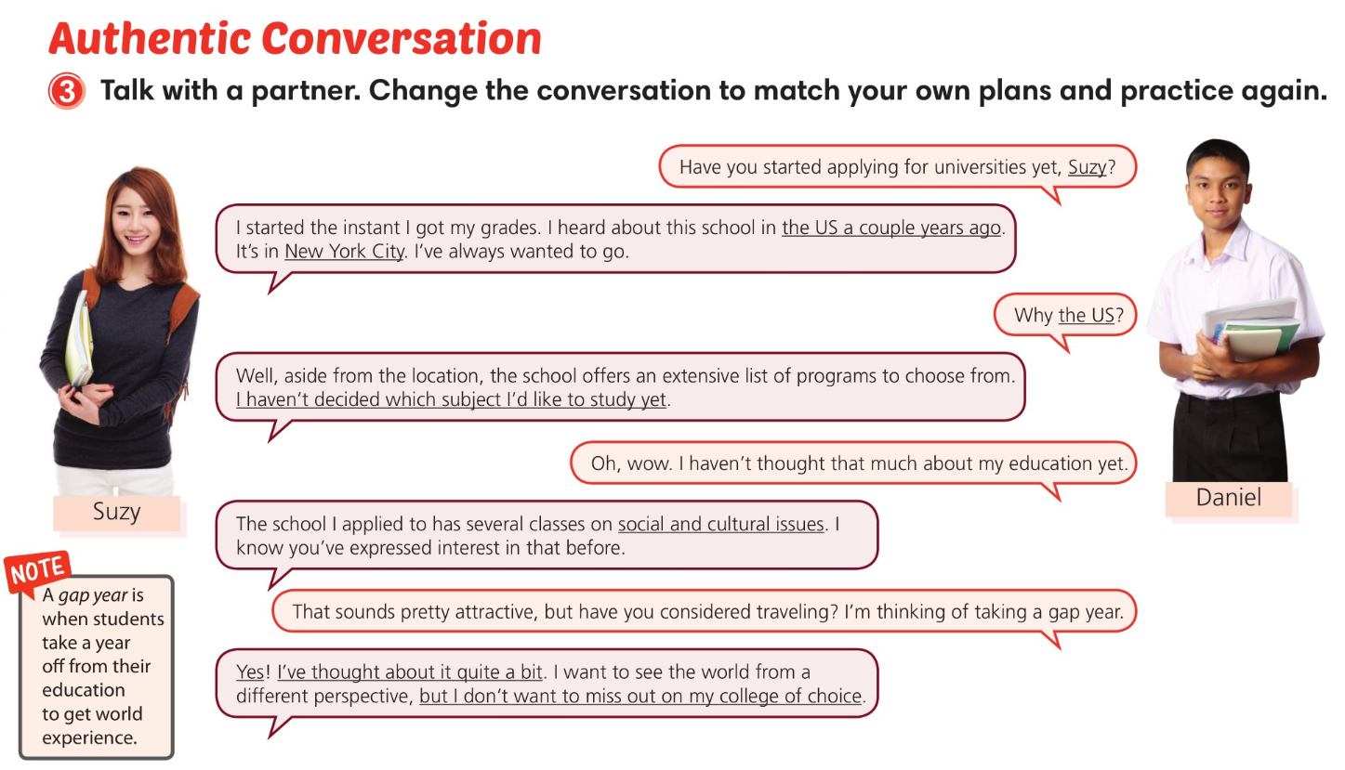

Slide 5
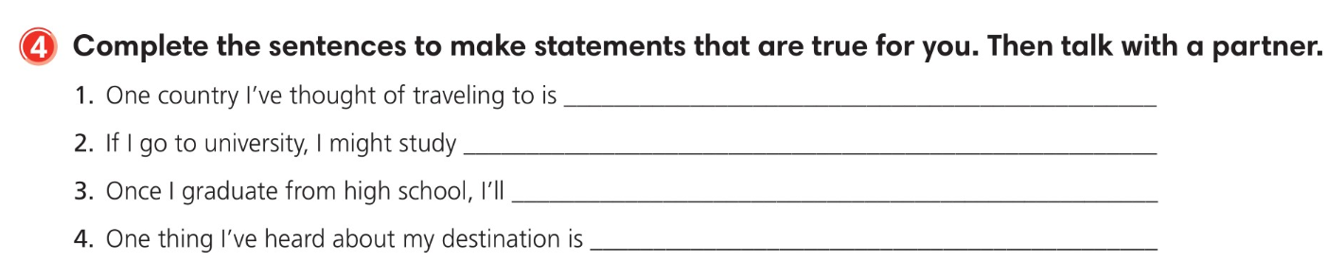
Jamaica.
physics.
travel.
that locals are friendly.

Slide 6
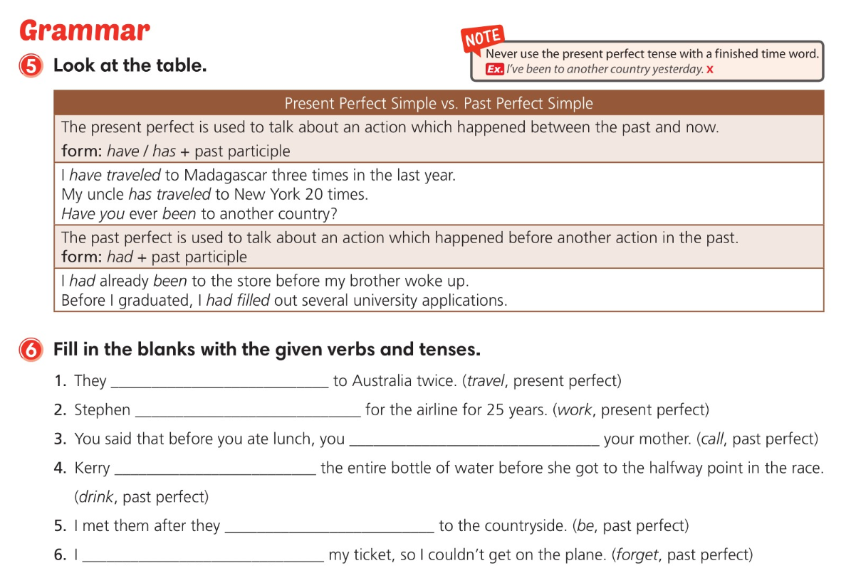
have traveled
has worked
had called
had drunk
had been
had forgotten

Slide 7
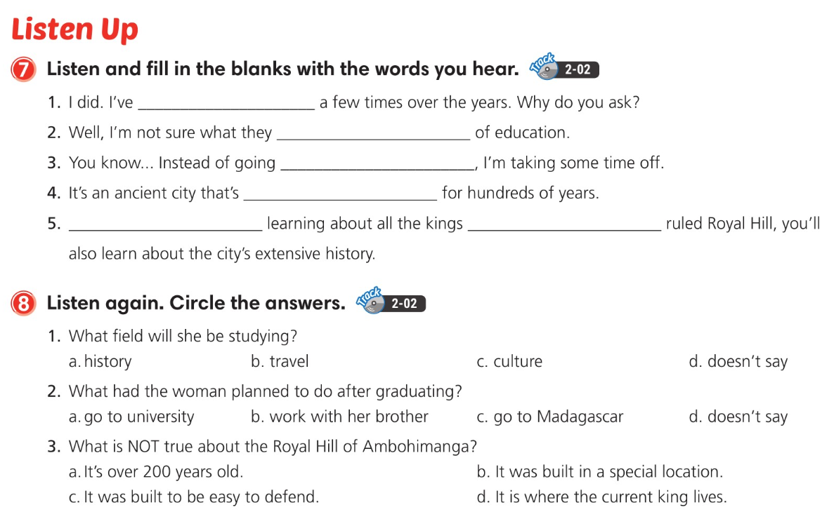
been there
offer in terms
straight to university
been preserved
Aside from
who’ve

Slide 8
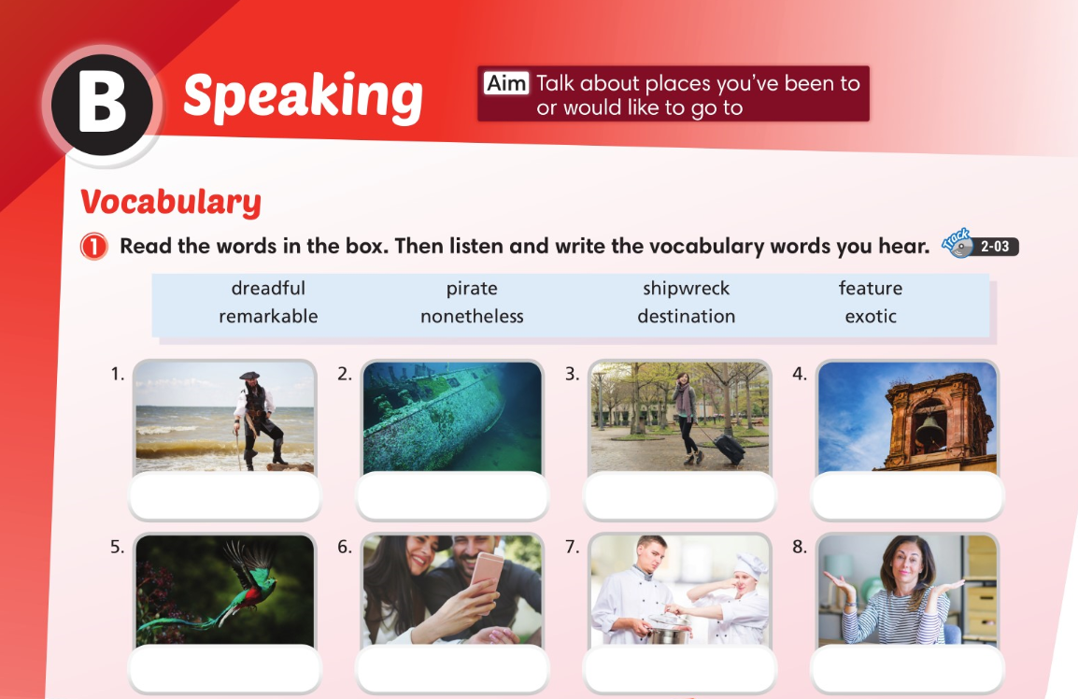

pirate
shipwreck
destination
feature
exotic
remarkable
dreadful
nonetheless

Slide 9
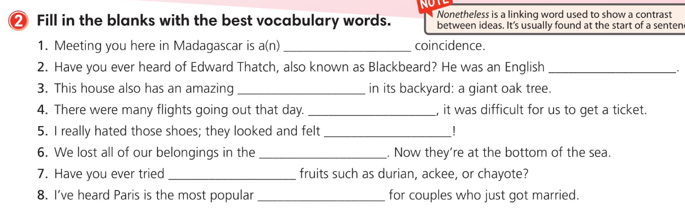
remarkable
pirate
feature
Nonetheless
dreadful
shipwreck
exotic
destination

Slide 10
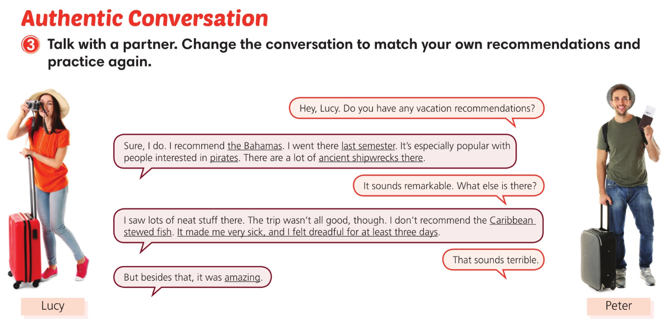

Slide 11
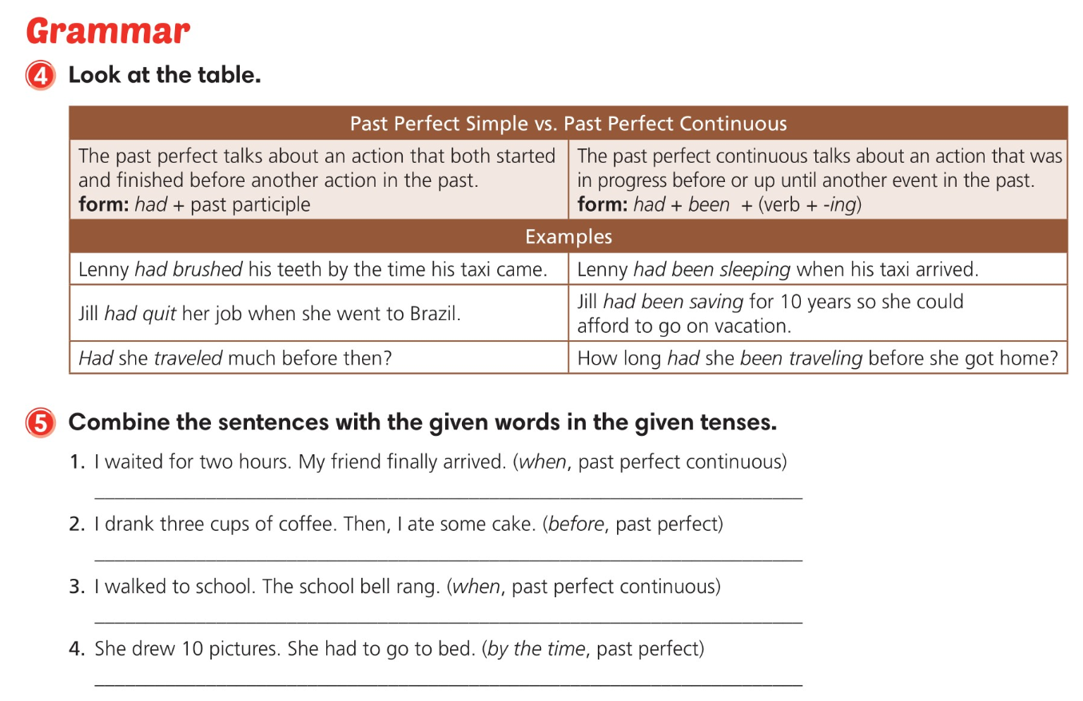
I had been waiting for two hours when my friend finally arrived.
I had drunk three cups of coffee before I ate some cake.
I had been walking to school when the school bell rang.
She’d drawn 10 pictures by the time she had to go to bed.

Slide 12
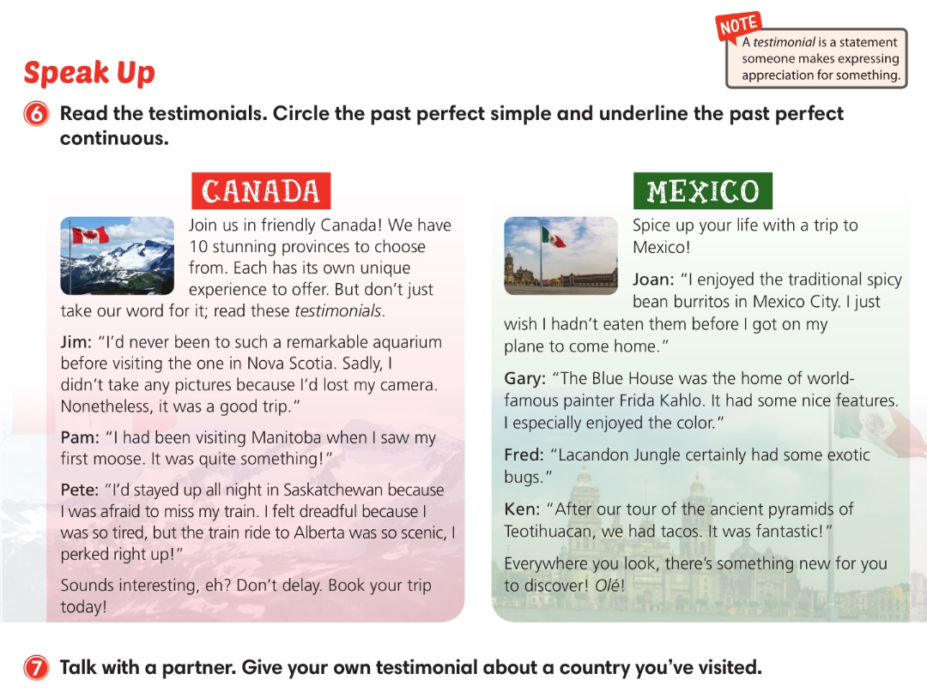

Slide 13
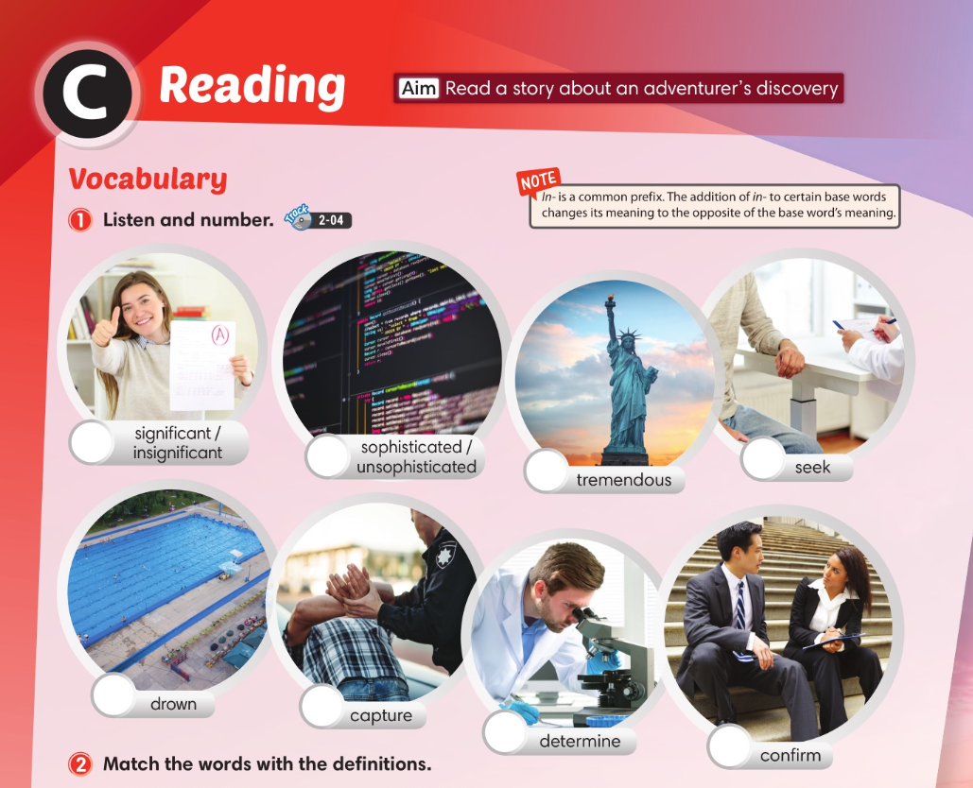
6
8
5
2
1
7
3
4

Slide 14
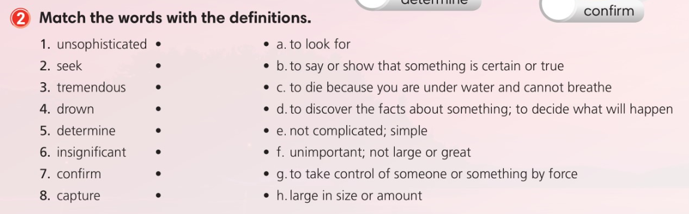

Slide 15
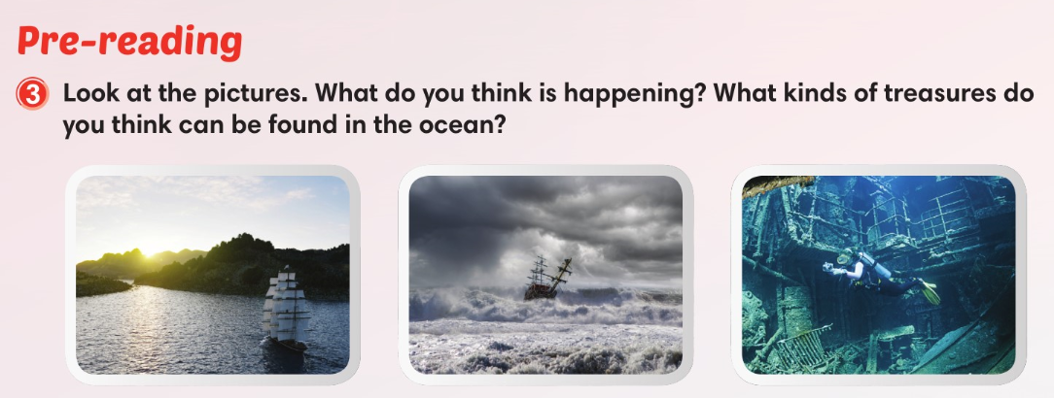

Slide 16
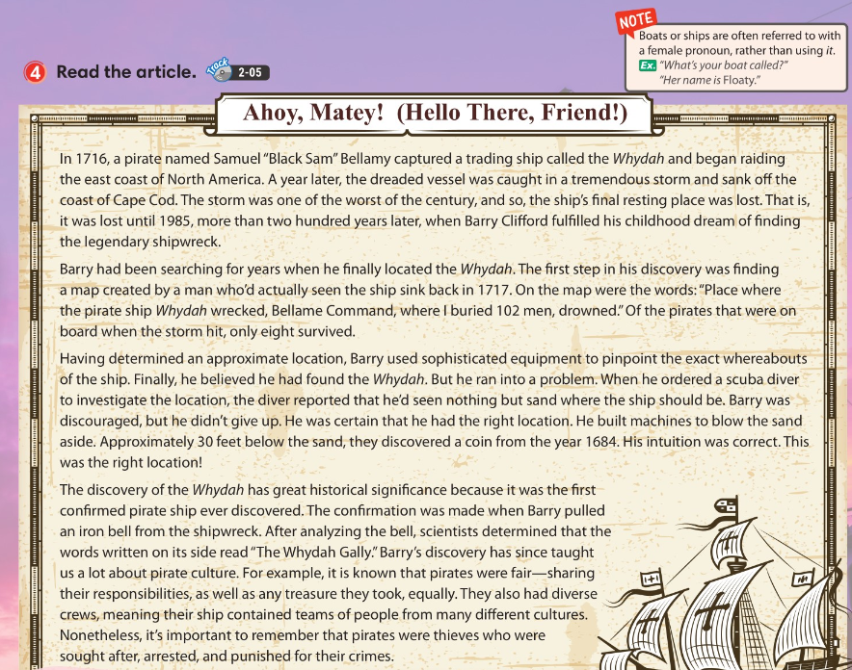

Slide 17
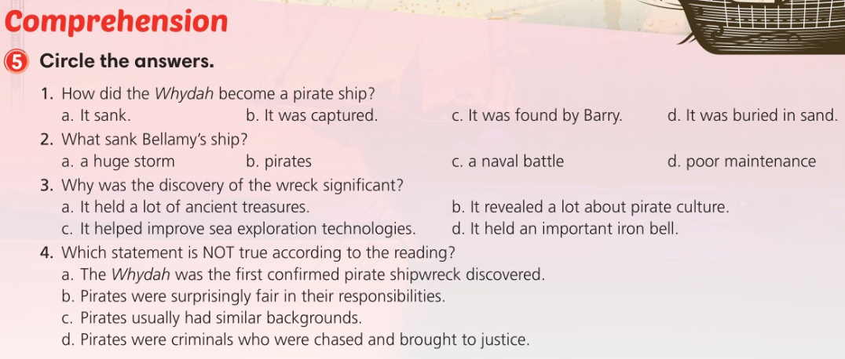

Slide 18
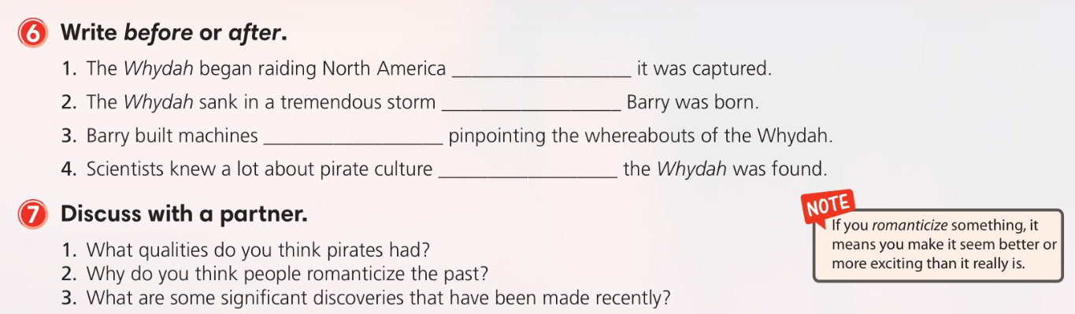
after
before
after
after

Slide 19
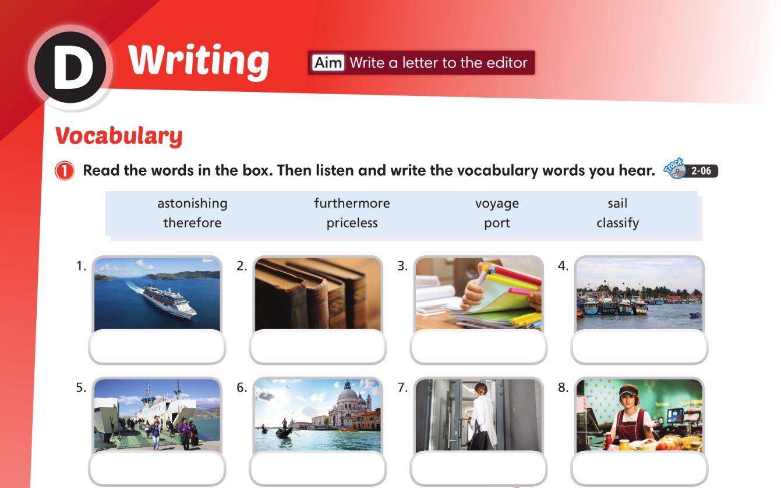
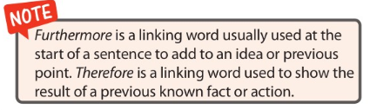
sail
priceless
classify
port
voyage
astonishing
furthermore
therefore

Slide 20
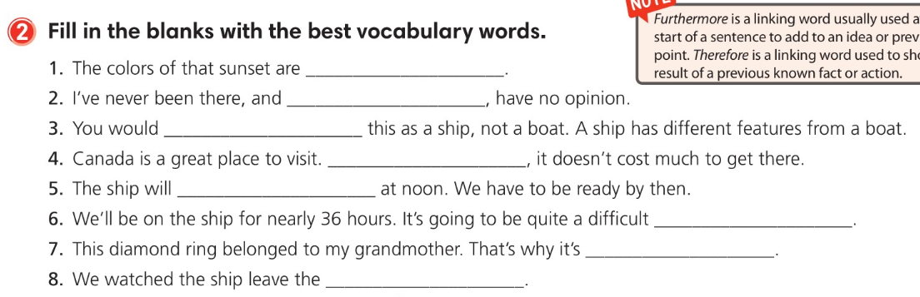
astonishing
therefore
classify
Furthermore
sail
voyage
priceless
port

Slide 21
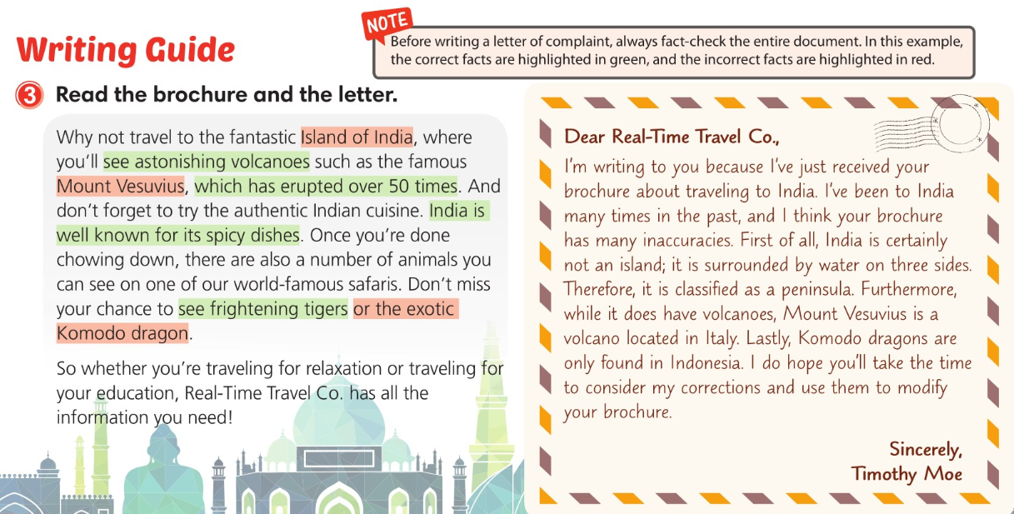

Slide 22
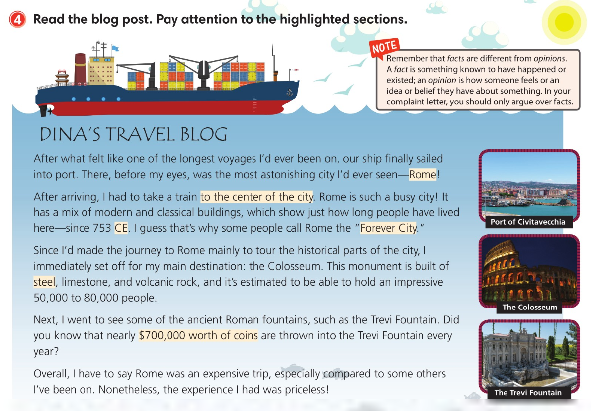

Slide 23
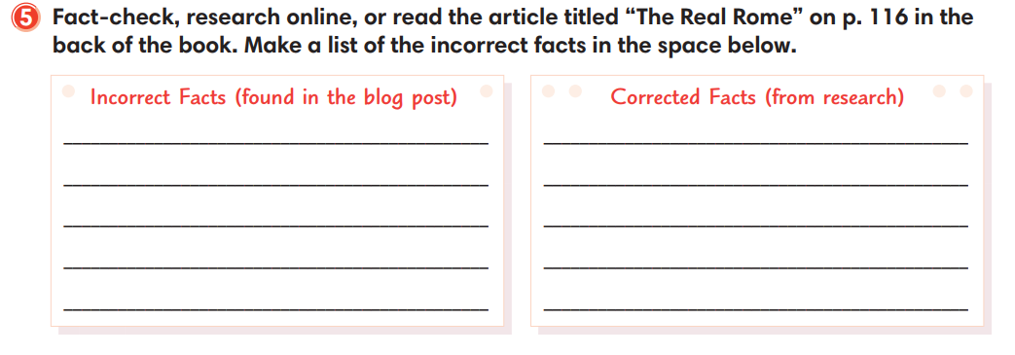
You can get to Rome by boat.
You have to take a train to get to Rome.
Rome was founded in 753 CE.
Rome was founded around 753 BC, but is even older than that.
It’s sometimes called the “Forever City.”
It is called the “Eternal City.
The Coliseum is built of steel, limestone, and volcanic rock.
It is built of limestone, volcanic rock, and concrete.
Nearly $700,000 worth of coin are thrown in the Trevi every year.
Nearly 700,000 Euros are thrown in it.

Slide 24
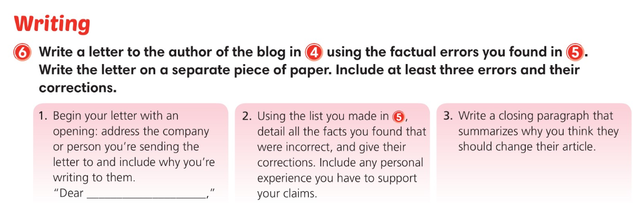

Slide 25
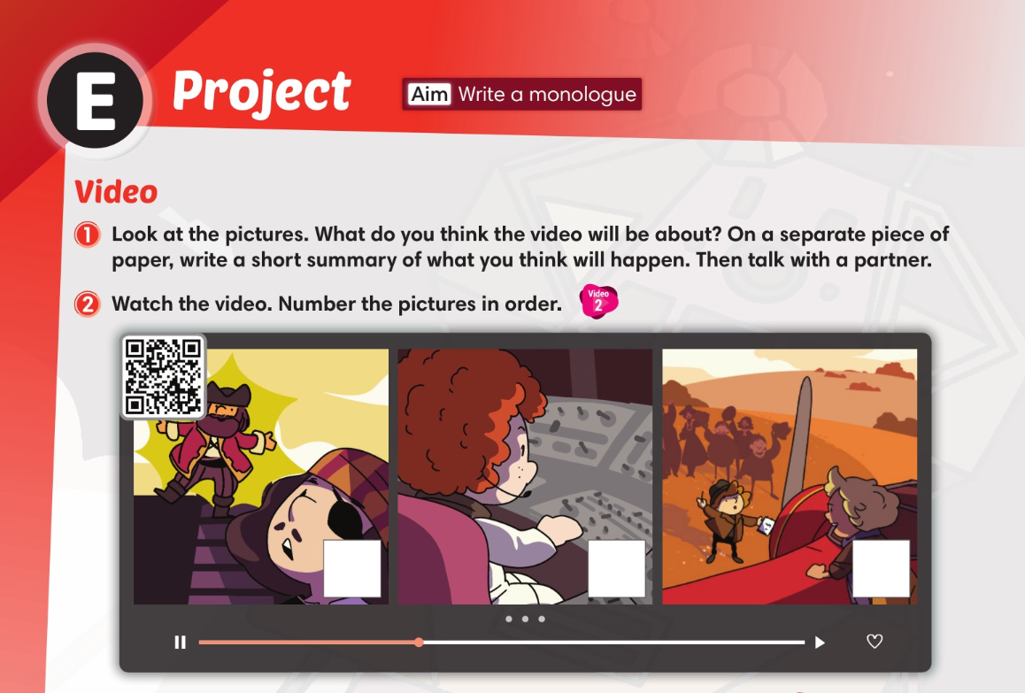
1
3
2

Slide 26
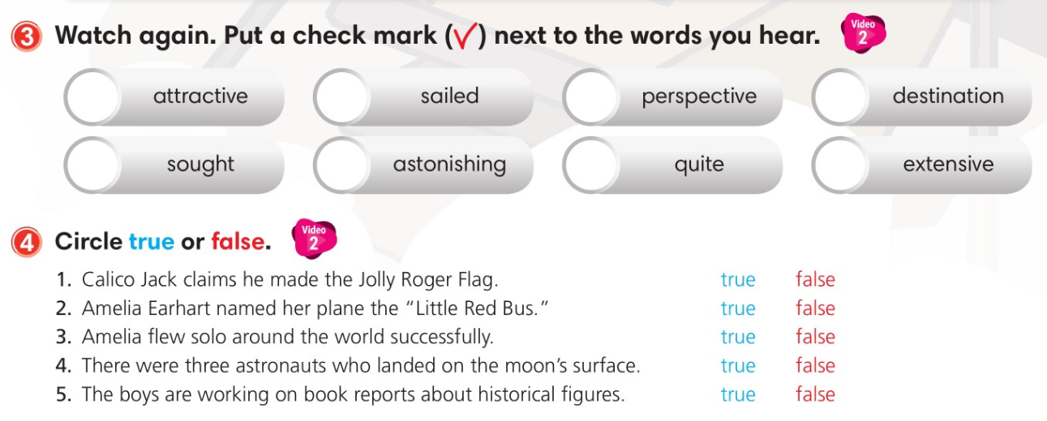


Slide 27
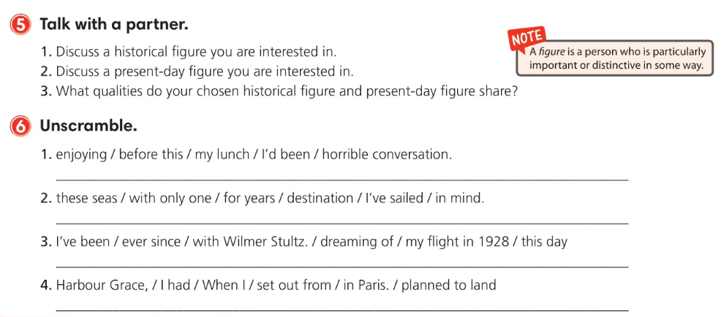
I’d been enjoying my lunch before this horrible conversation.
I’ve sailed these seas for years with only one destination in mind.
I’ve been dreaming of this day ever since my flight in 1928 with Wilmer Stultz.
When I set out from Harbour Grace, I had planned to land in Paris.

Slide 28
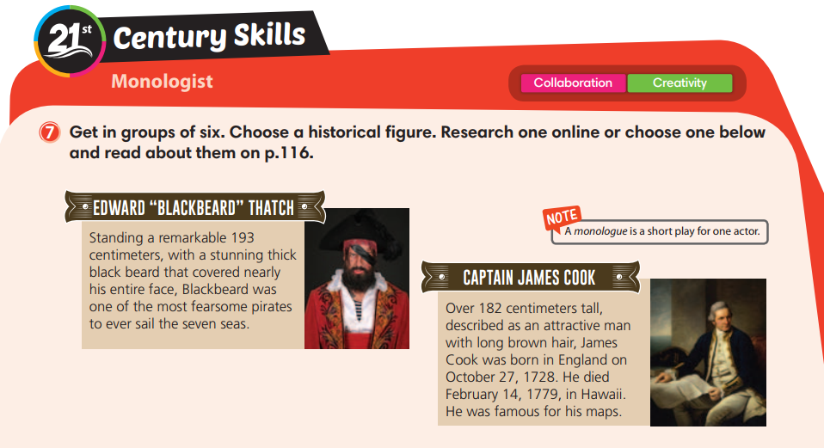

Slide 29
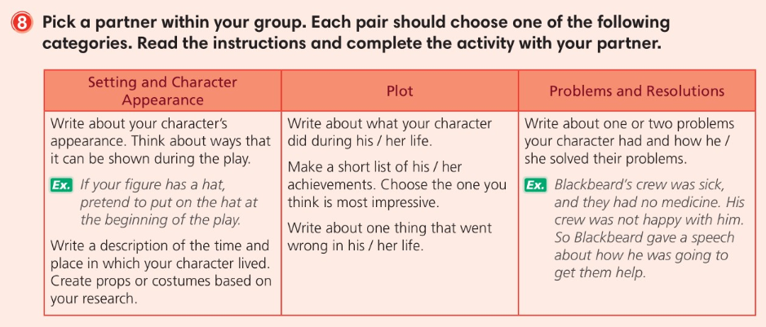

Slide 30
