Slide 1
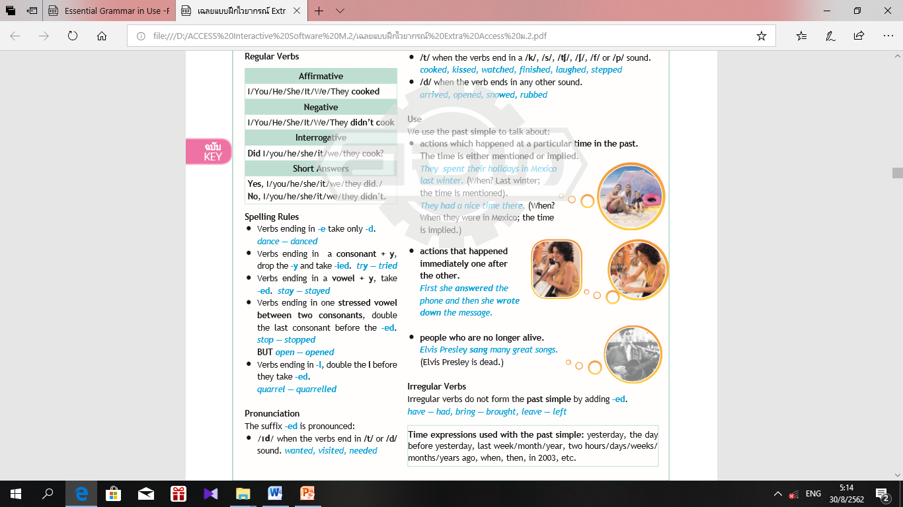
I was playing tennis at 5 o’clock yesterday afternoon.
But
I played tennis yesterday afternoon.
Past simple Tense & Past Continuous Tense

Slide 2
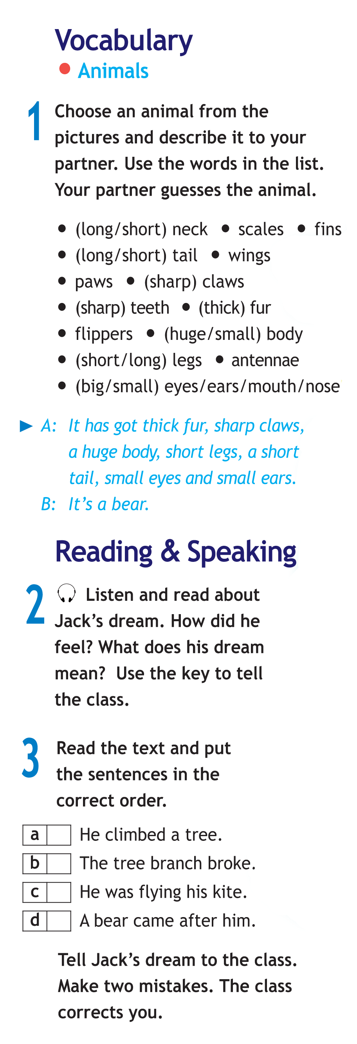




In my dream it was a warm autumn
afternoon. I was having a picnic in the
forest with my family. My parents
were relaxing while I was flying my
kite. Suddenly, a big bear appeared
from behind a tree. It was looking
for food. It saw me and came after
me. I quickly climbed a tree but then
I heard a loud cracking noise. I was
falling out of the tree and the bear was
waiting for me below. I started screaming
and ... I woke up.
Jack

Slide 3

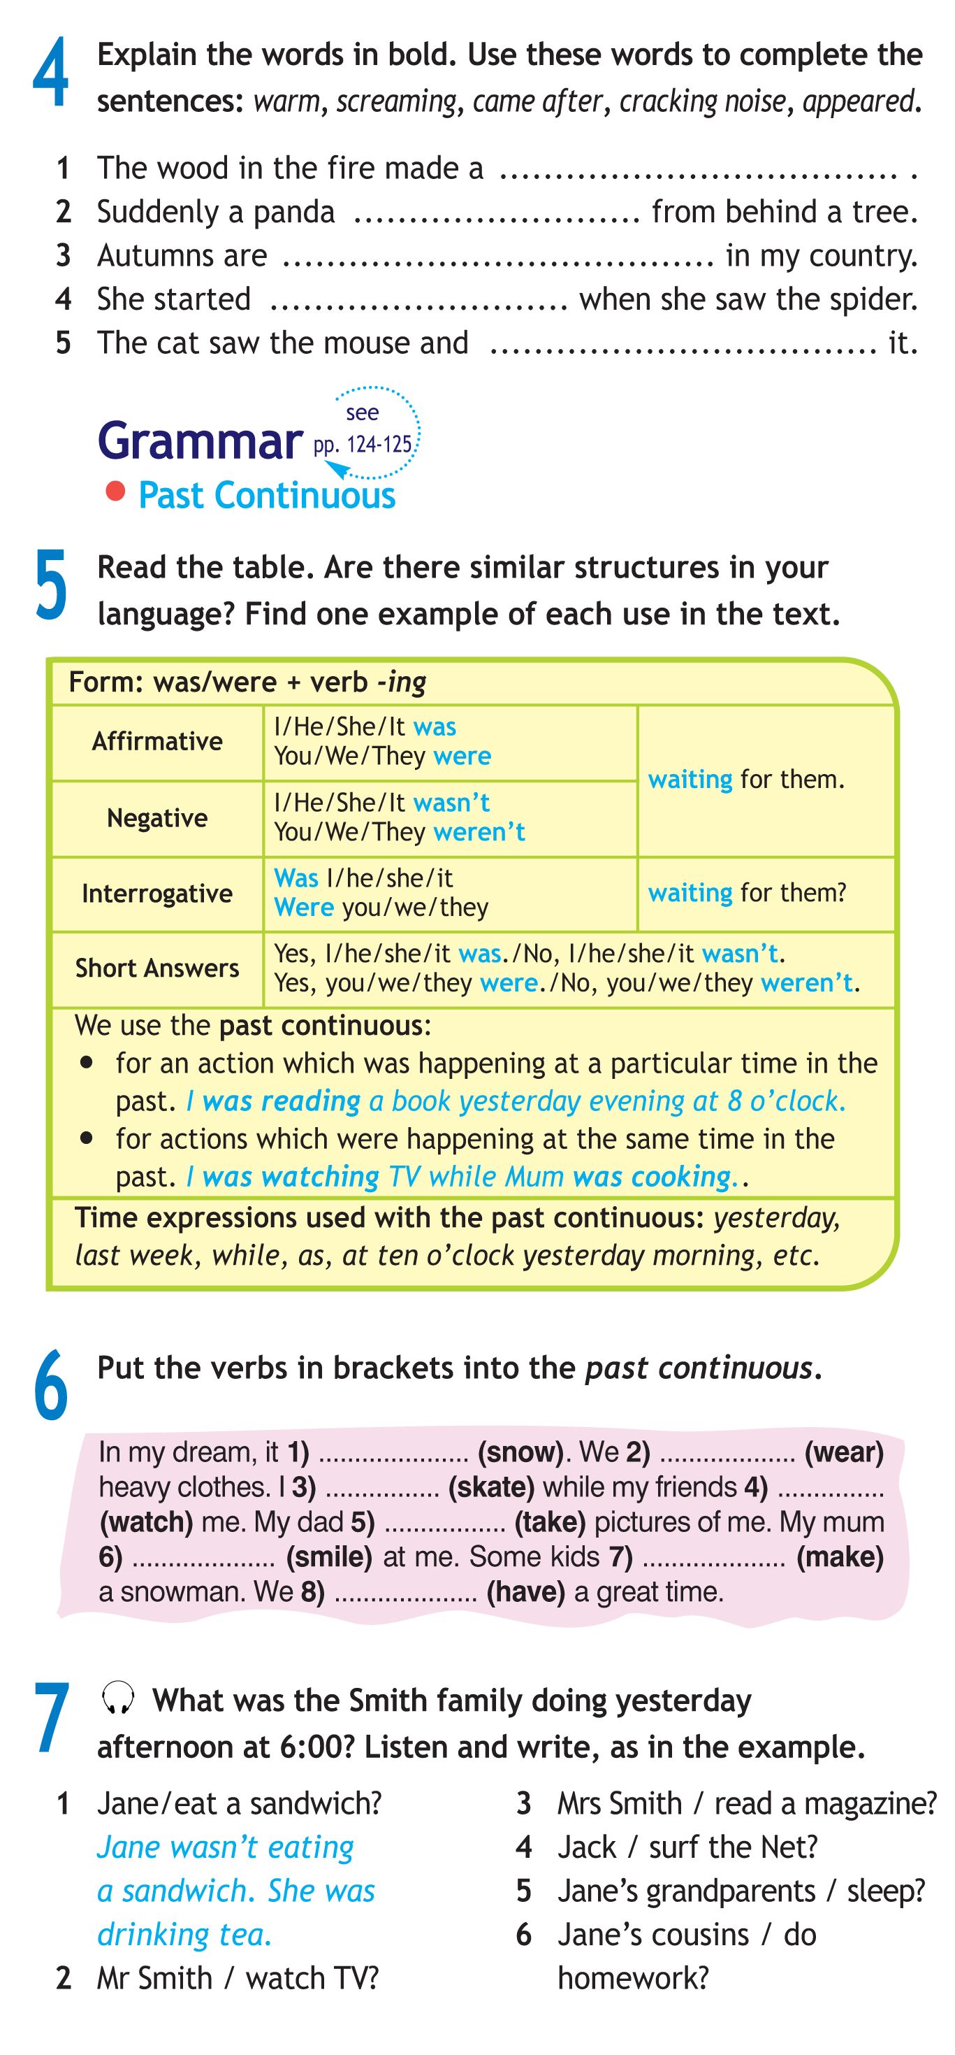

Slide 4





Slide 5

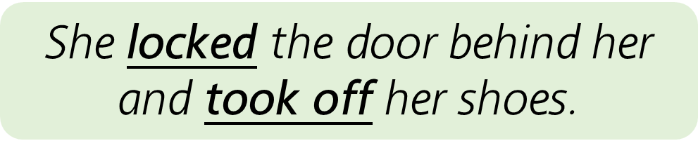

Slide 7

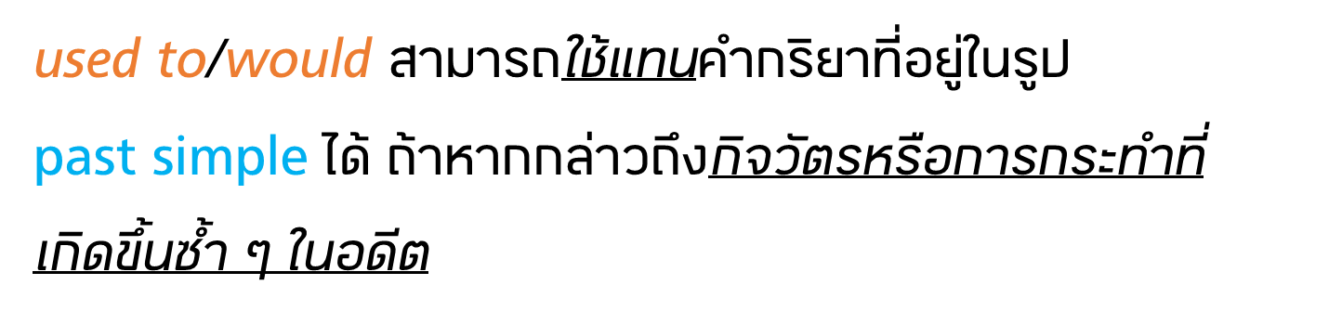

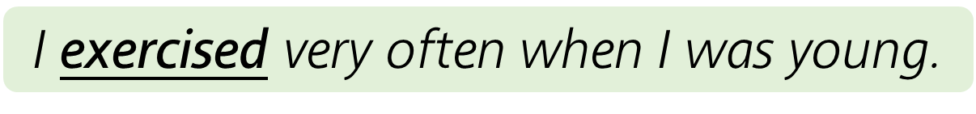


Slide 8


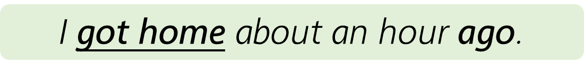

Slide 9
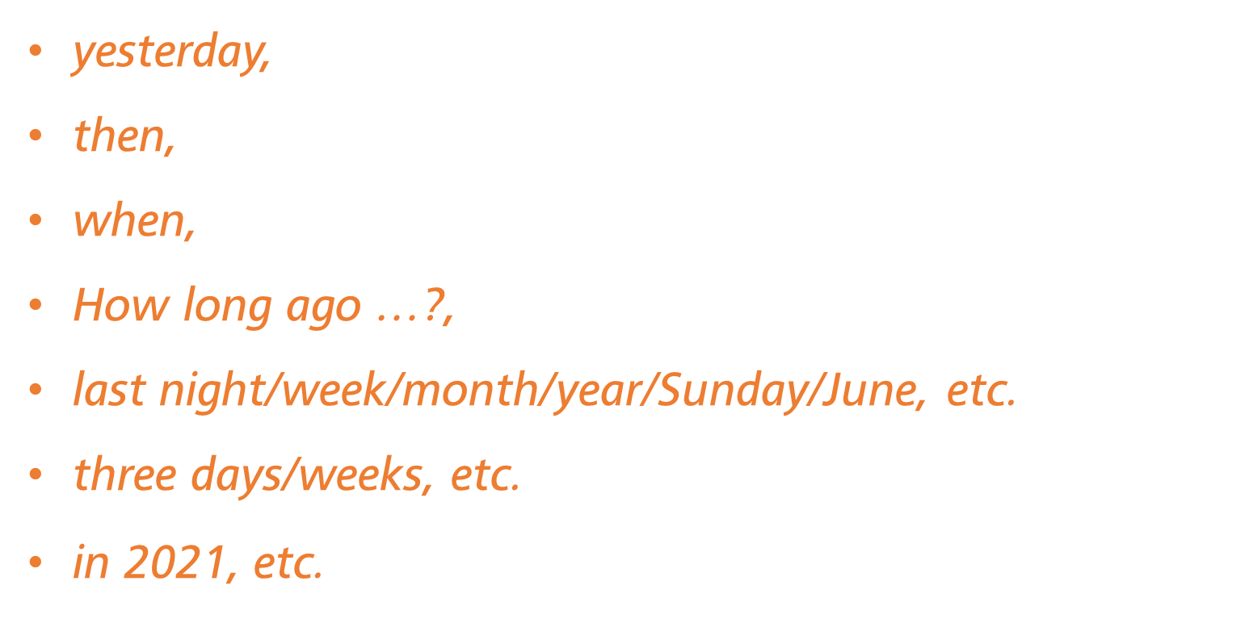

Slide 10




Slide 11

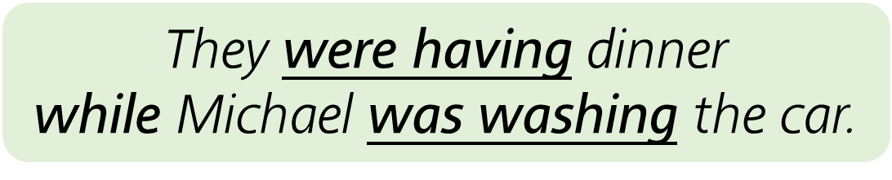

Slide 12
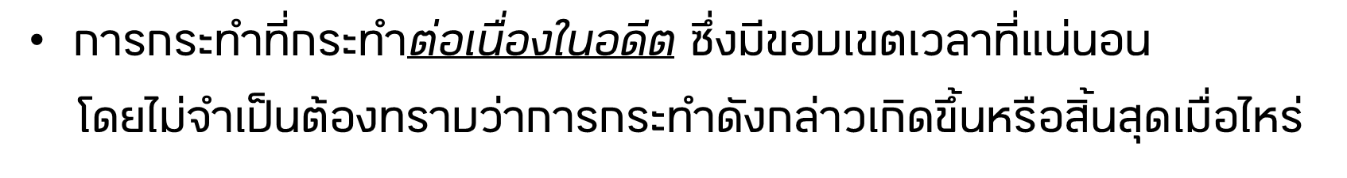

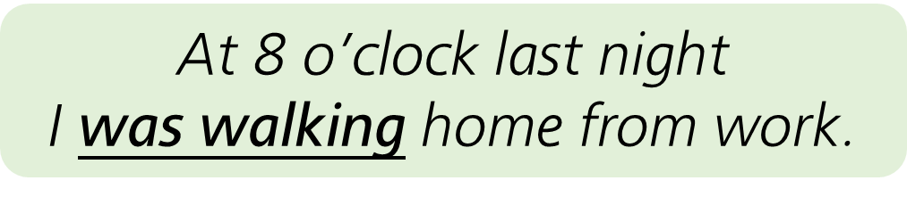

Slide 13
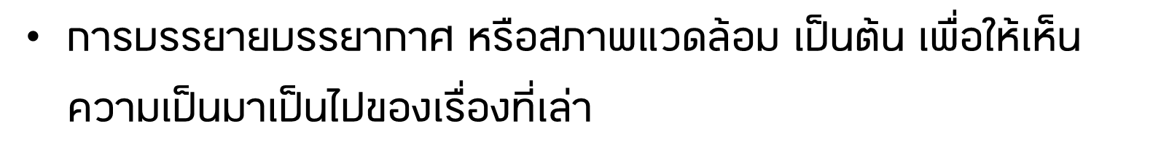
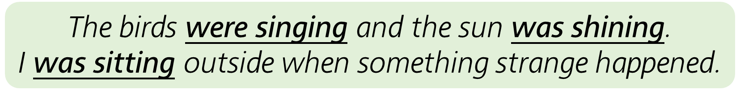

Slide 14

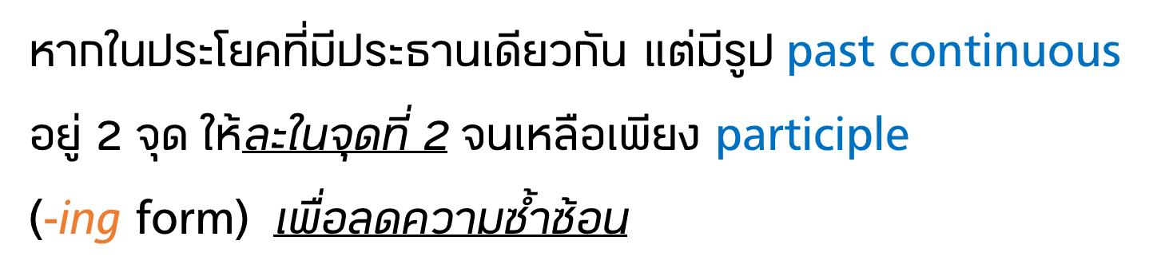


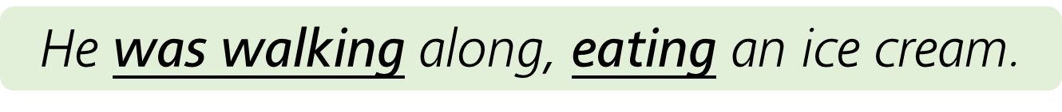

Slide 15
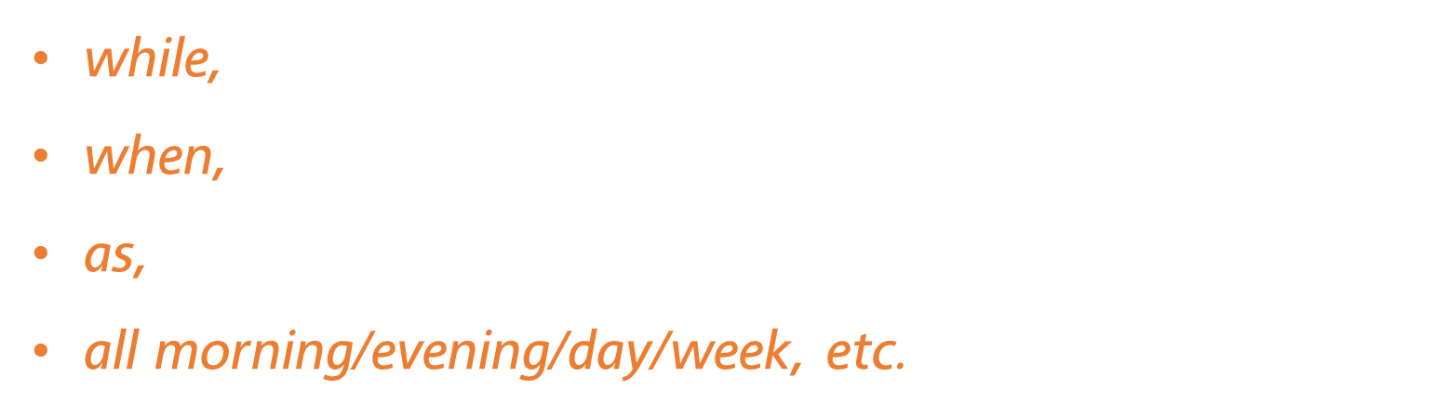

Slide 16
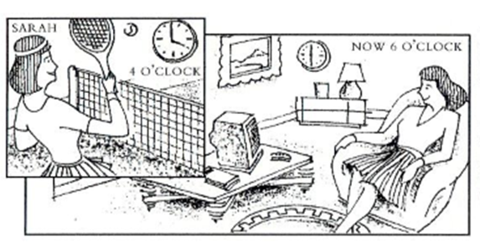
At 4 o’clock she wasn’t at home.
She was at the sports club.
It is 6 o’clock. Sarah is at home.
She is watching television.
เล่าเรื่องที่เกิดขึ้น

Slide 17
She was playing tennis.
She wasn’t watching television.
At 4 o’clock in the afternoon.

Slide 18
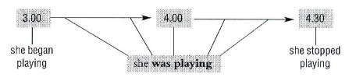
She was playing tennis.
She wasn’t watching television.

Slide 19
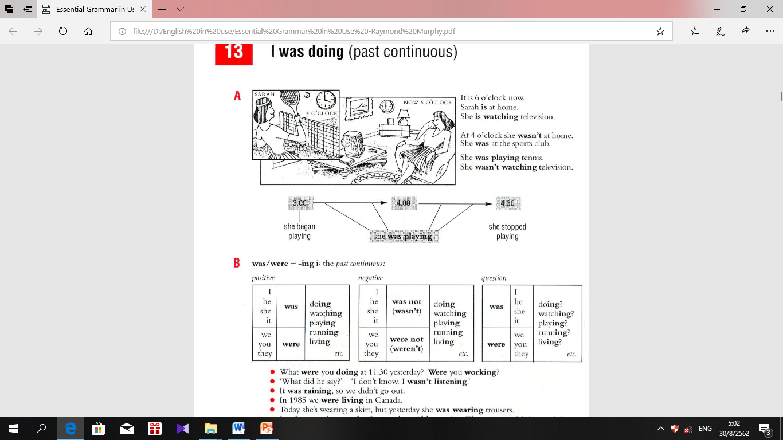
Structure sentence
Yes, ……was./ Yes,…..were.
No, ……wasn’t./ Yes,…..weren’t.

Slide 20
Time expressions :
Past simple
Past continuous
Yesterday
The day before yesterday
Last week / last month / last year
Two days ago
When
Then
In 2018
All day yesterday
All night yesterday
All morning yesterday
At 4 o’clock yesterday
At 4.30 in the afternoon
while
as

Slide 21
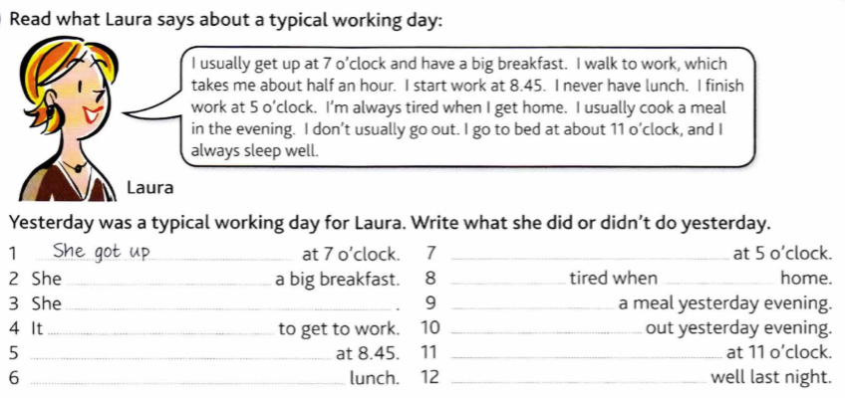
Past simple Tense มีกลุ่มคำแสดงเวลา ต่อไปนี้
Yesterday The day before yesterday Last week / last month / last year
Two day ago When Then In 2018

Slide 22
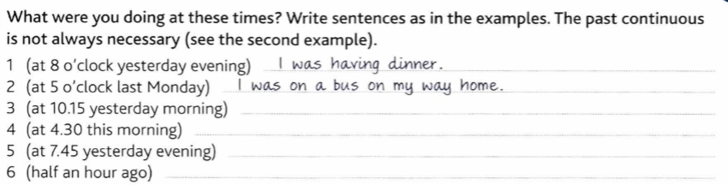
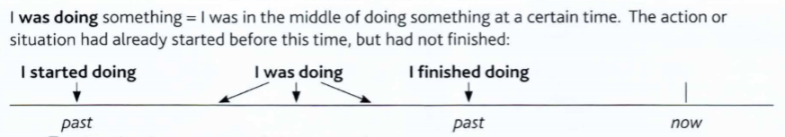
Past Continuous Tense

Slide 23
was snowing
were wearing
was skating
were watching
was taking
was smiling
were making
were having

Slide 24
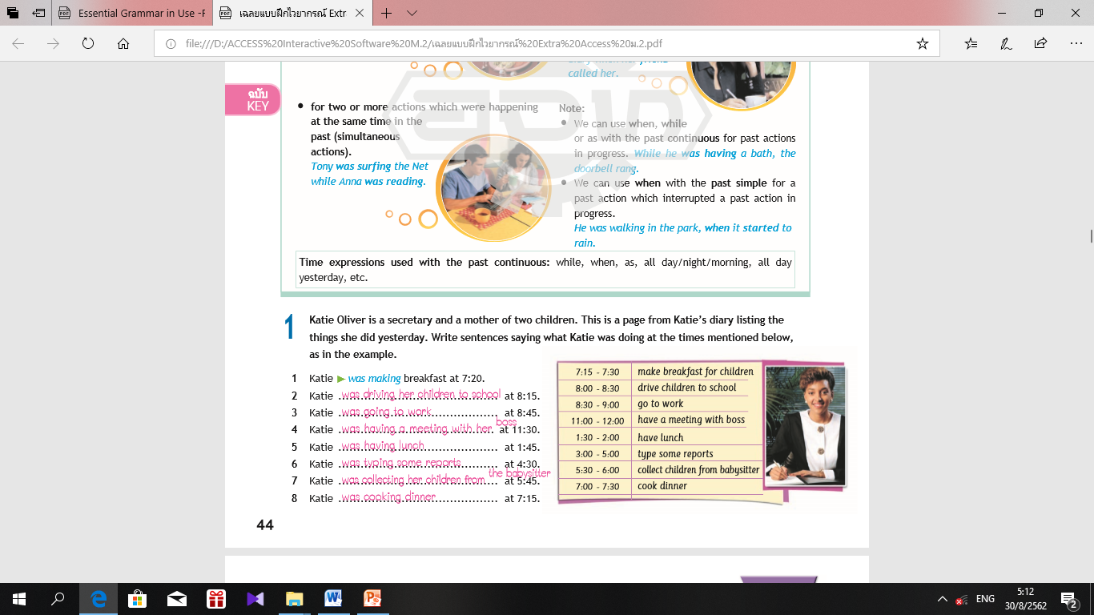

Slide 26
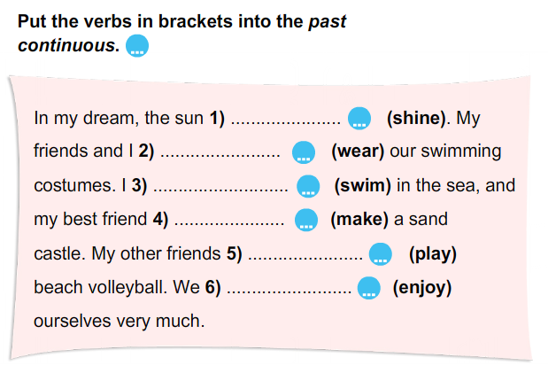
Do exercise : Past continuous

Slide 27
Suggested Answer Key
Example in the text
Action happening at a particular time in the past
I was having a picnic, in my dream I was falling out of the tree.
Actions happening at the same time in the past
My parents were relaxing while I was flying my kite.

Slide 28
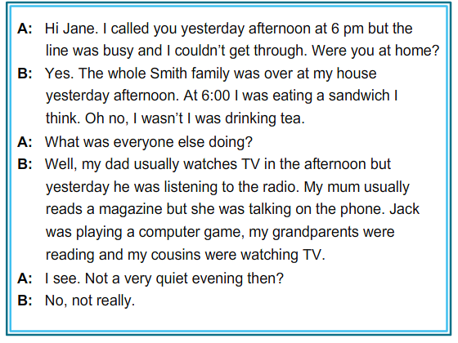


Slide 29
Mr Smith wasn’t watching TV. He was listening to the radio.
Mrs Smith wasn’t reading a magazine. She was talking on the phone.
Jack wasn’t surfing the Net. He was playing a computer game.
Jane’s grandparents weren’t sleeping. They were reading.
Jane’s cousins weren’t doing their homework. They were watching TV.

Slide 30
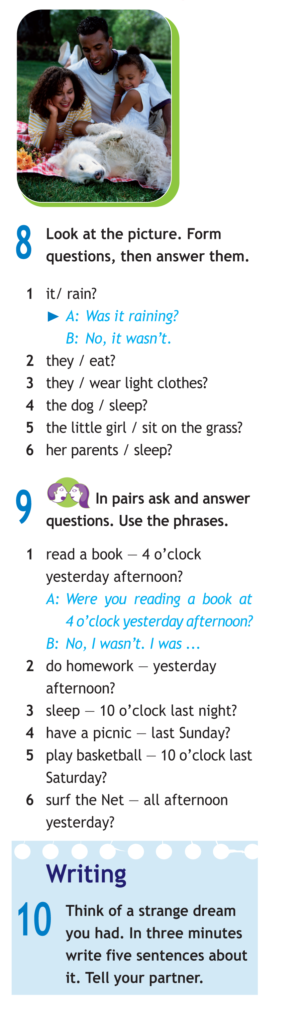
A: Were they eating?
B: No, they weren’t.
A: Were they wearing light clothes?
B: Yes, they were.

Slide 31
A: Was the dog sleeping?
B: No, it wasn’t.
A: Was the little girl sitting on the grass?
B: No, she wasn’t.
A: Were her parents sleeping?
B: No, they weren’t.

Slide 32
Suggested Answer Key
2 A: Were you doing your homework yesterday afternoon?
B: Yes, I was.
3 A: Were you sleeping at 10 o’clock last night?
B: No, I wasn’t. I was watching TV.
4 A: Were you having a picnic last Sunday?
B: No, I wasn’t. I was doing my homework.
etc

Slide 33
A: Were you doing your homework yesterday afternoon?
B: Yes, I was.

Slide 34
A: Were you sleeping at 10 o’clock last night?
B: No, I wasn’t. I was watching TV.
A: Were you having a picnic last Sunday?
B: No, I wasn’t. I was doing my homework.

Slide 35
A: Were you playing basketball at 10 o’clock last Saturday?
B: No, I wasn’t. I was __________________.
A: Were you surfing the Net all afternoon?
B: No, I wasn’t. I was going shopping at the mall.

Slide 36


Slide 37
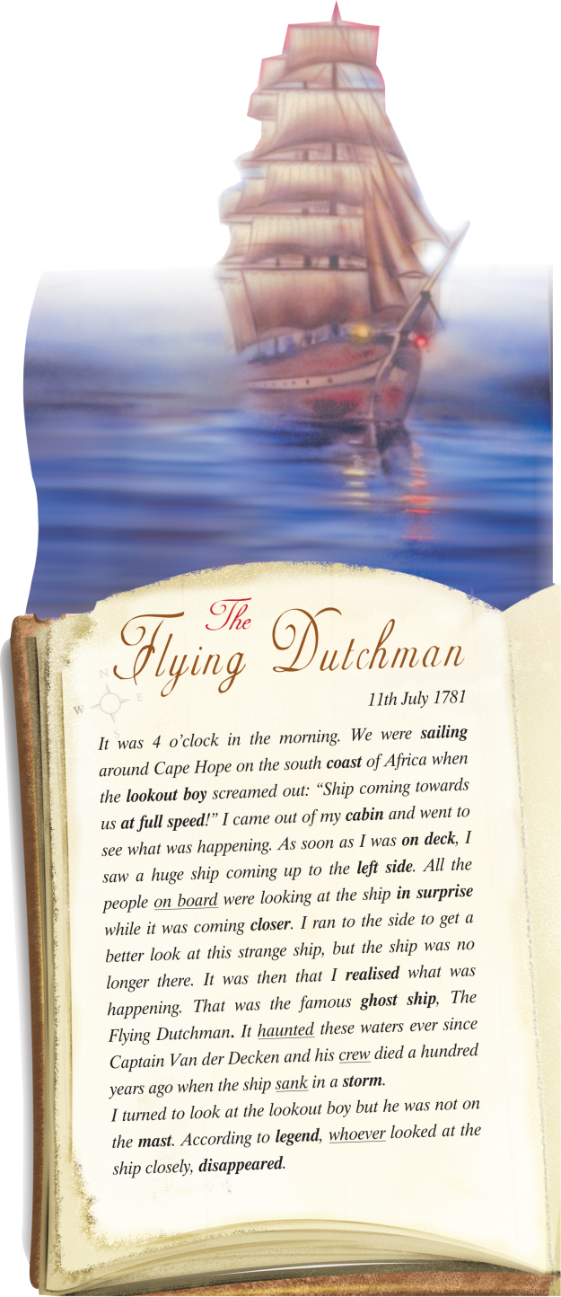

Slide 38
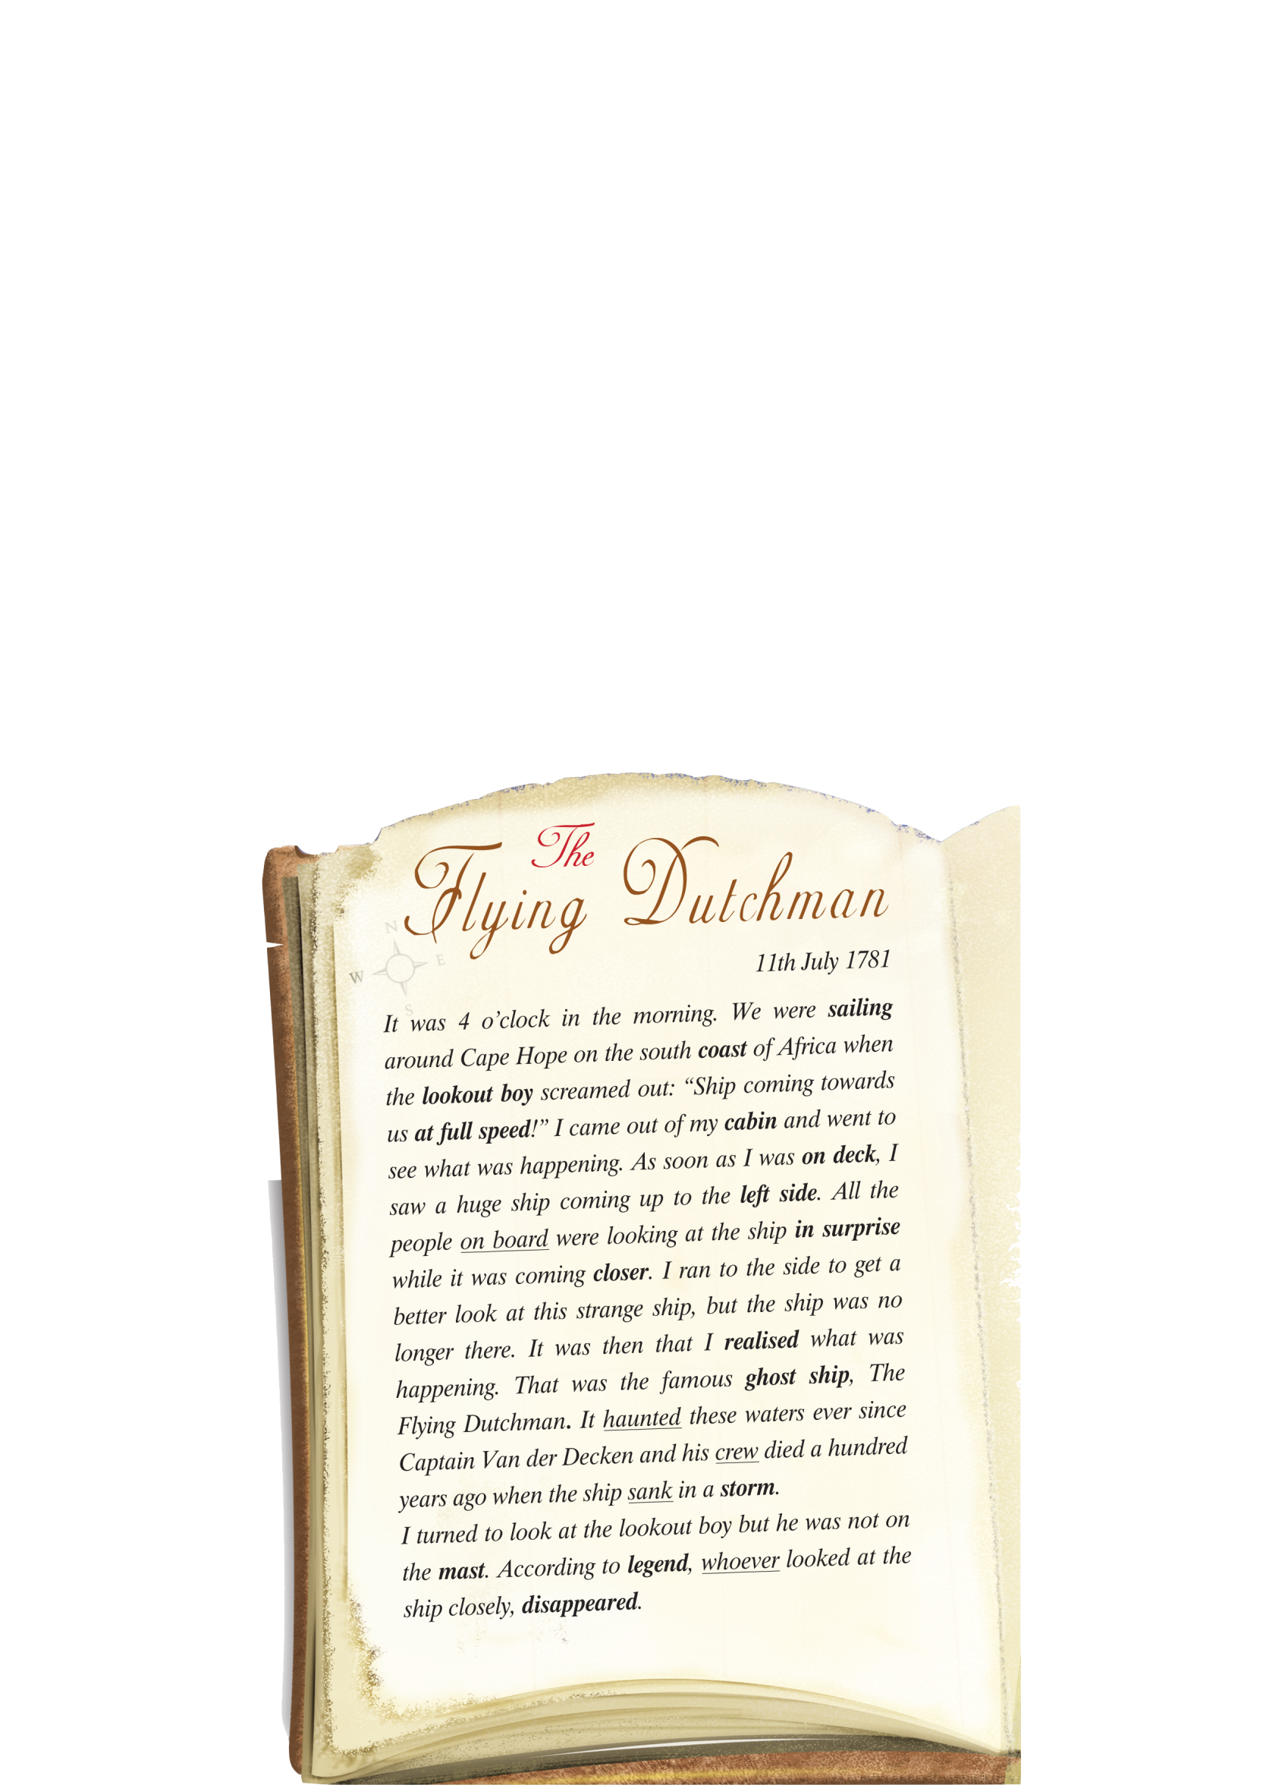
ฝั่งทะเล
deck ดาดฟ้าเรือ
on board บนเรือ
มักปรากฏขึ้นเสมอ
พายุ
หายลับไป
legend เลจ'เจินดฺ ตำนาน
mast เสาเรือ

Slide 39
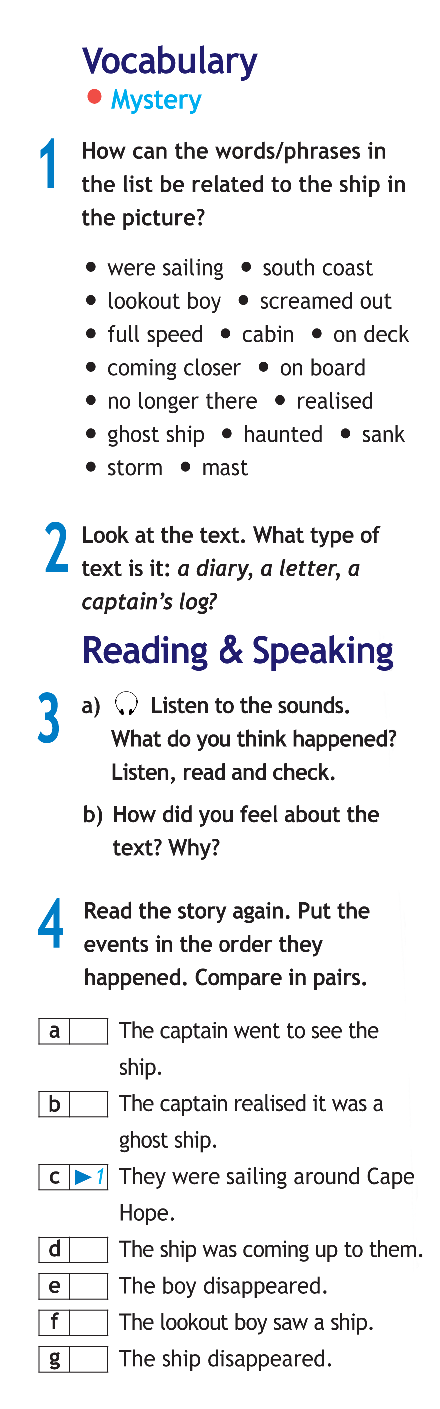
4
6
3
7
2
5

Slide 40
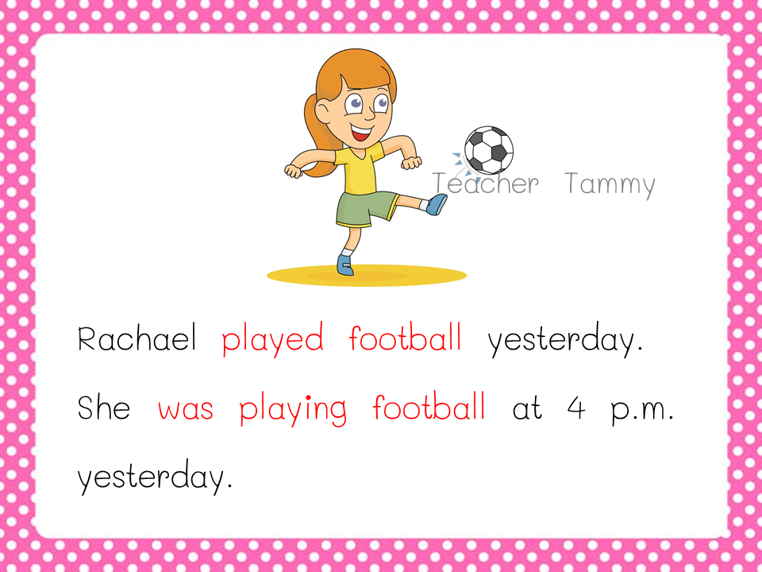
Past simple
Past continuous

Slide 41
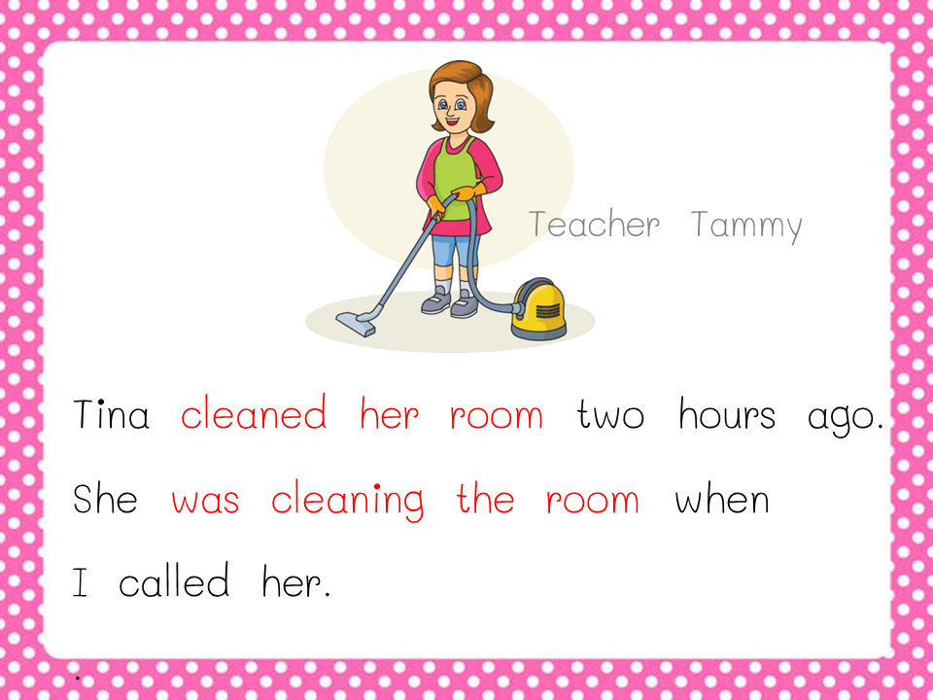
While she was cleaning the room, I called her.
I called her while she was cleaning the room.
มีเหตุการณ์เกิดขึ้น 2 เหตุการณ์
When I called her , she was cleaning the room.
She was cleaning the room when I called her.
เกิดขึ้นอยู่ก่อน
แทรกเข้ามา

Slide 42
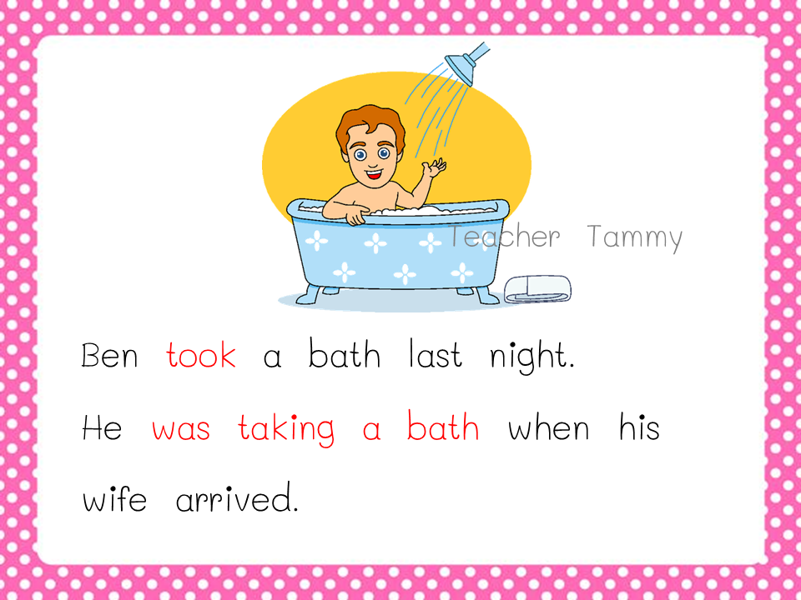

Slide 43
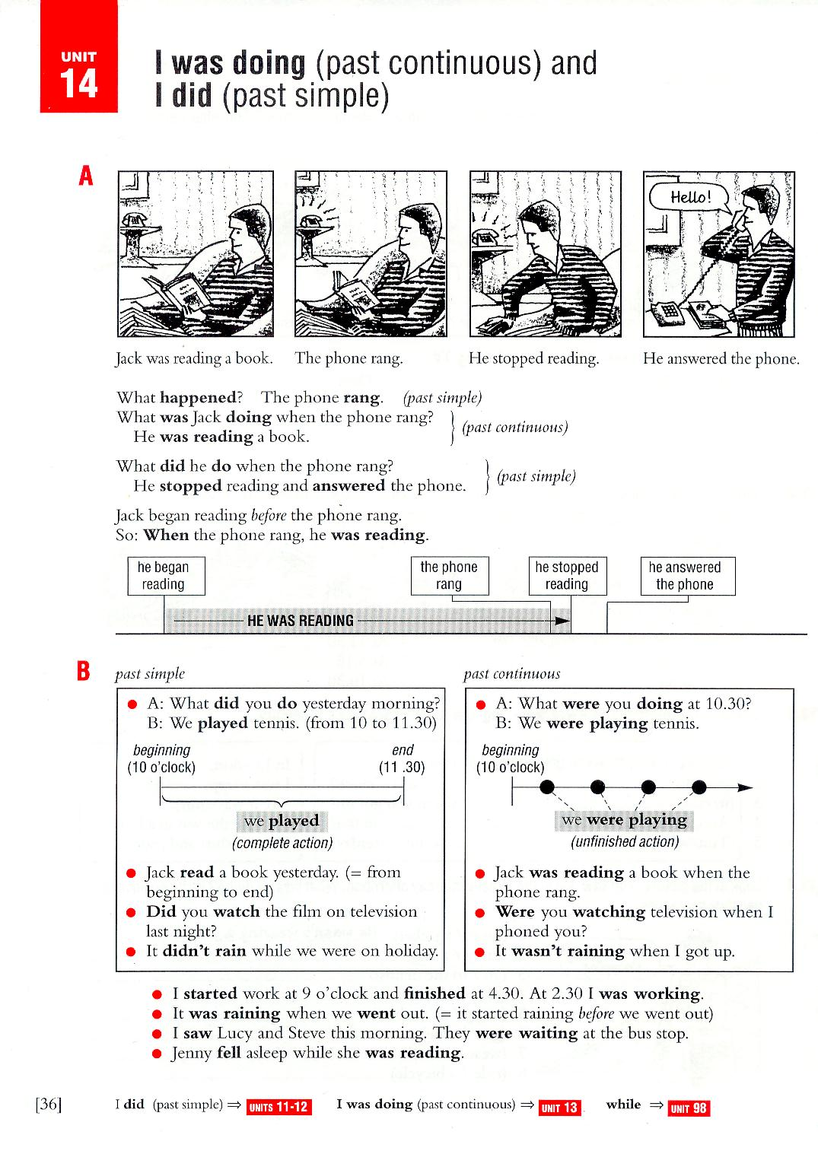

Slide 46
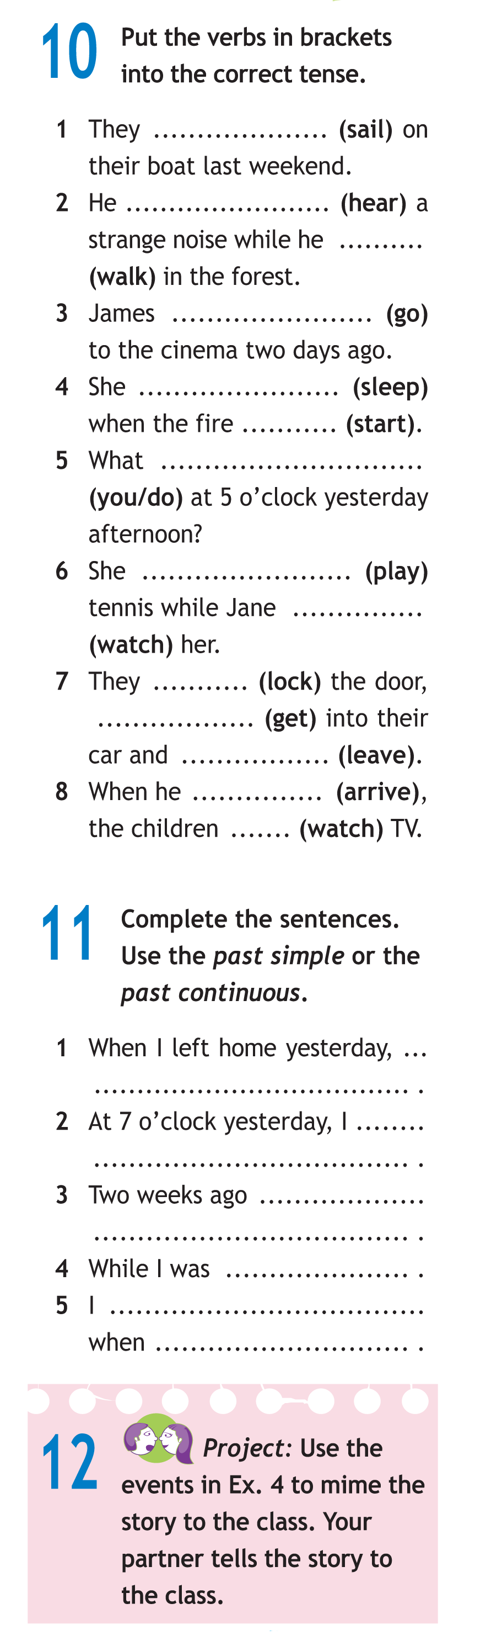
sailed
were you doing
heard
was walking
was playing
was watching
went
locked
got
was sleeping
left
started
arrived
were watching

Slide 47
I forgot to take my umbrella
was reading a book at home
I went to the art gallery
washing the car, my friends arrived
was watching TV
the phone rang

Slide 48
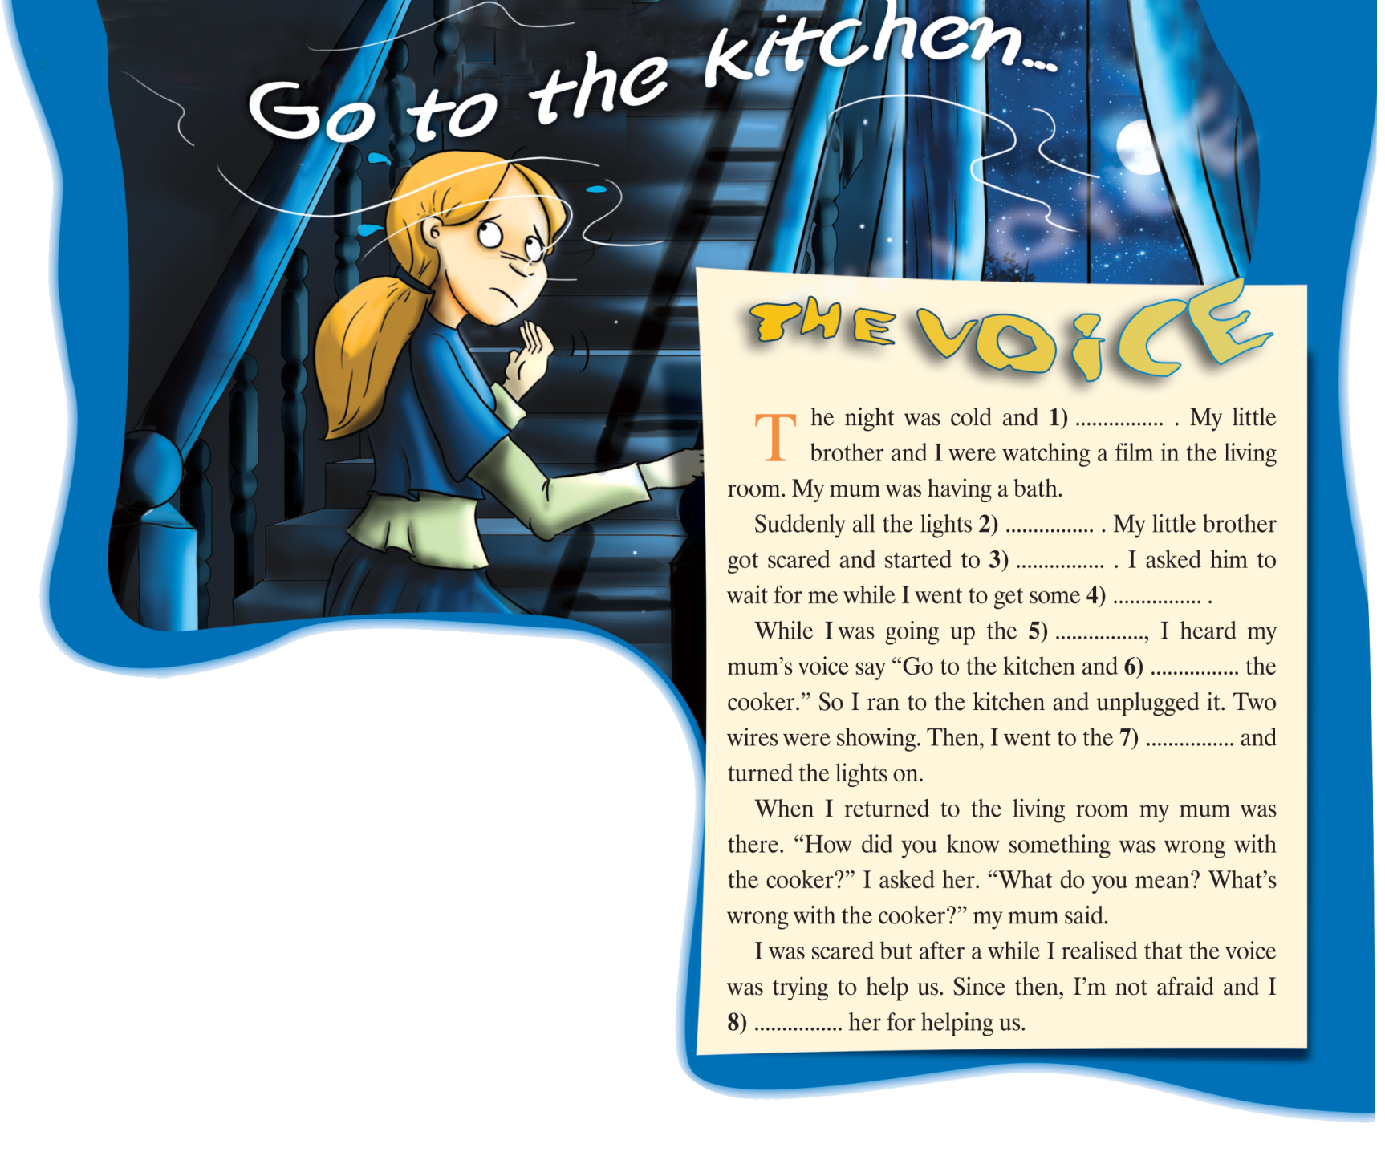
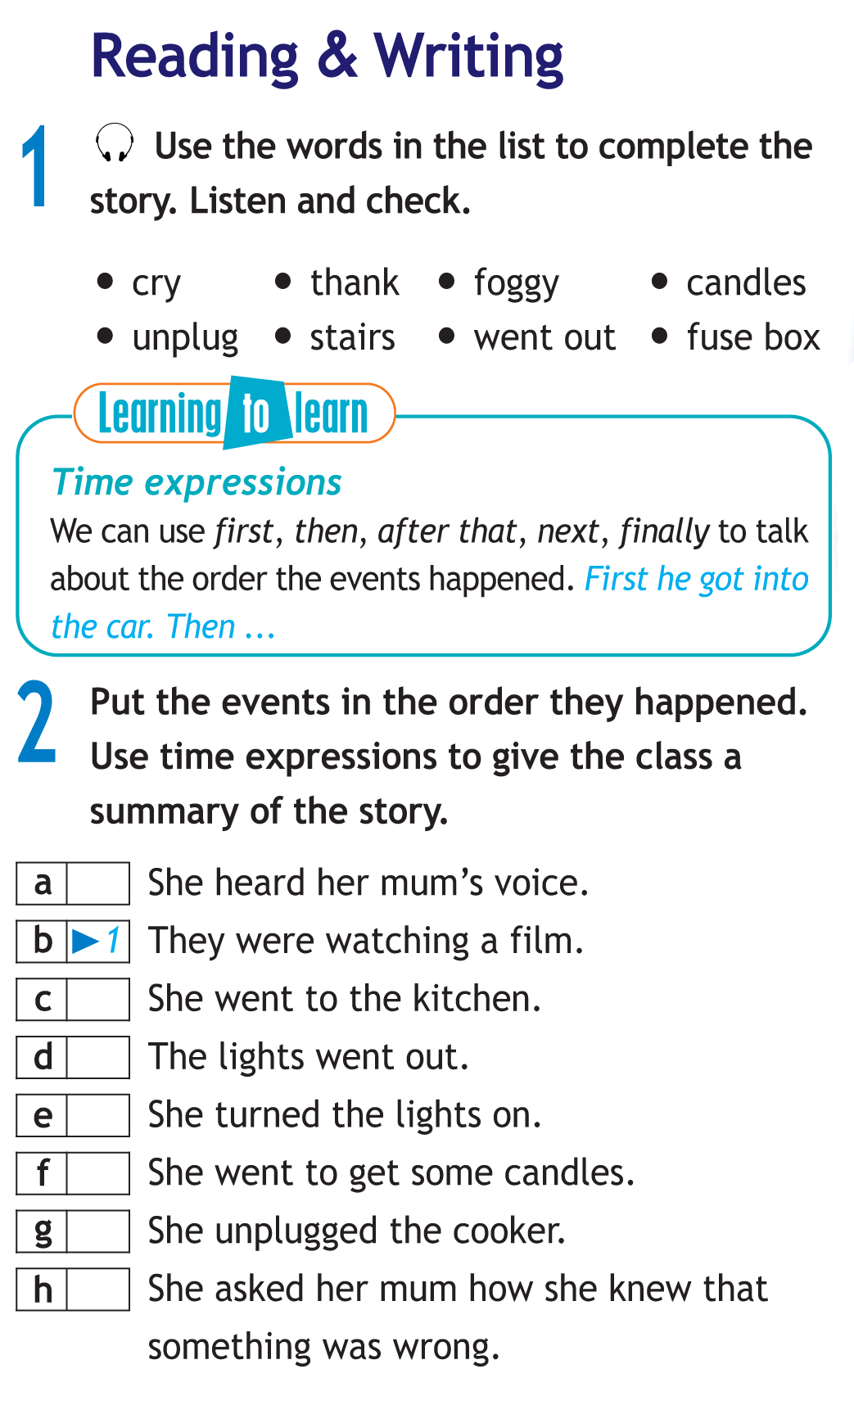
Unit 4c
Stories
Answer Key
1 foggy 5 stairs
2 went out 6 unplug
3 cry 7 fuse box
4 candles 8 thank

Slide 49
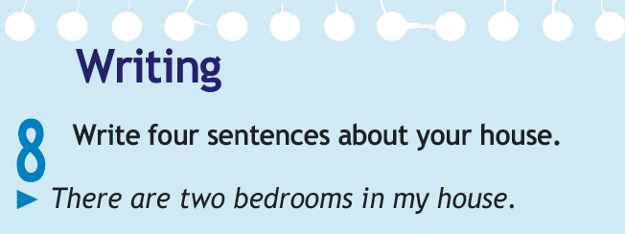
Suggested Answer Key
It was a Saturday morning last winter. I was at home with my family. I woke up, got dressed and went downstairs to make breakfast.
I heard the TV in the living room so I popped my head around the door to see who was there. My mum was sitting in her armchair watching TV. I asked her if she wanted a cup of tea, but she didn’t answer. I asked her again but still there was no answer. She didn’t even look at me. I decided to make her one anyway and went into the kitchen. My mum was standing there making breakfast. I was confused. I ran back into the living room but now it was empty and the TV was off.
I felt scared and frustrated, but I decided not to tell anyone. After all it could have been my imagination. Who can tell?

Slide 50
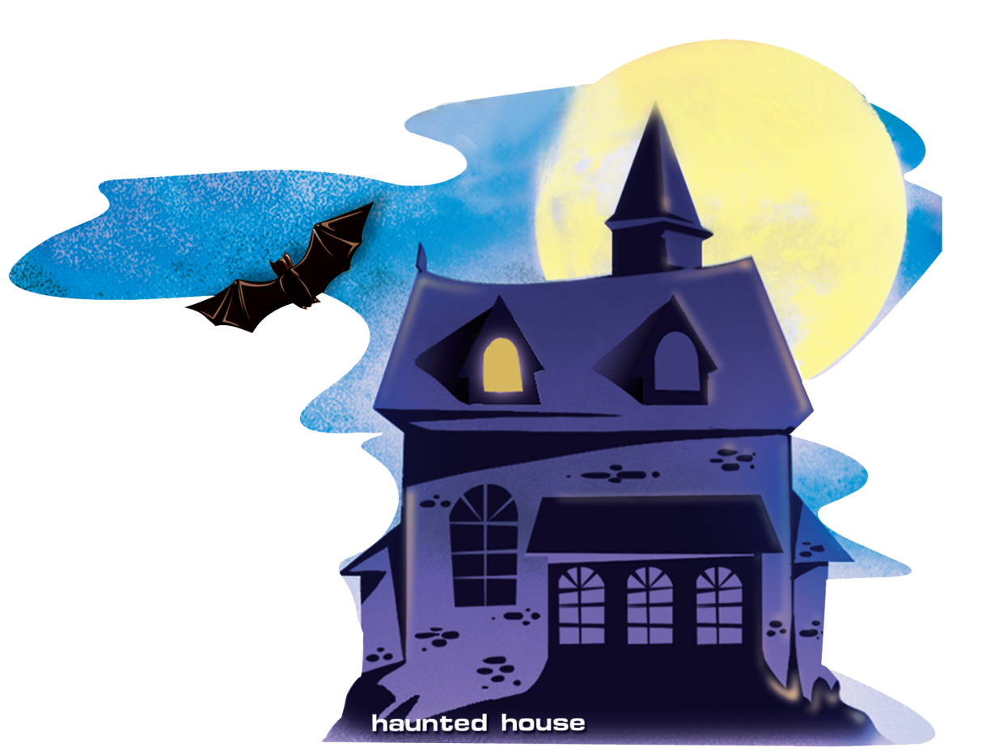
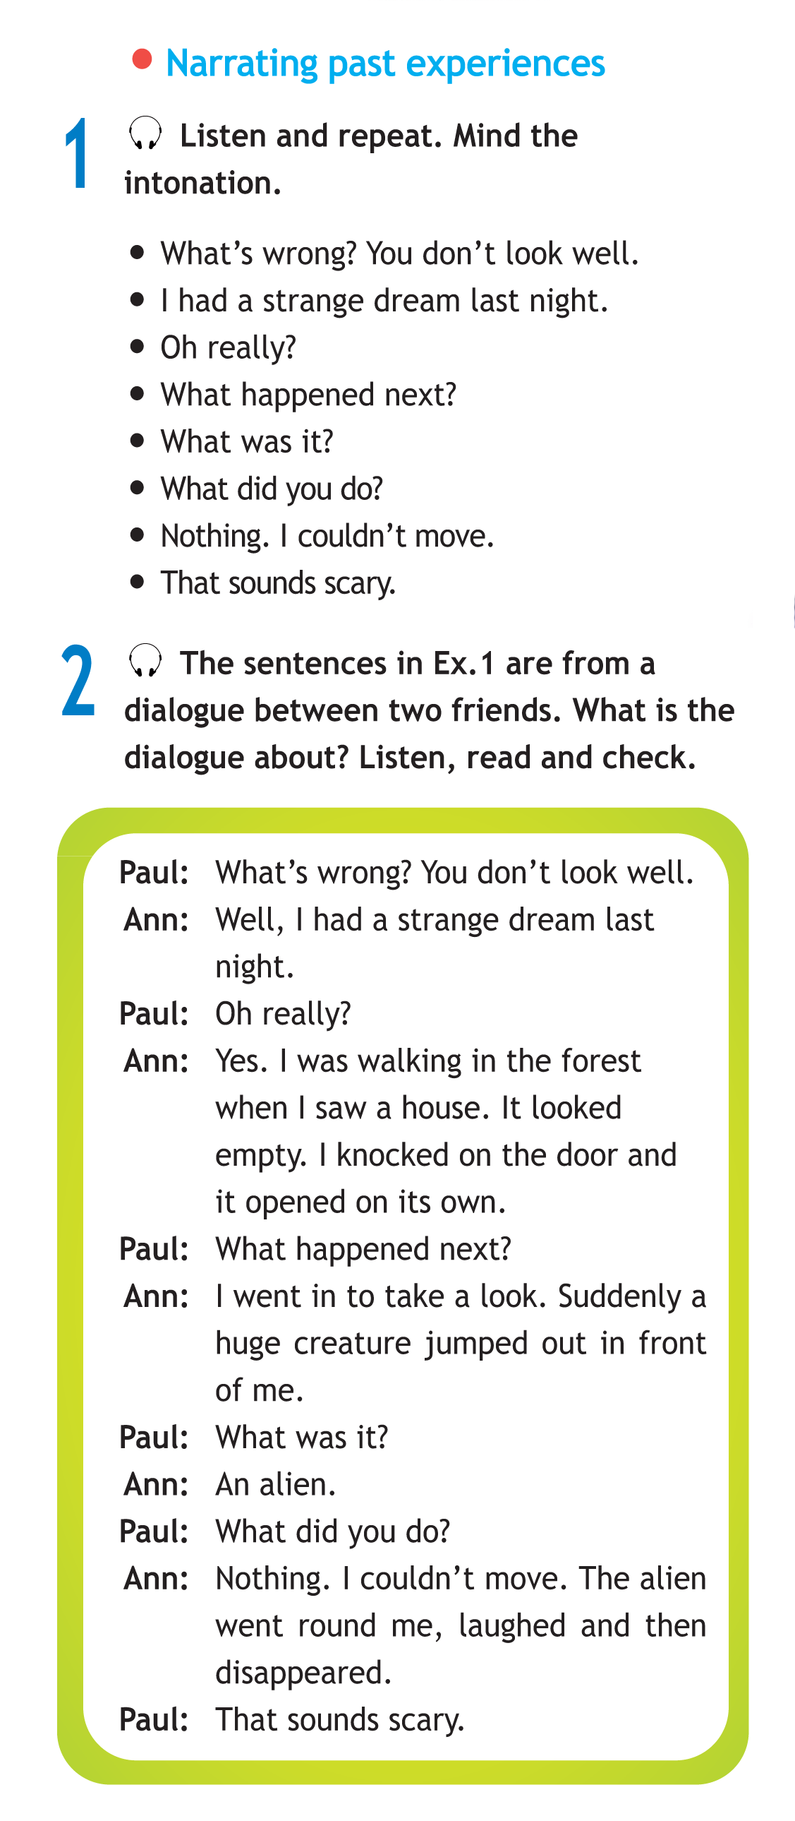


Slide 51
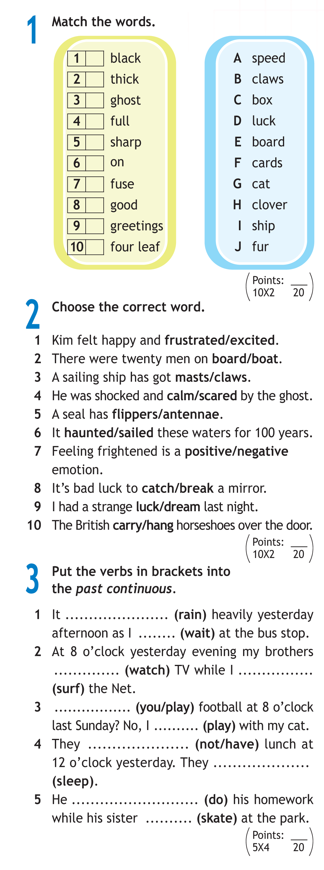
was raining
was waiting
were watching
was surfing
Were you playing
was playing
weren’t having
were sleeping
was doing
was skating

Slide 52
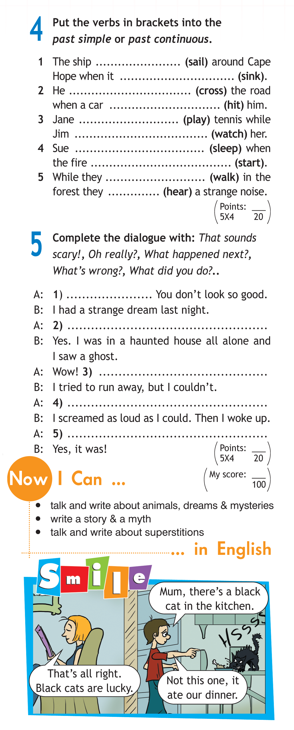
was sailing
sank
was crossing
hit
was playing
was watching
was sleeping
started
were walking
heard

Slide 53
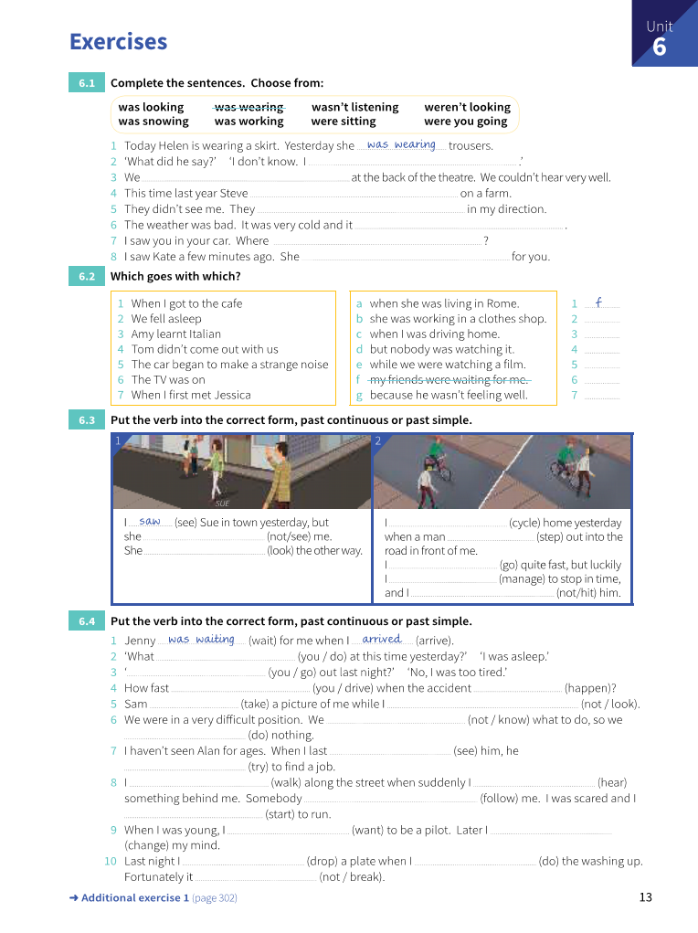

Slide 54
