Slide 1

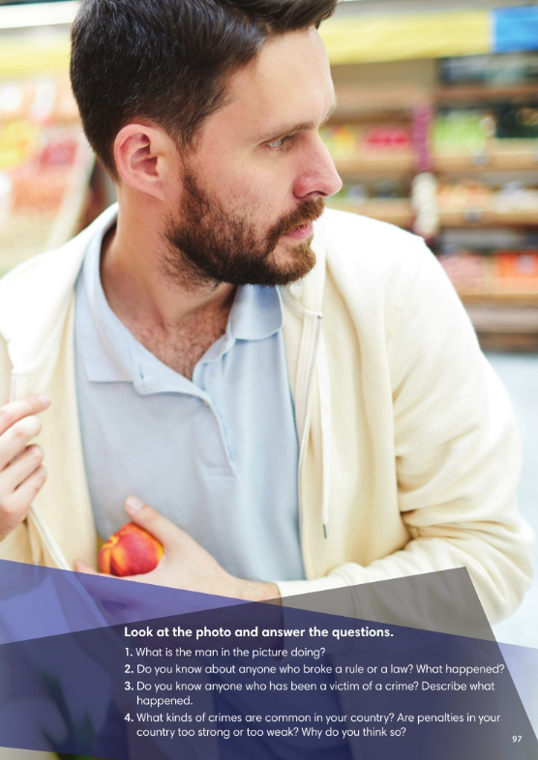

Slide 2
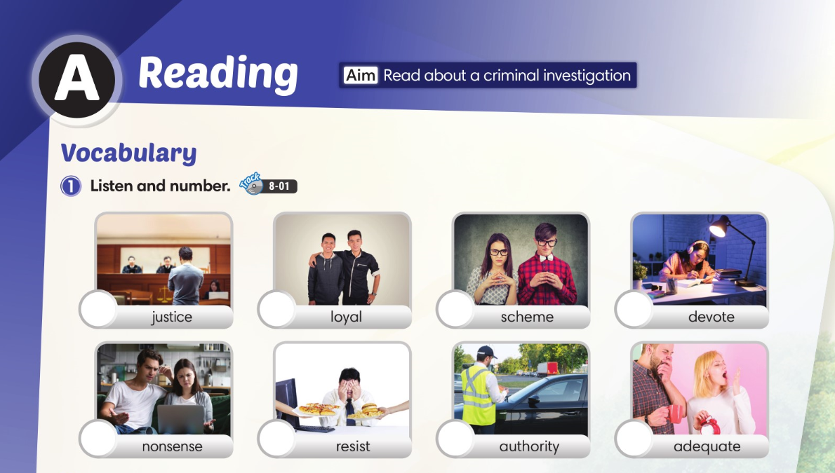

3
6
8
4
7
5
2
1

Slide 3
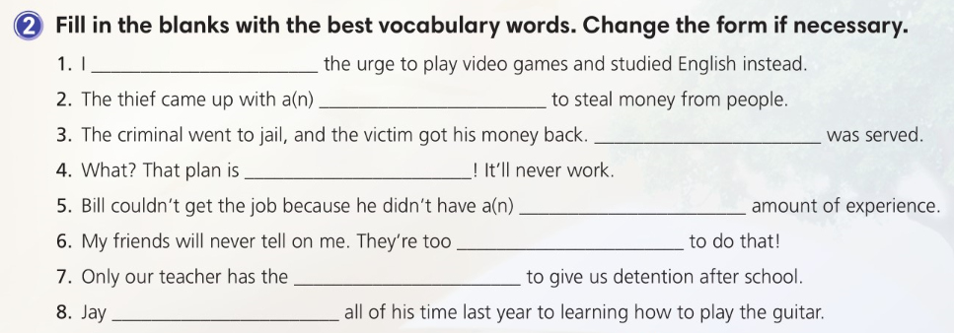

resisted
scheme
Justice
nonsense
adequate
loyal
authority
devoted

Slide 4
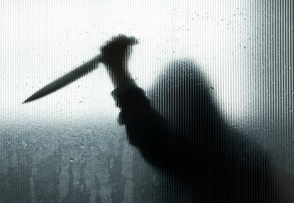
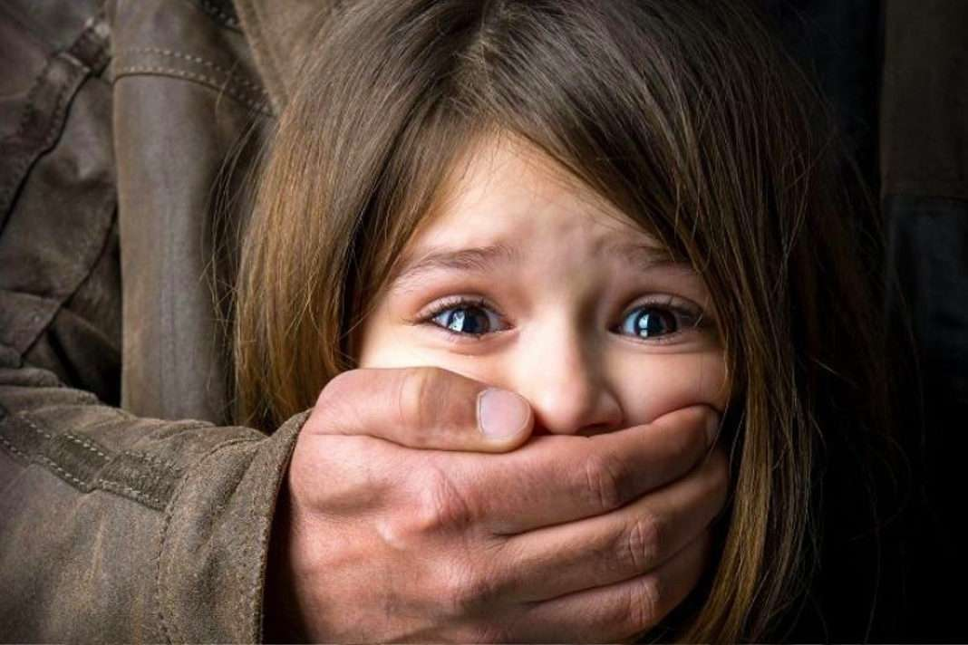

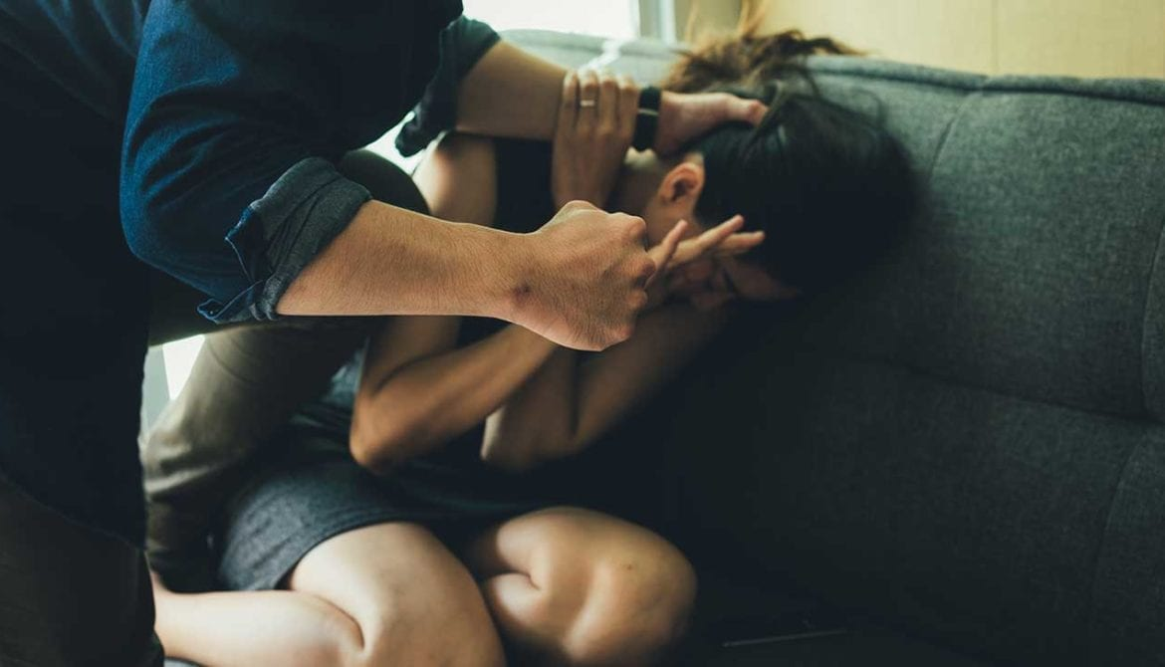
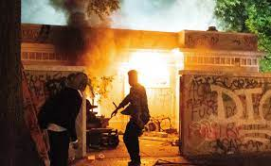
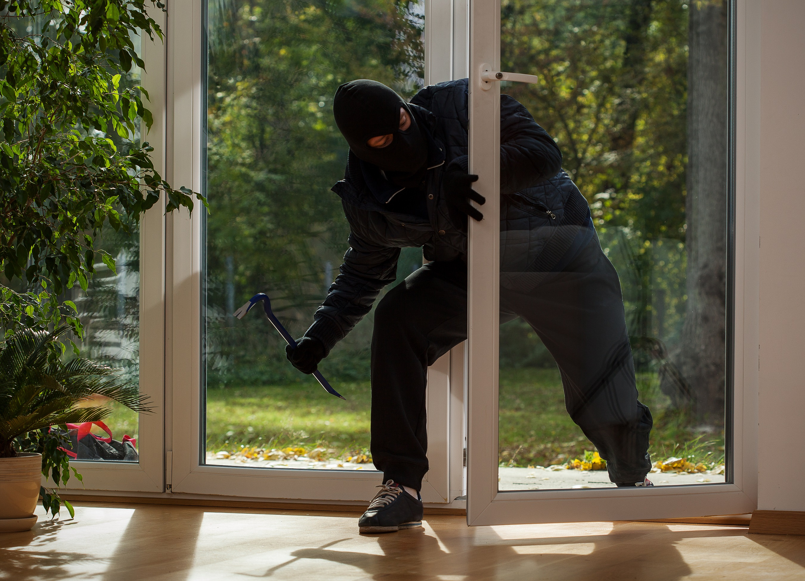
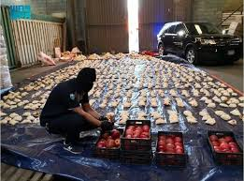
murder
If you kill somebody
rape
forcing someone to have sexual relations
shoplifting
If you steal items from shops
Types of crime
assault
If you attack someone physically
burglary
If you illegally enter a building and steal things
arson
If deliberately start a fire
smuggling
If you illegally take people or goods into or out of a country

Slide 5
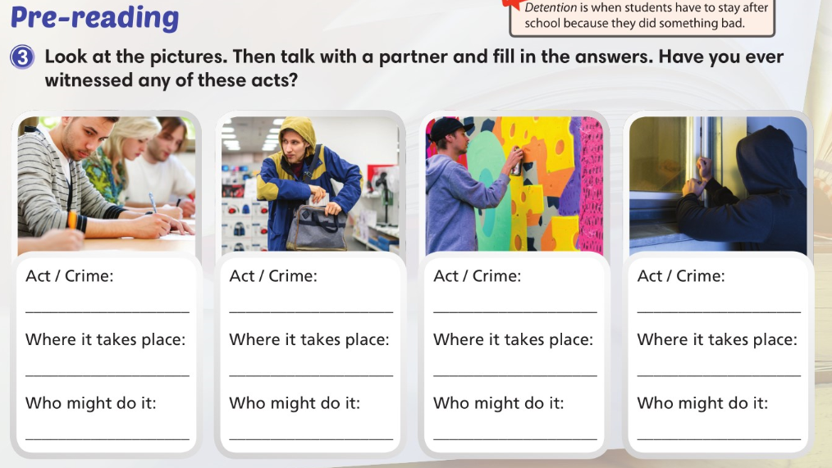

Slide 6
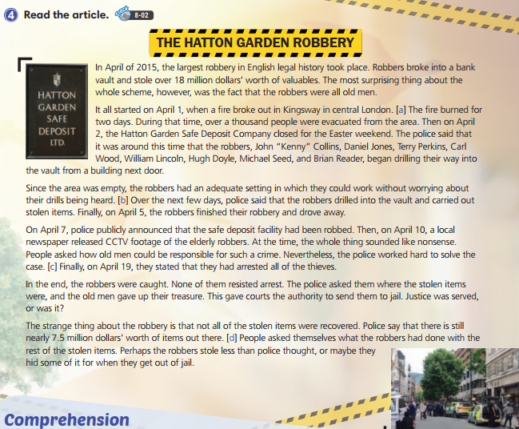

Slide 7
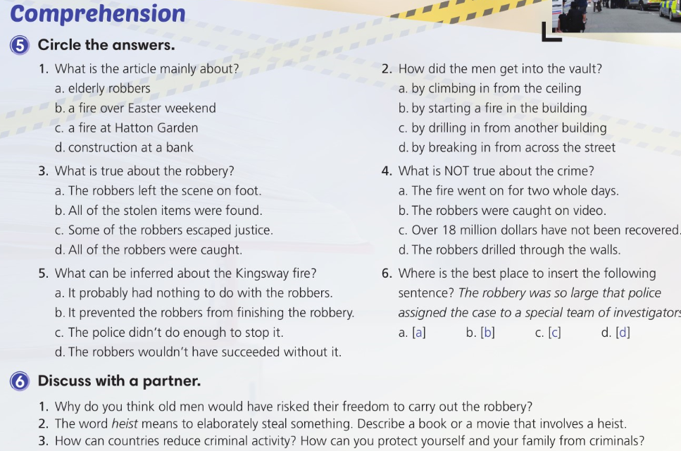

Slide 8
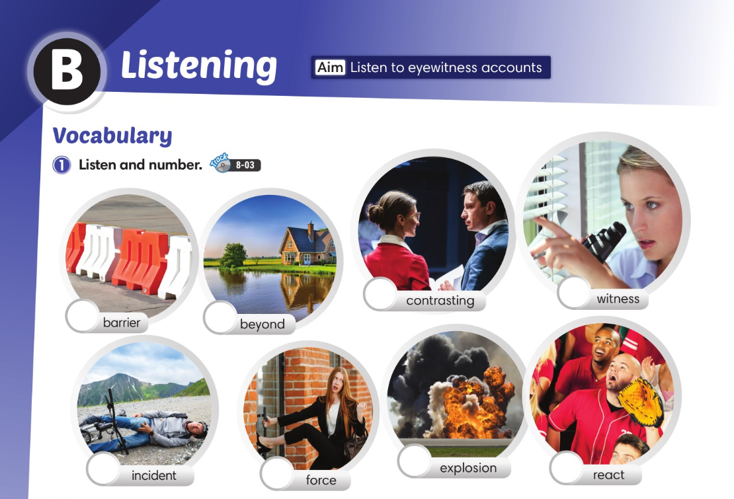
2
8
3
5
6
4
7
1

Slide 9
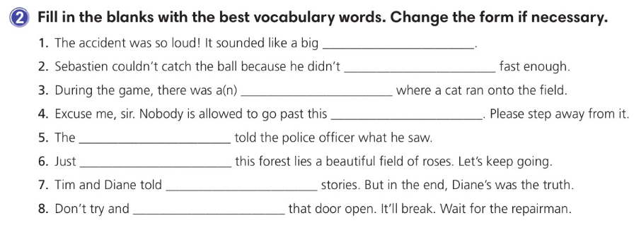
explosion
react
incident
barrier
witness
beyond
contrasting
force

Slide 10
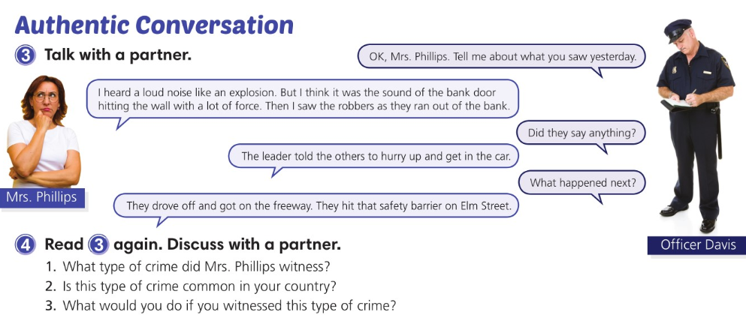

Slide 11
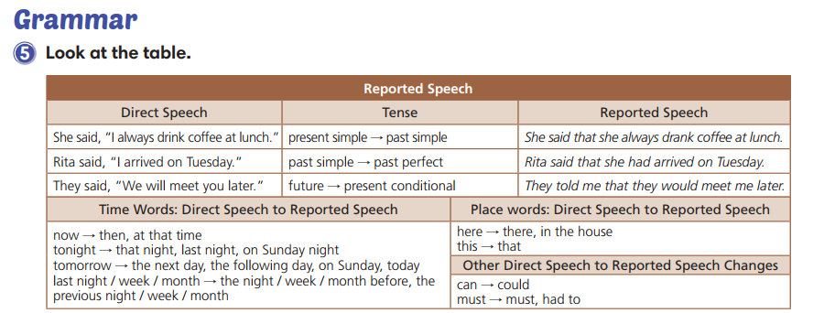

Slide 12
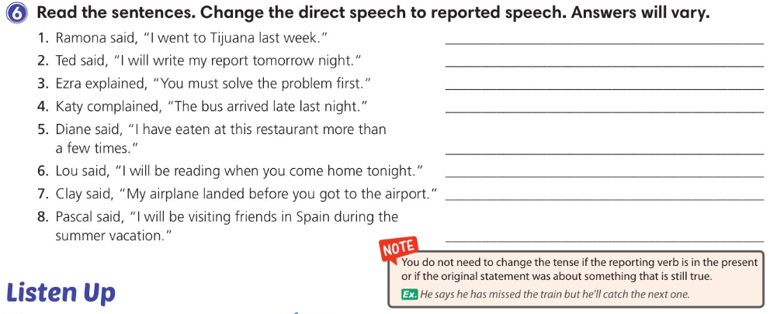
Ramona told me (that) she had gone to Tijuana the week before.
Ted said (that) he would write his report the following night.
Ezra explained (that) I must/had to solve the problem first.
Katy complained (that) the bus had arrived late the night before.
Diane told me (that) she had eaten at that restaurant more than a few times.
Lou told me (that) he would be reading when I came home that night.
Clay said (that) his airplane had landed before I had gotten
to the airport.
Pascal said (that) he would be visiting friends in Spain during
the summer vacation.

Slide 13
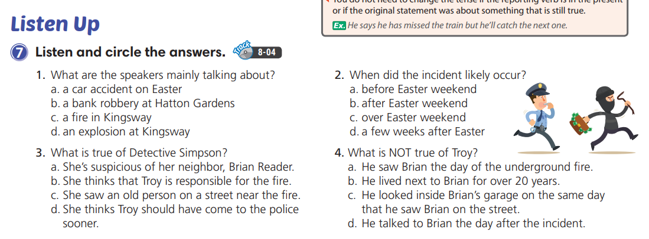

Slide 14
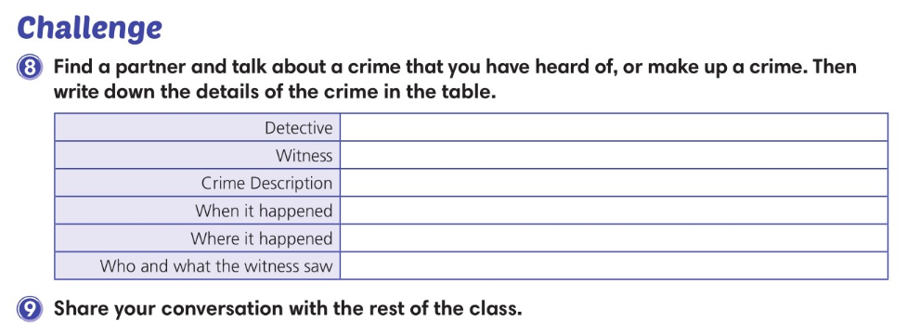

Slide 15
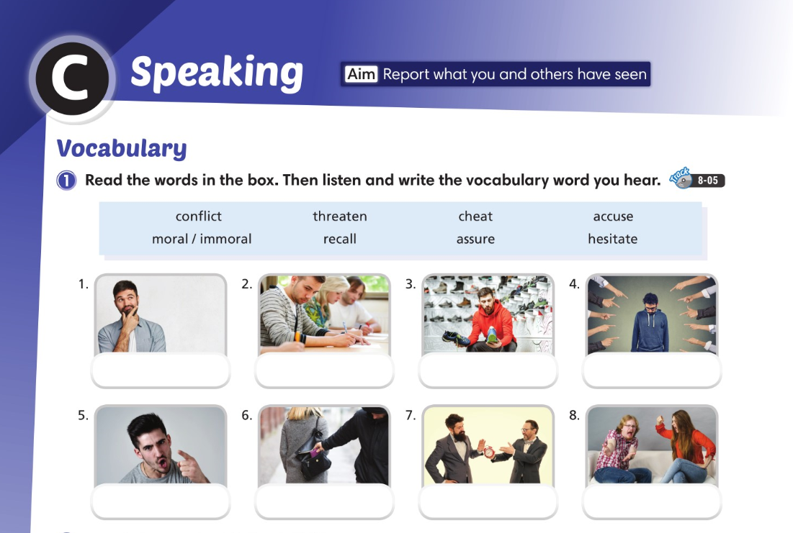
recall
cheat
hesitate
accuse
threaten
immoral
assure
conflict

Slide 16
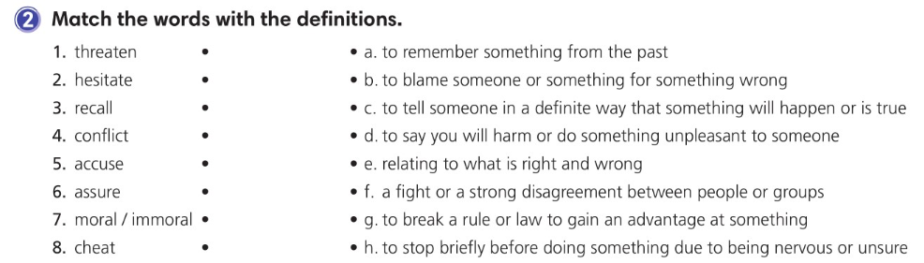

Slide 17
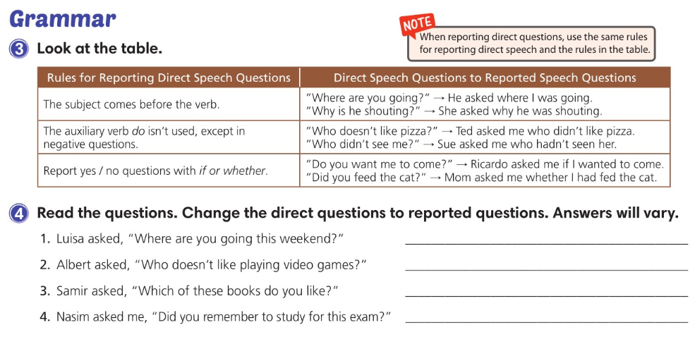
Luisa asked me where I was going that weekend.
Albert asked me who didn’t like playing video games.
Samir asked me which of those books I liked.
Nasim asked me if/whether I remembered to
study for that exam.

Slide 18
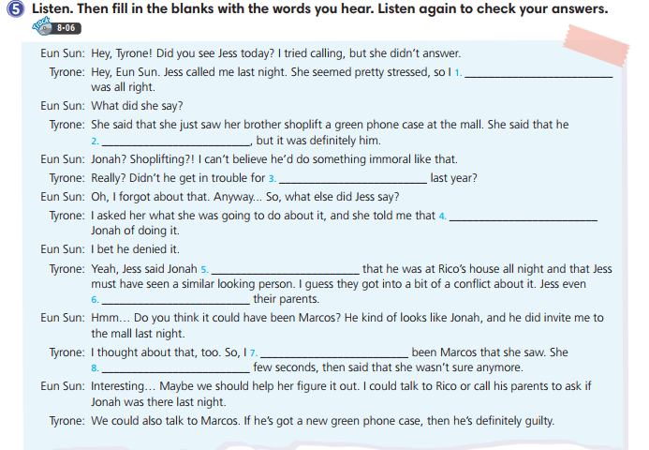
asked her if everything
was pretty far away
cheating on his final exam
she had already accused
assured her
threatened to tell
asked Jess if it could have
hesitated for a

Slide 19
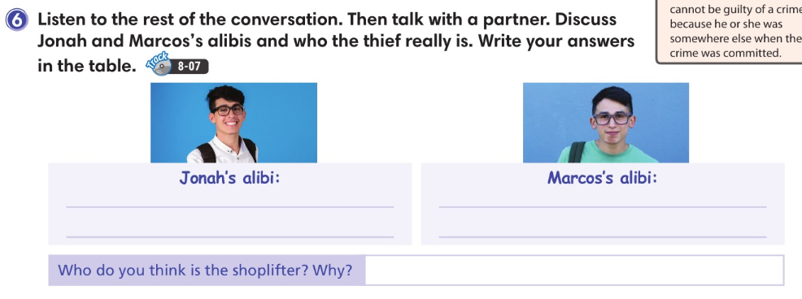
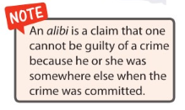

Slide 20
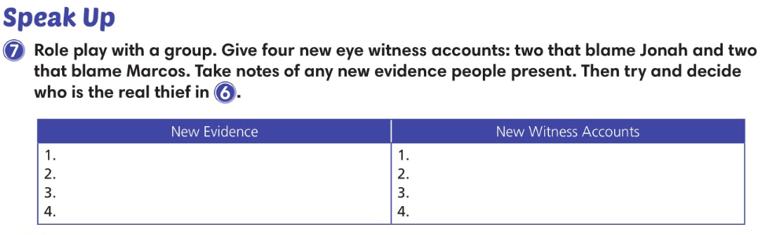

Slide 21
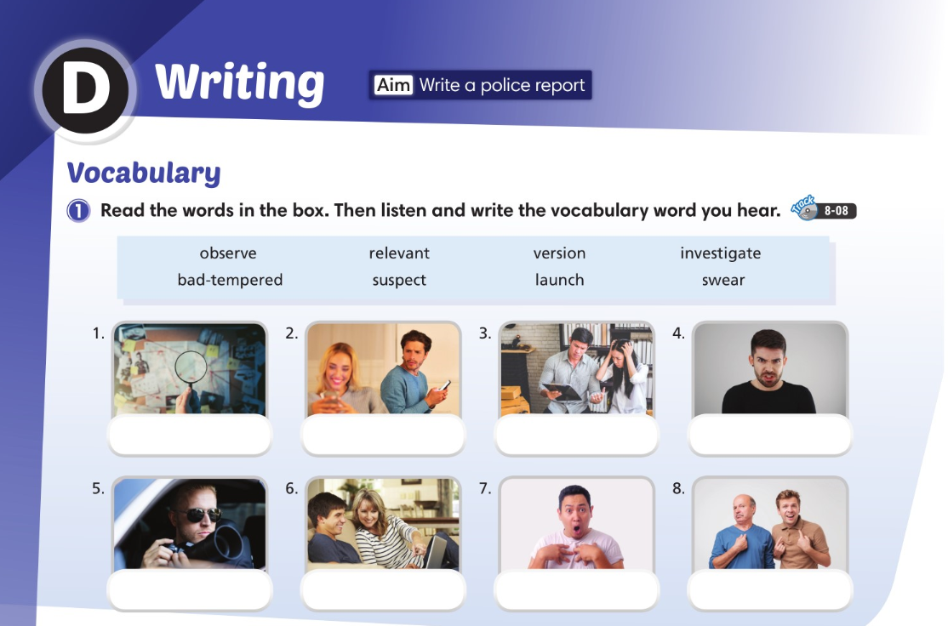
investigate
suspect
relevant
bad-tempered
observe
launch
swear
version

Slide 22
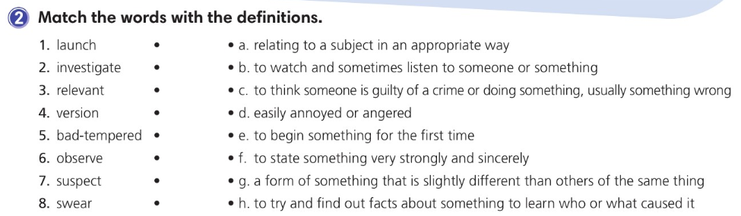

Slide 23
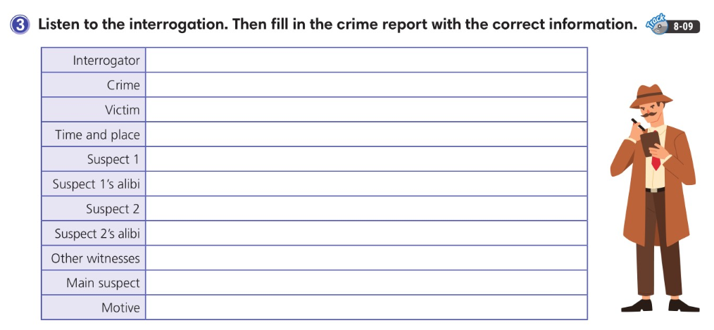
Mrs. Phillips
Purse stolen
Sunny
Classroom in the morning
Skyler
Was in the restroom. Sunny saw him come back.
Eddie
Doctor’s appointment
Coach Carter
Eddie
Buy a new pair of basketball shoes

Slide 24
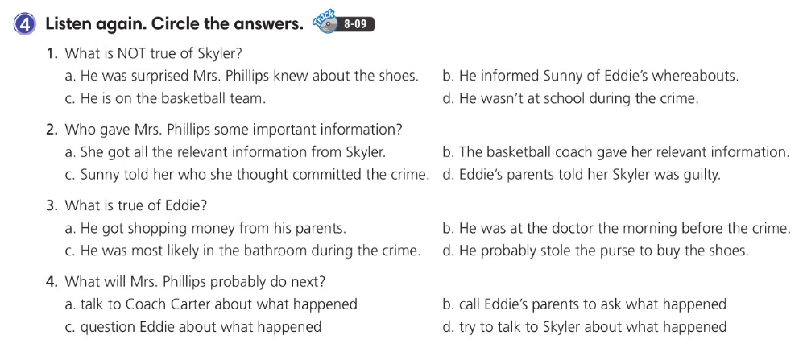

Slide 25
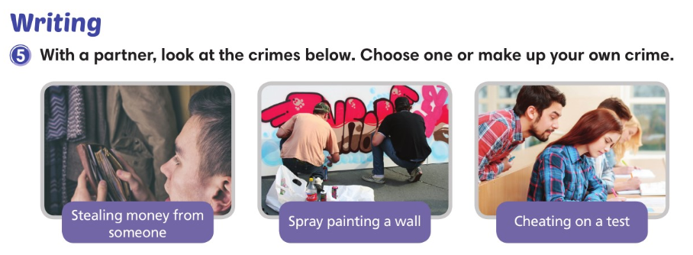

Slide 26
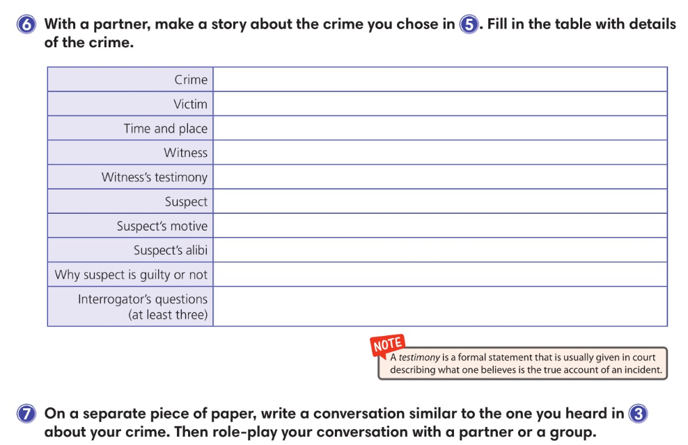

Slide 27
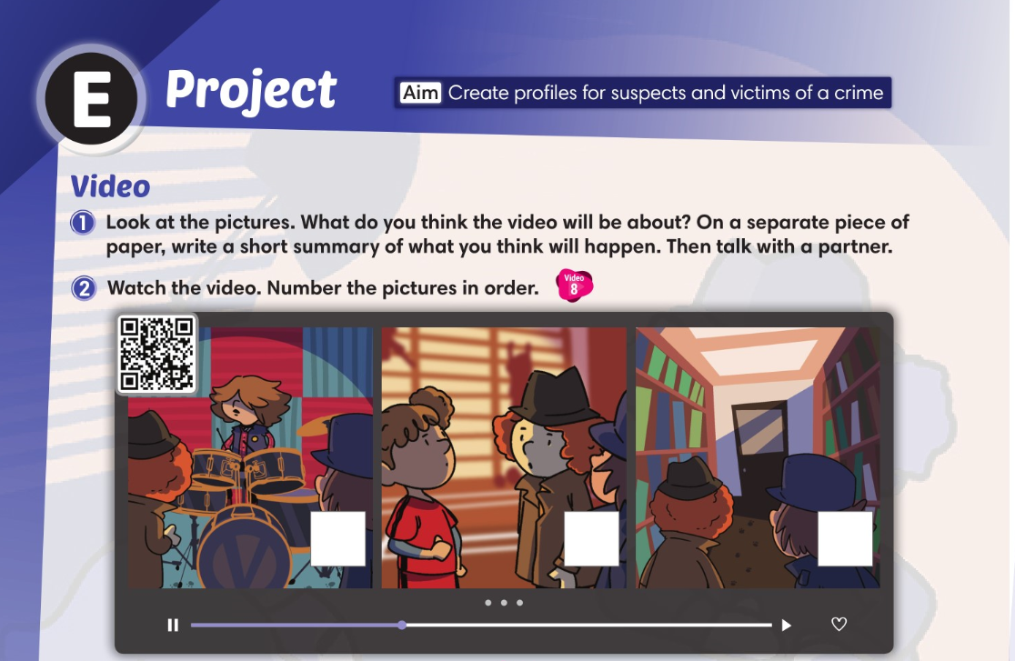
1
2
3

Slide 28
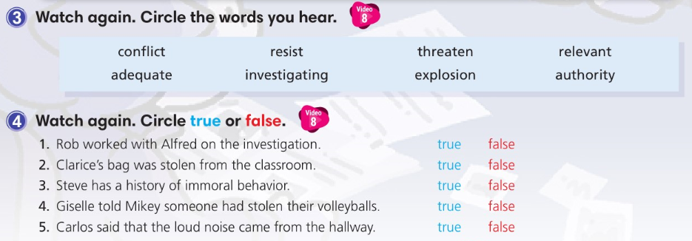

Slide 29
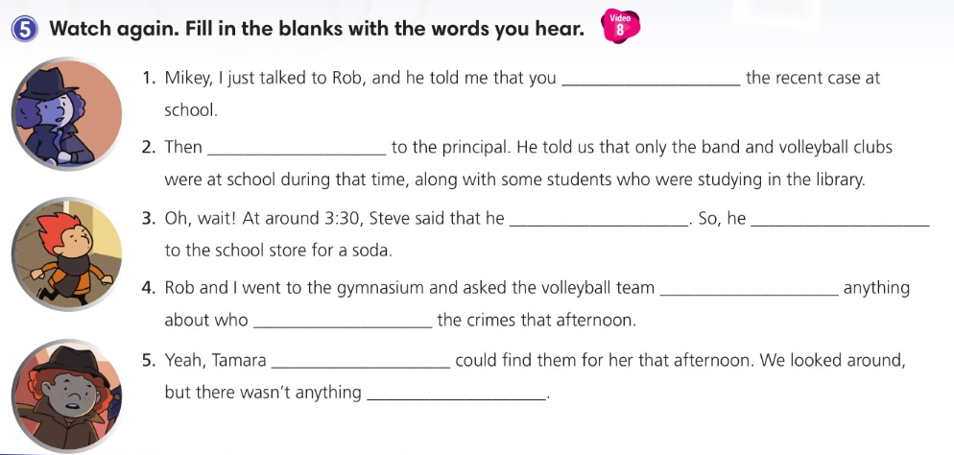
finished investigating
we talked
was thirsty
went
whether they knew
had committed
asked us if we
relevant

Slide 30
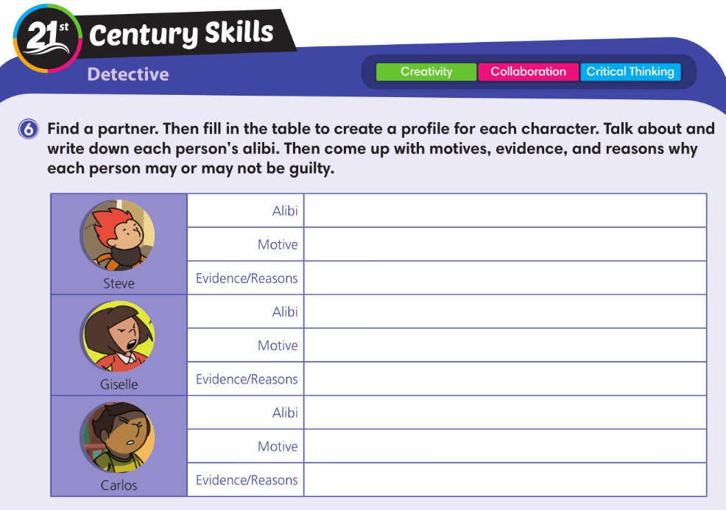

Slide 31
