Slide 1



Slide 2


5
6
2
3
8
7
1
4

Slide 3
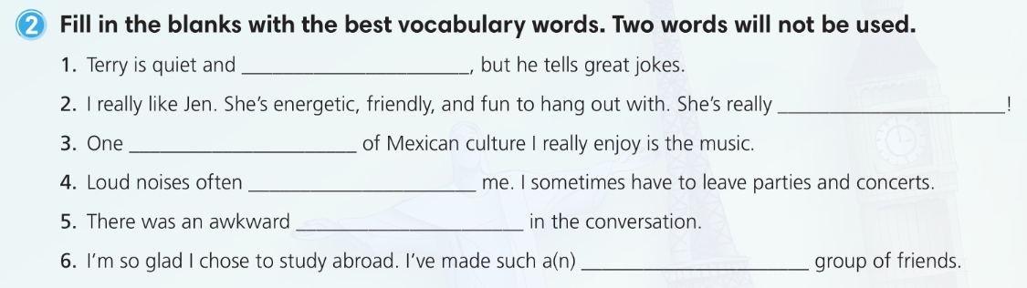
reserved
outgoing
aspect
overwhelm
pause
diverse

Slide 4
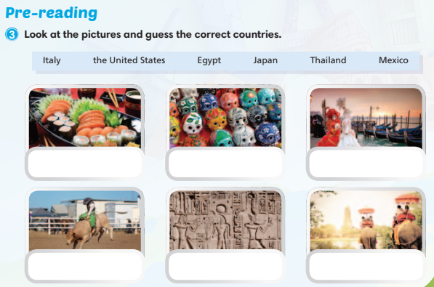
Japan
Mexico
Italy
the United States
Egypt
Thailand

Slide 5
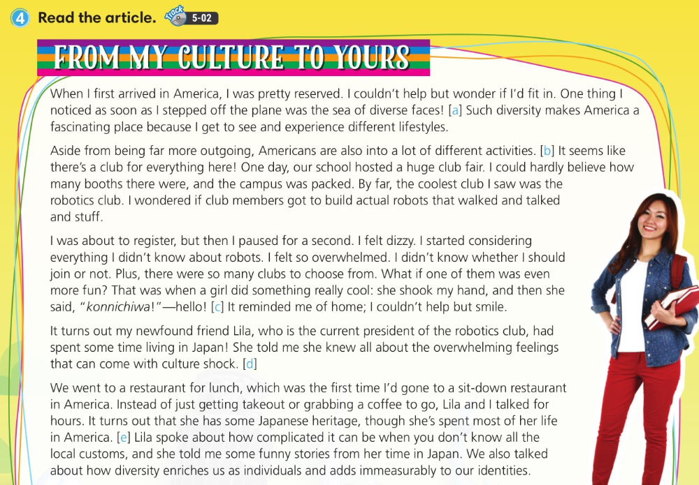

Slide 6
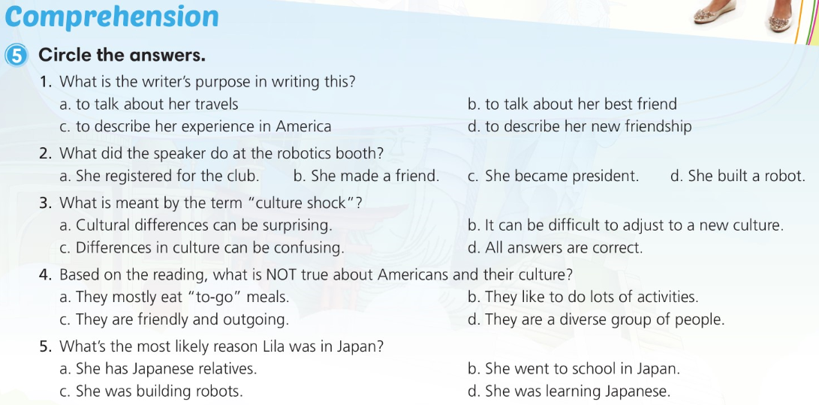

Slide 7
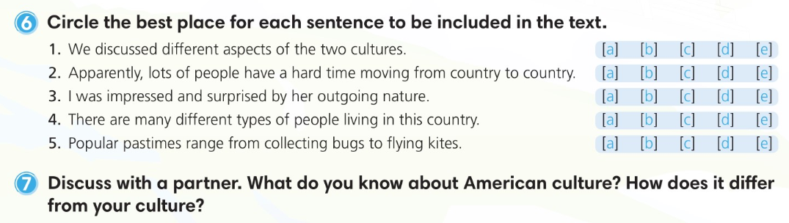

Slide 8
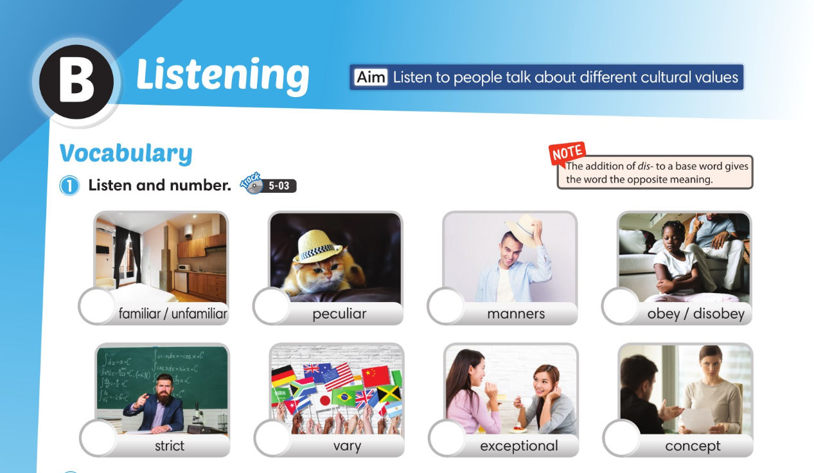
5
6
4
2
8
7
1
3

Slide 9
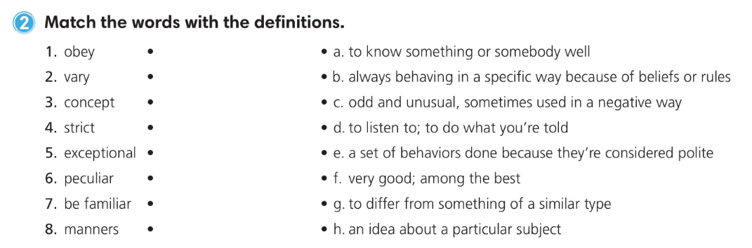

Slide 10
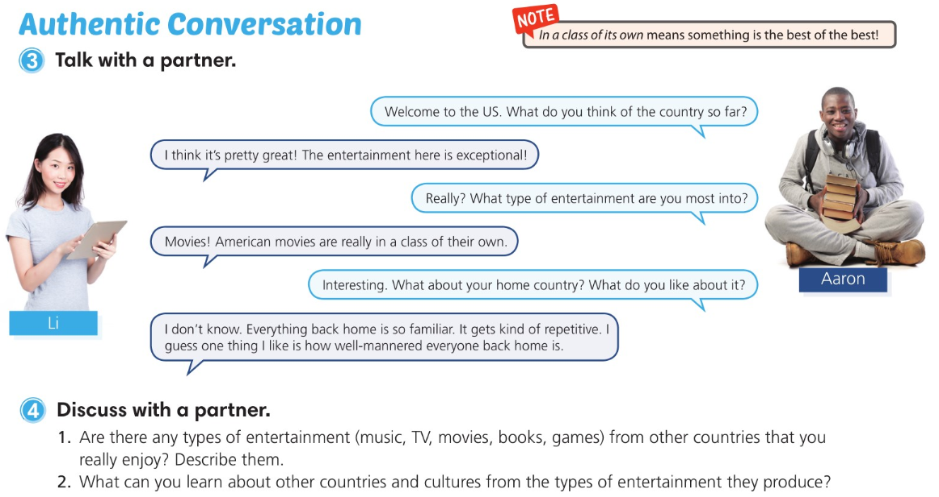

Slide 11
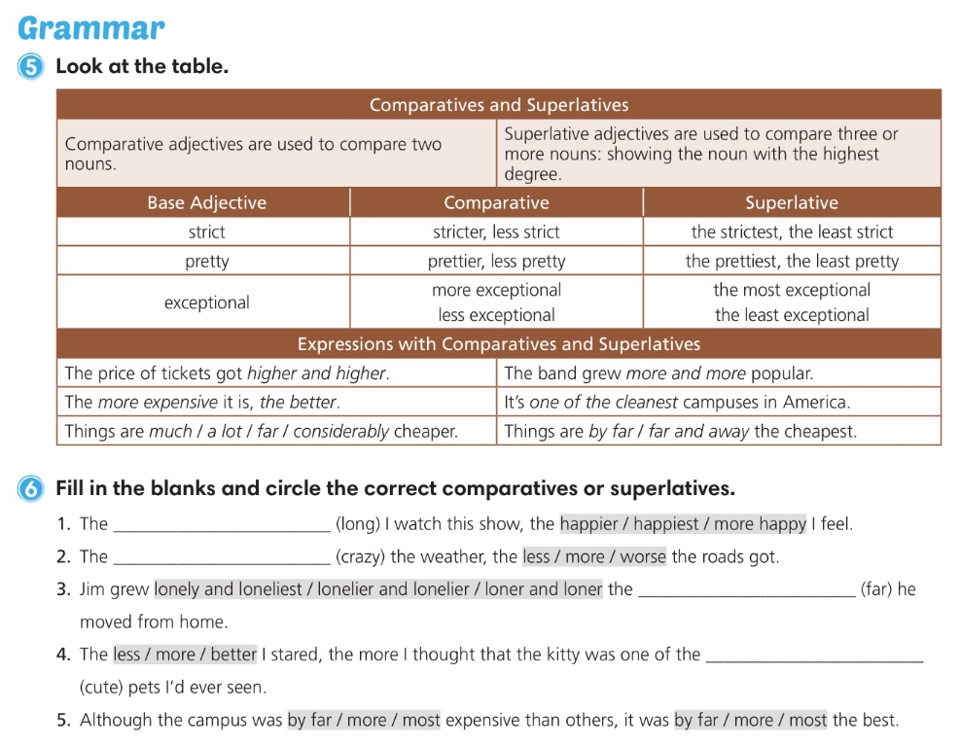
longer
crazier
farther
cutest

Slide 12
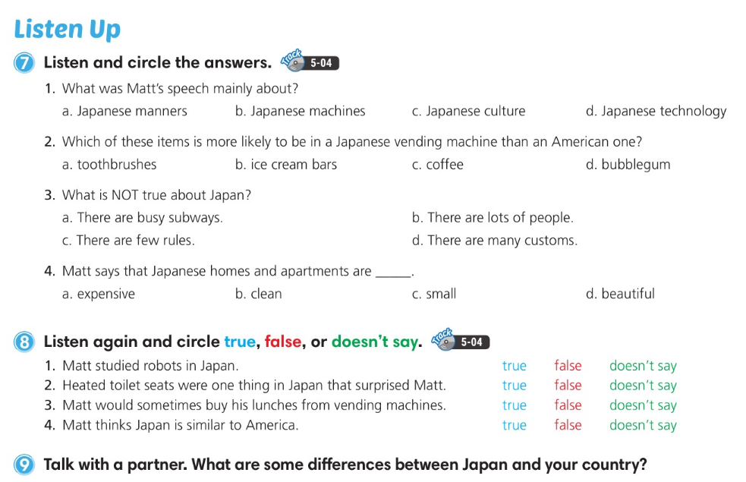

Slide 13
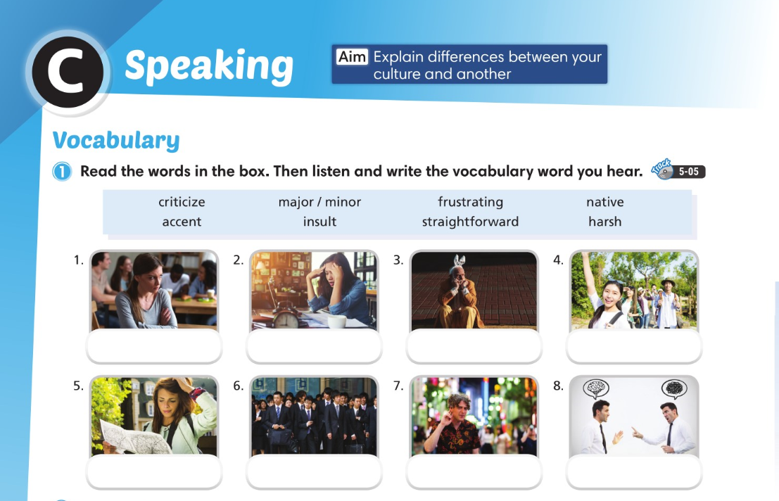
insult
frustrating
harsh
native
straightforward
major
accent
criticize

Slide 14
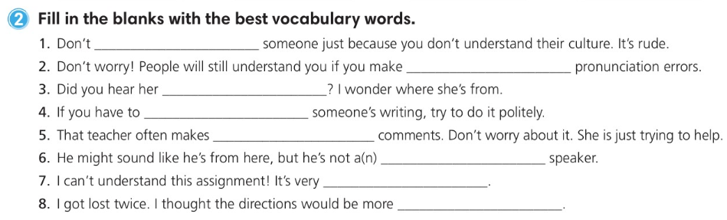
insult
minor
accent
criticize
harsh
native
frustrating
straightforward

Slide 15
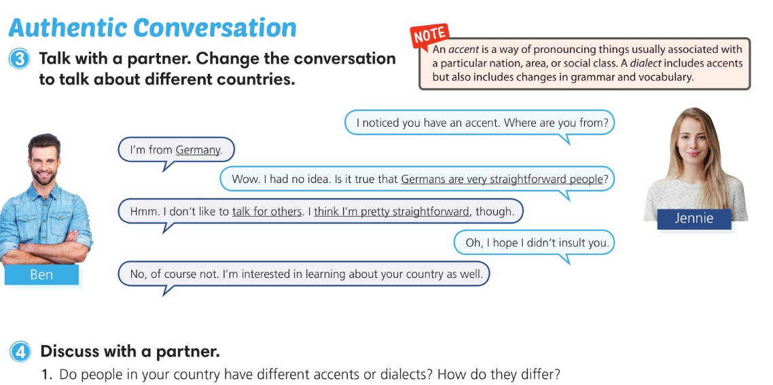

Slide 16
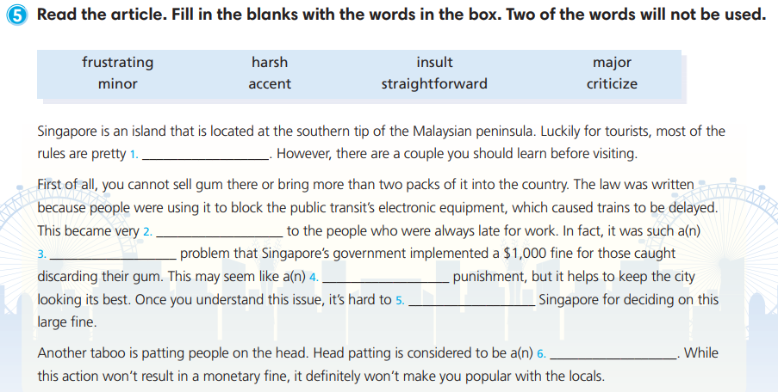
straightforward
frustrating
major
harsh
criticize
insult

Slide 17


Slide 18

6
7
1
3
8
5
4
2

Slide 19
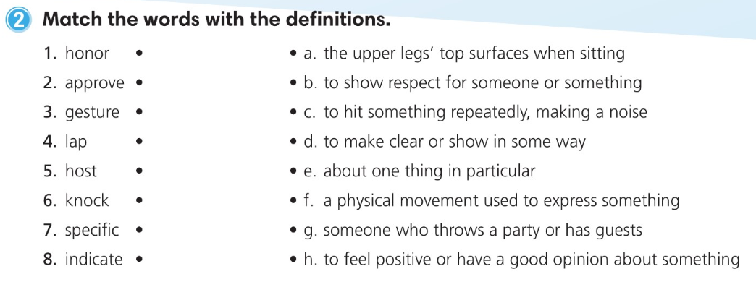

Slide 20
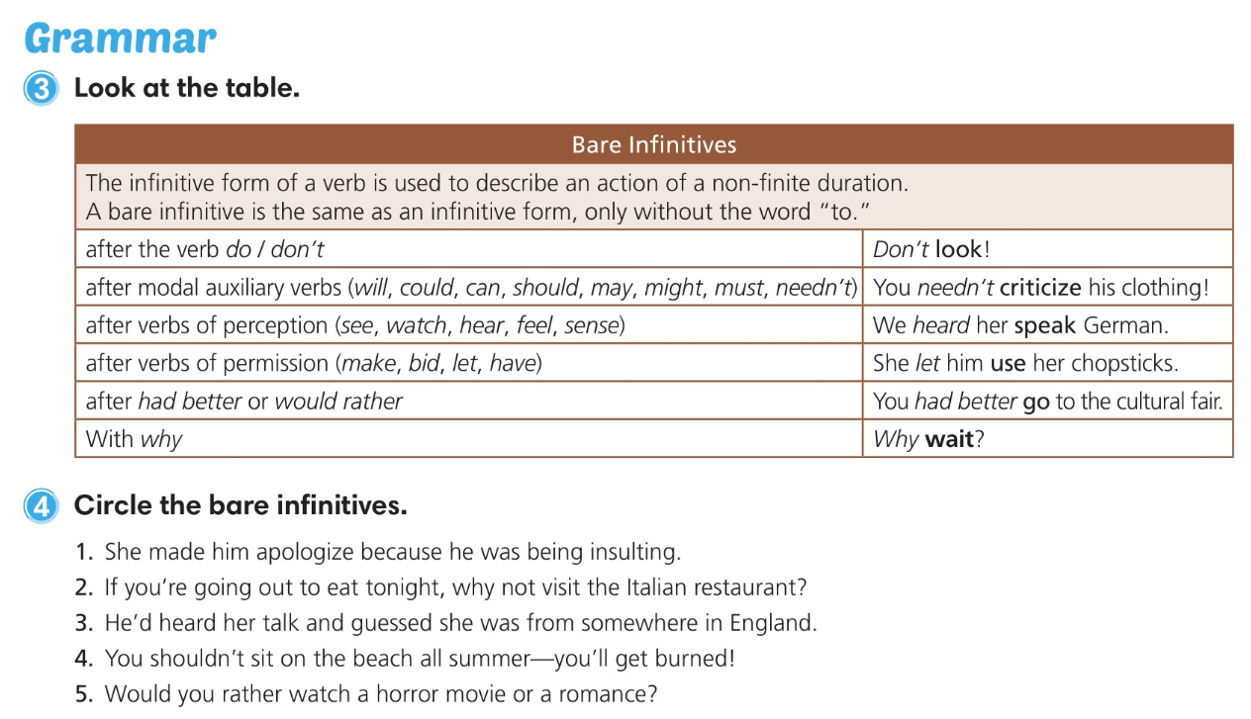

Slide 21
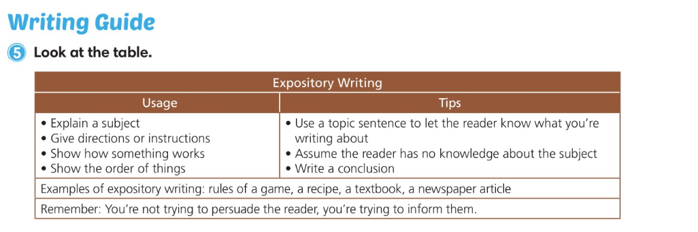

Slide 22
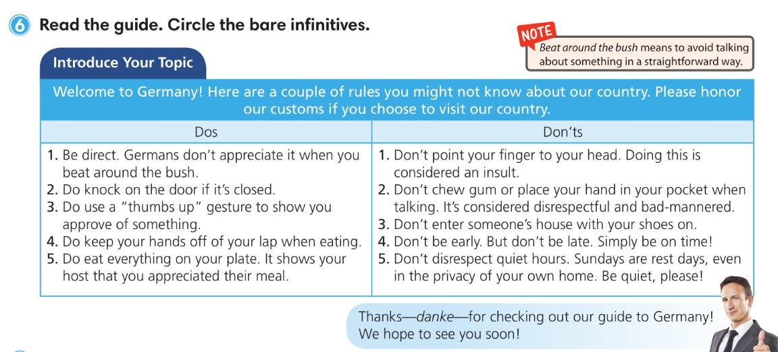

Slide 23


Slide 24
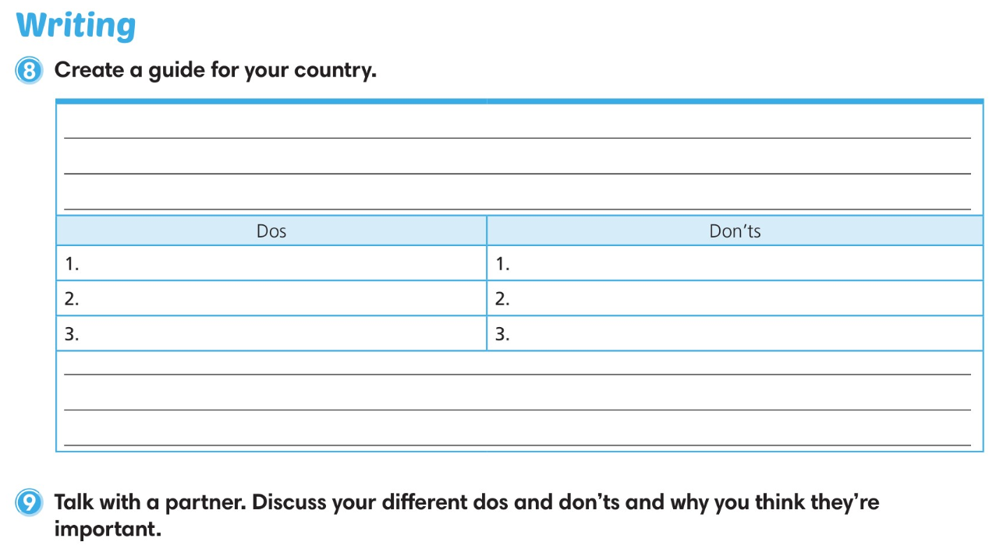

Slide 25
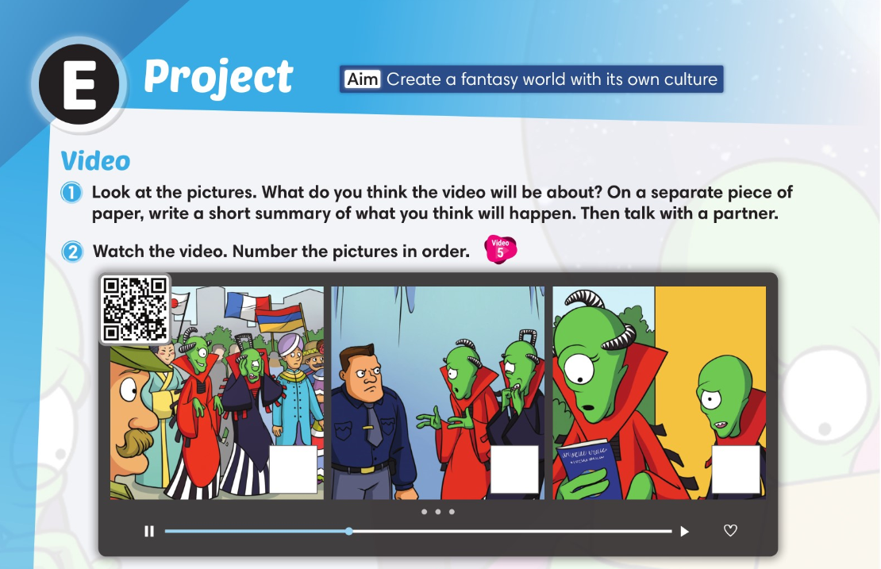
1
2
3

Slide 26
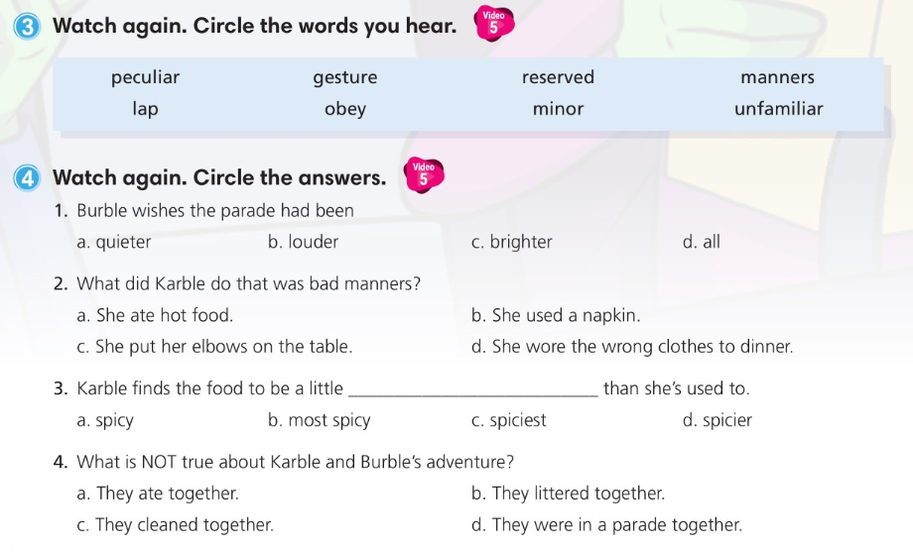

Slide 27
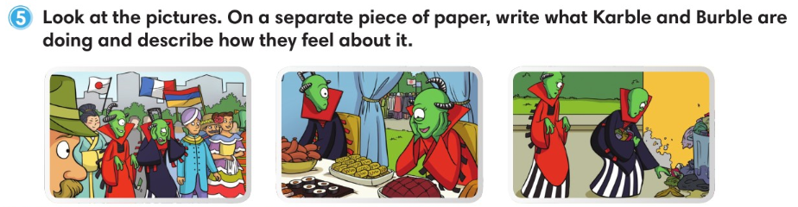

Slide 28
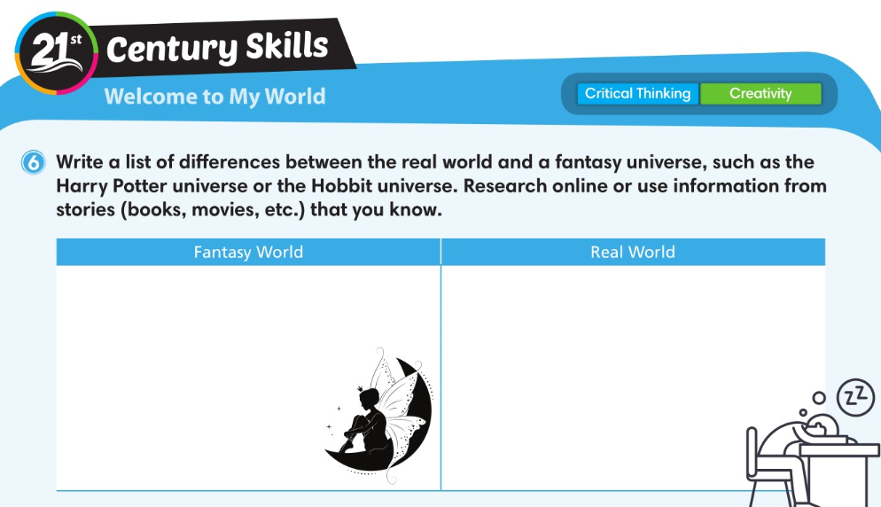

Slide 29
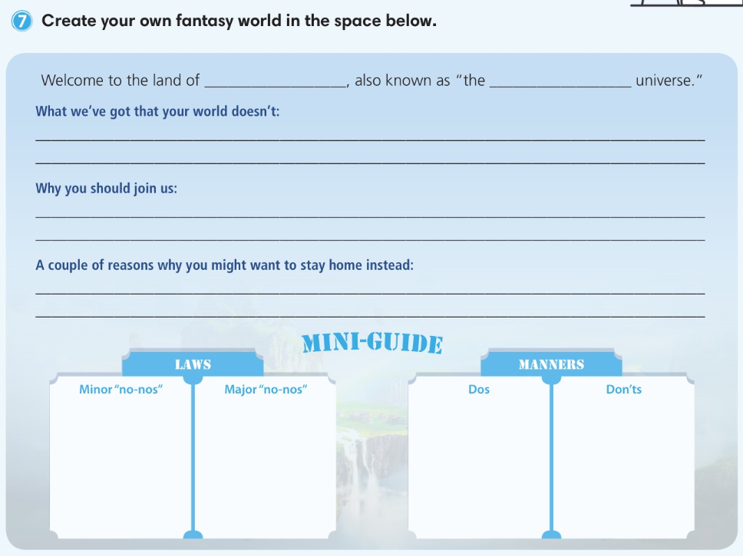

Slide 30


