Slide 1



Slide 2


4
1
7
6
5
8
3
2

Slide 3
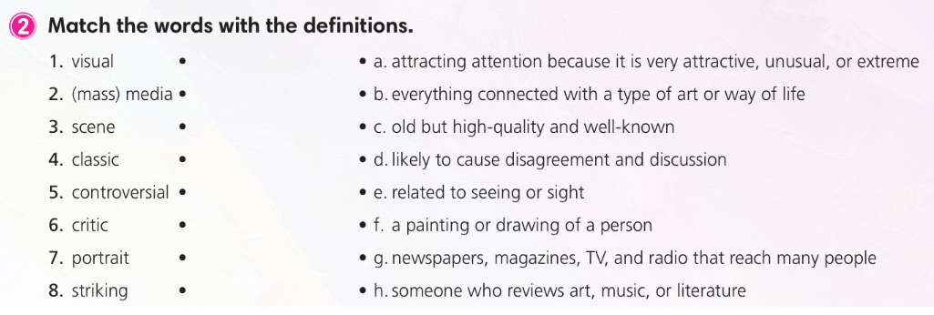

Slide 4
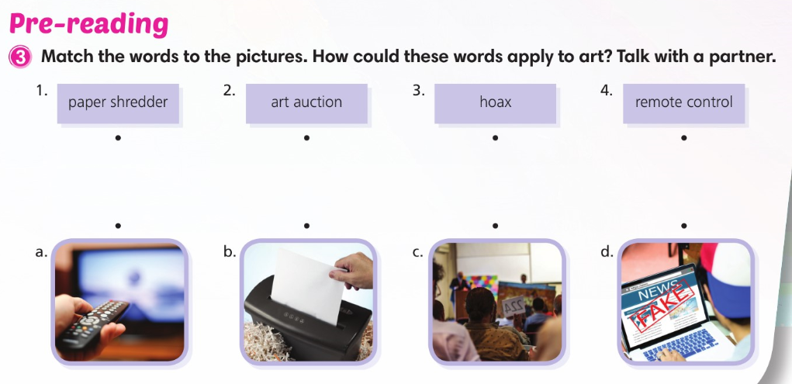

Slide 5
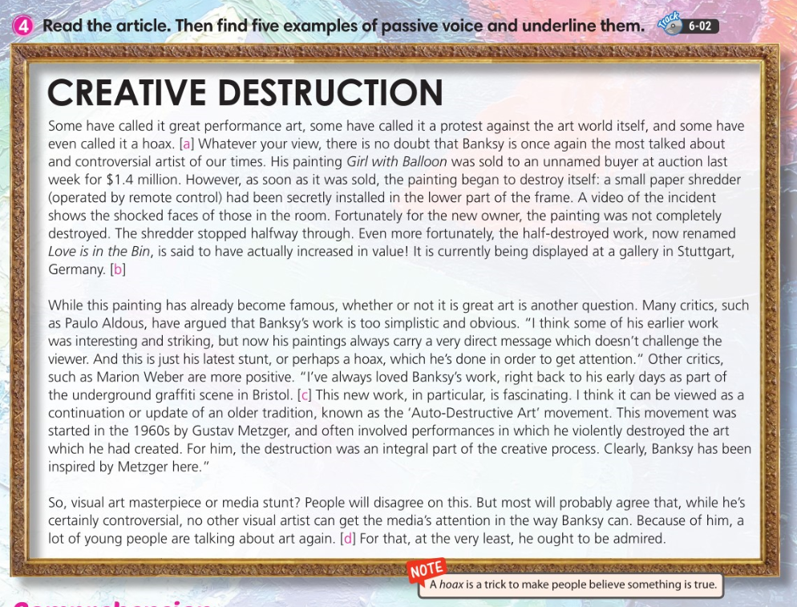


Slide 6
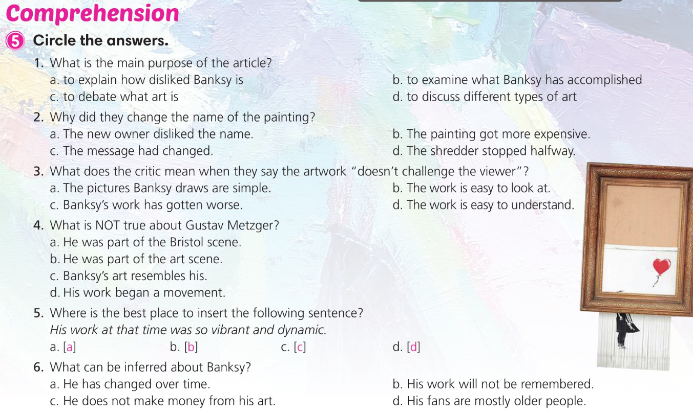

Slide 7
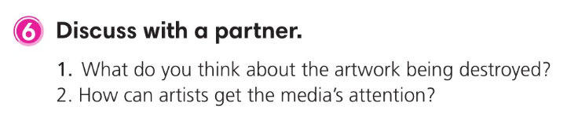

Slide 8

8
5
3
1
2
6
4
7

Slide 9
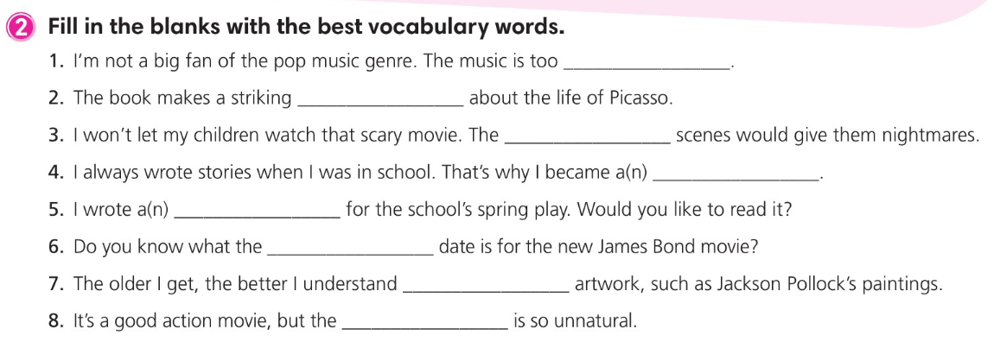
commercial
observation
violent
novelist
script
release
abstract
dialogue

Slide 10
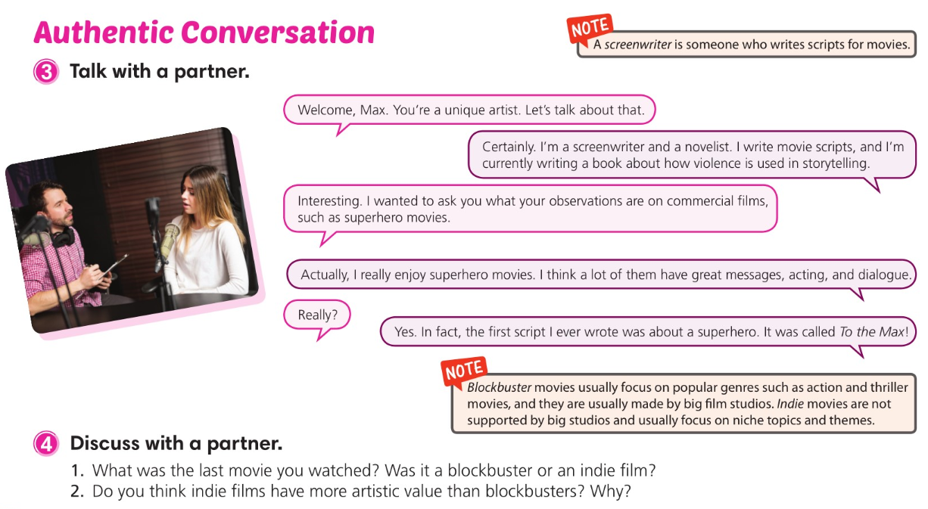

Slide 11
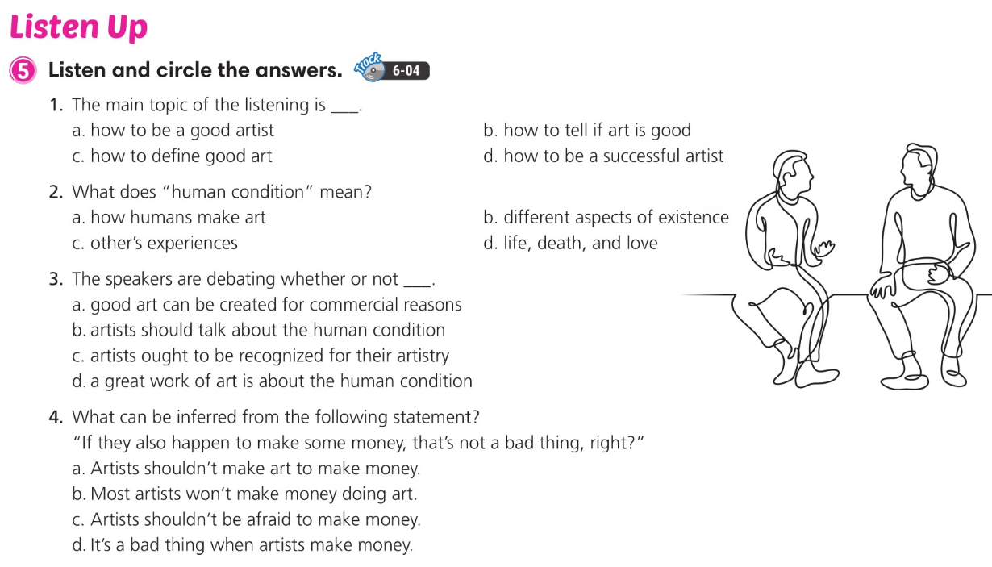

Slide 12
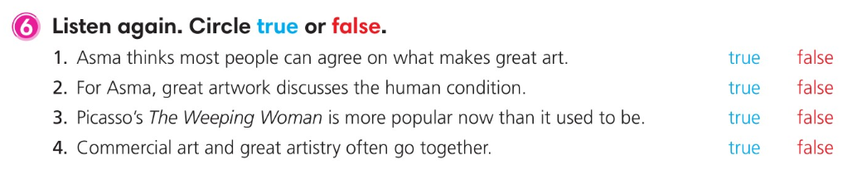

Slide 13
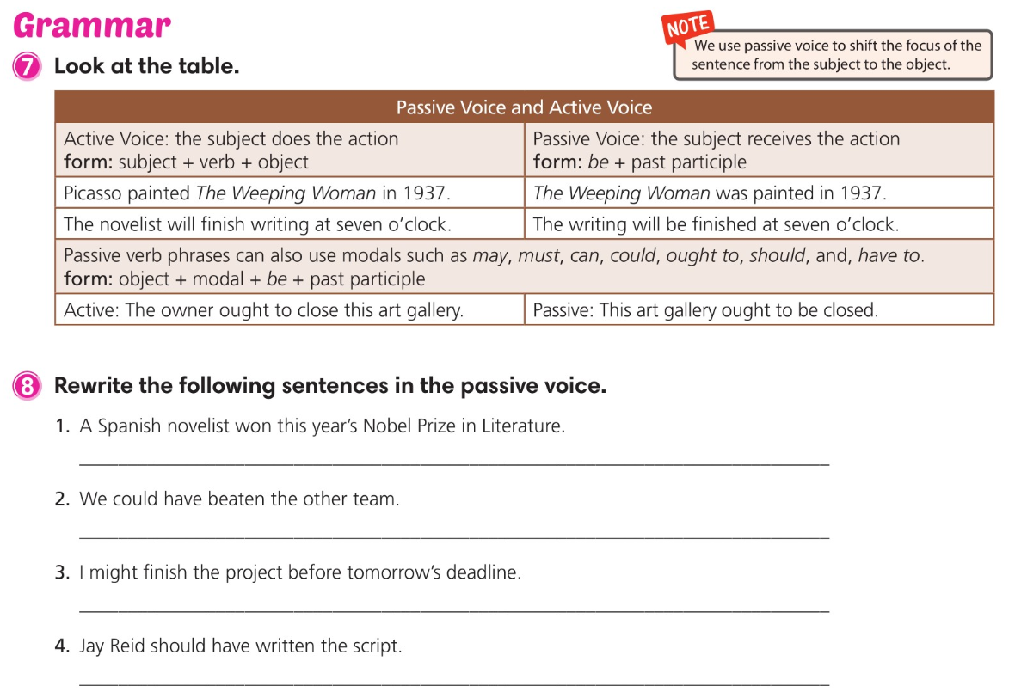
This year’s Nobel Prize in literature was won by a Spanish novelist.
The other team could have been beaten.
The project might be finished before tomorrow’s deadline.
The script should have been written by Jay Reid.

Slide 14

3
7
2
1
4
5
6
8

Slide 15
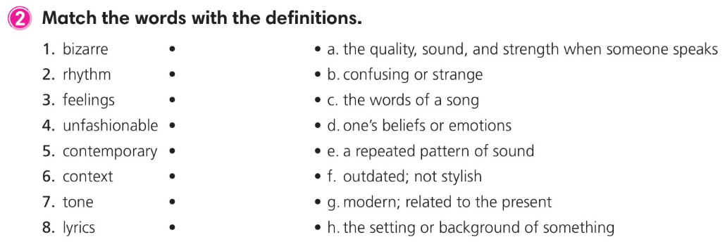

Slide 16
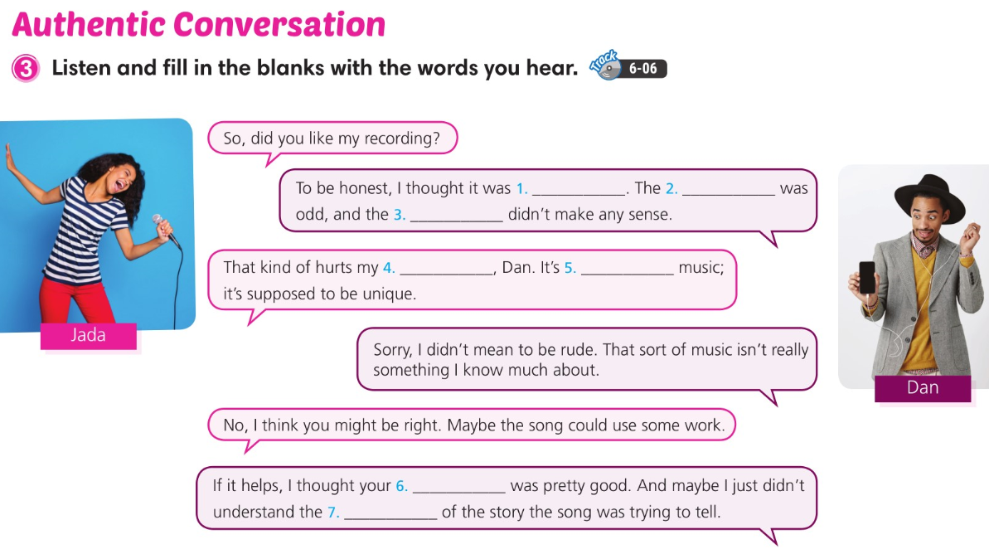
bizarre
rhythm
lyrics
feelings
contemporary
tone
context

Slide 17
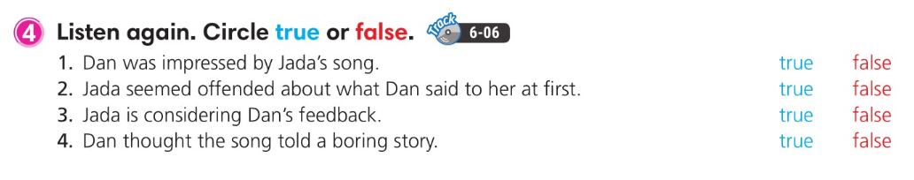

Slide 18
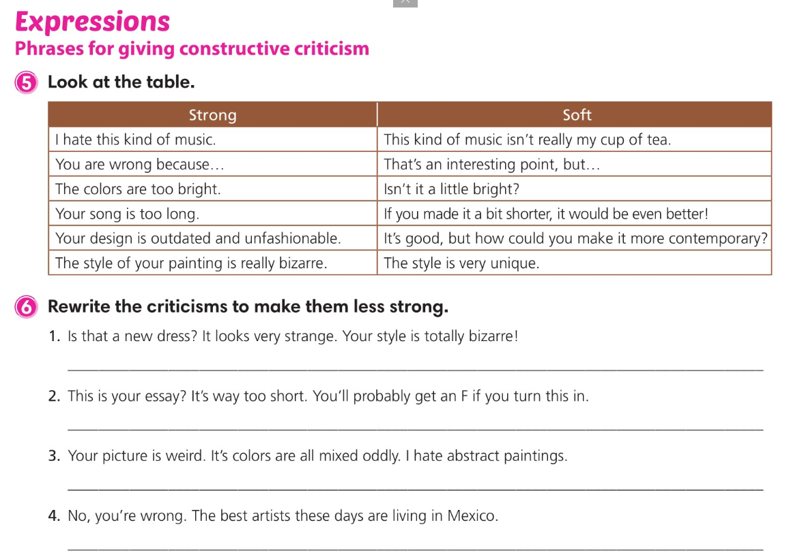
Is that a new dress? It’s very unique.
This is your essay? If you make it a bit longer, you’ll get a better grade on it.
Your picture is very unique, but abstract paintings aren’t my cup of tea.
That’s an interesting point, but I think the best artists are living in Mexico these days.

Slide 19
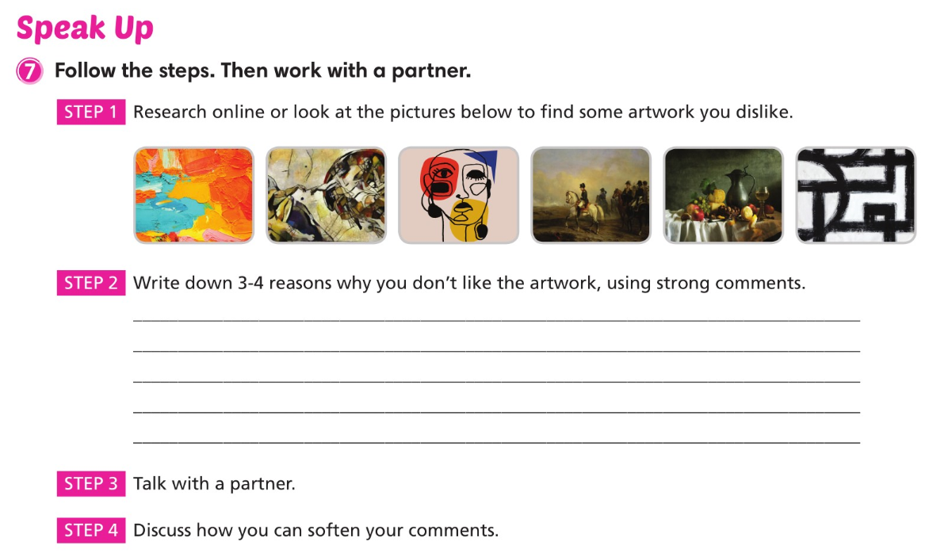

Slide 20

2
4
1
3
8
7
5
6

Slide 21
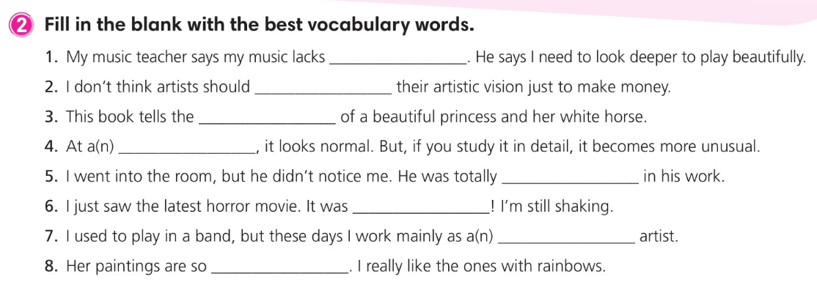
soul
compromise
tale
glance
absorbed
terrifying
solo
colorful

Slide 22
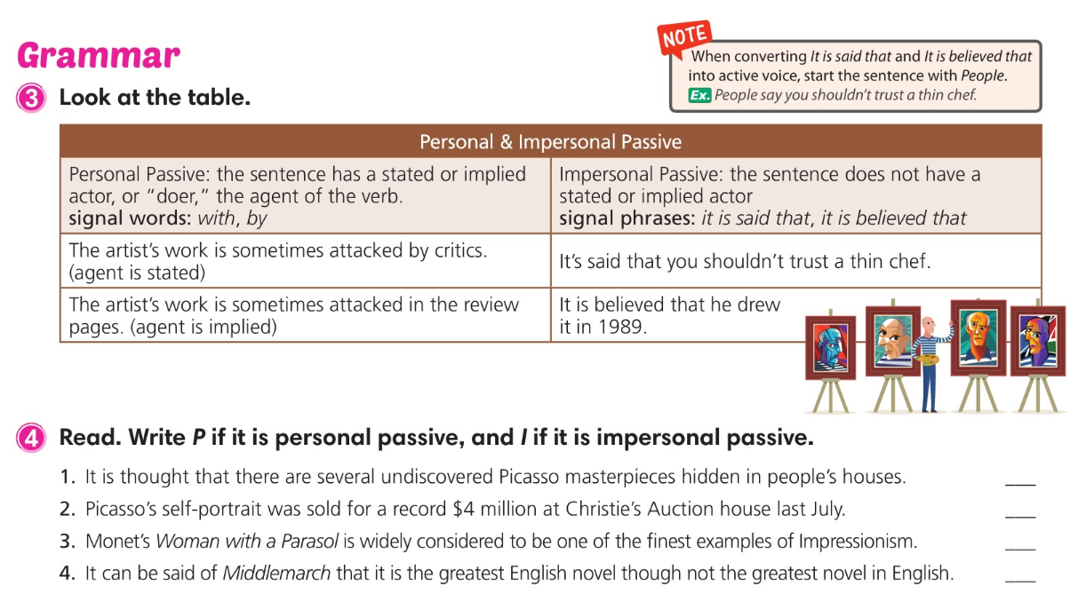
I
P
P
I

Slide 23
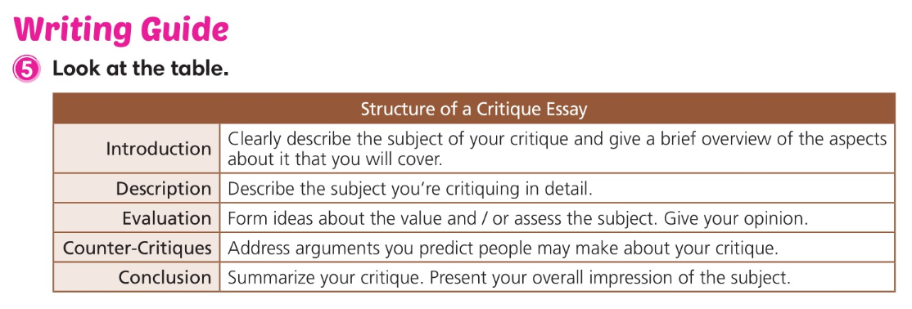

Slide 24
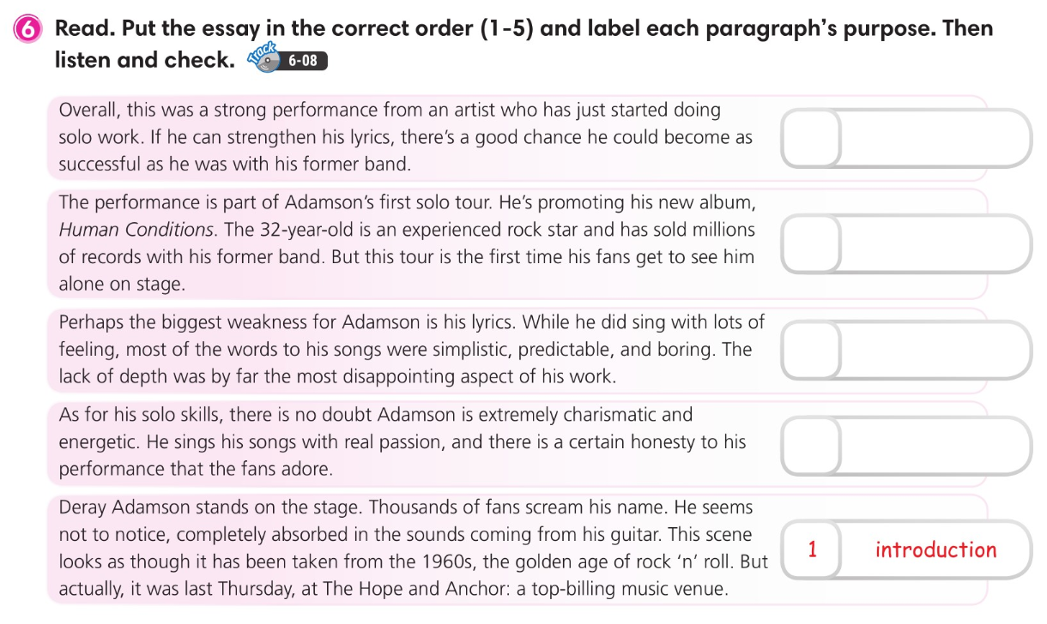
5
conclusion
2
description
4
counter critiques
3
evaluation

Slide 25
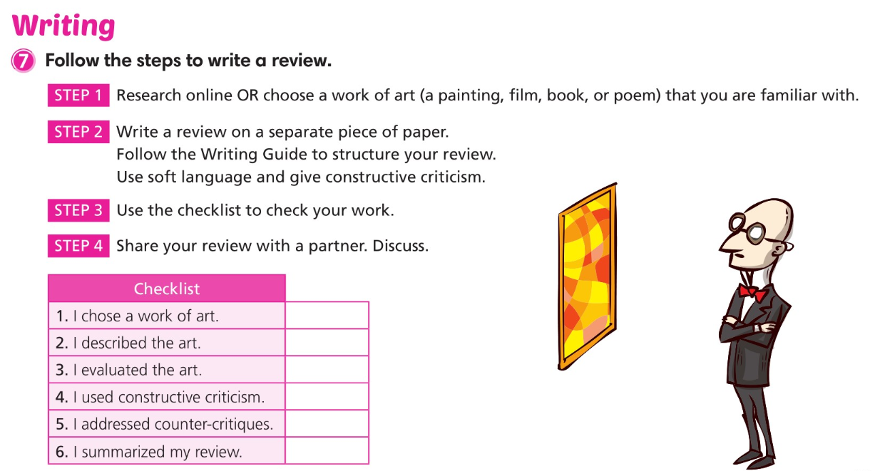

Slide 26
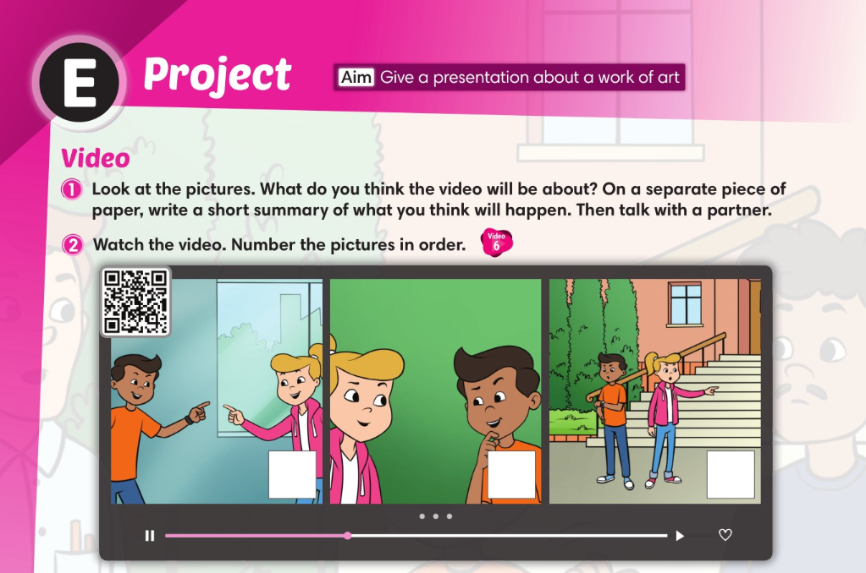
1
3
2

Slide 27
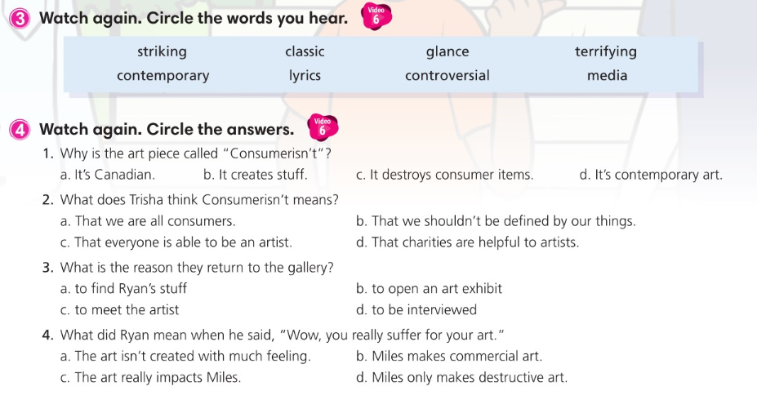

Slide 28
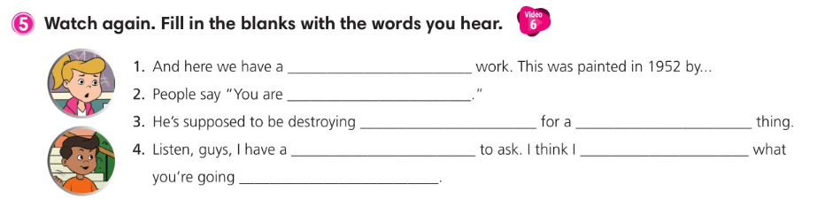
classic abstract
what you eat
his possessions
contemporary art
favor
can guess
to say

Slide 29
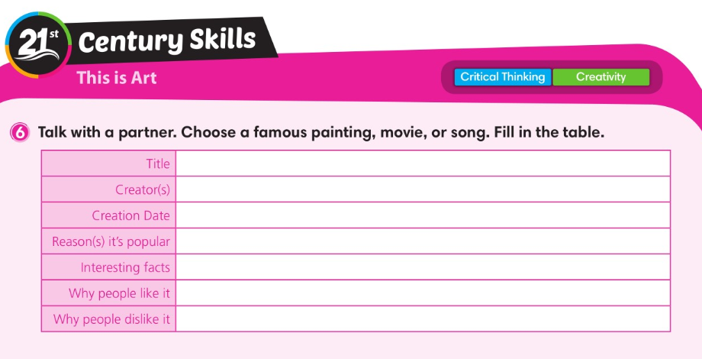

Slide 30
