Slide 1


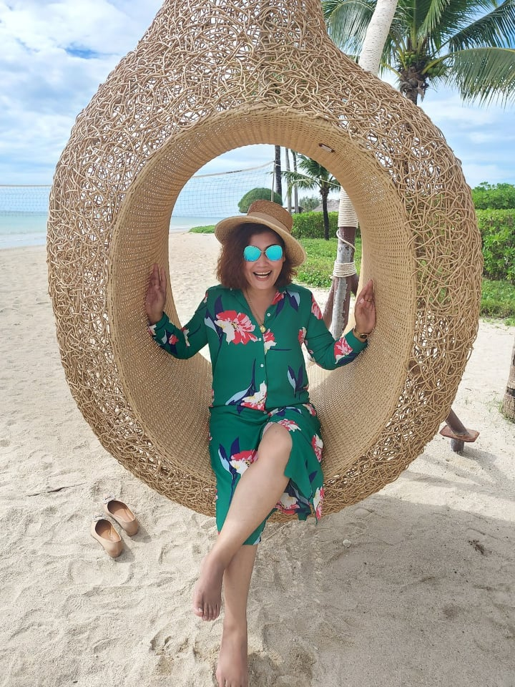
What
are
you
doing?

Slide 2
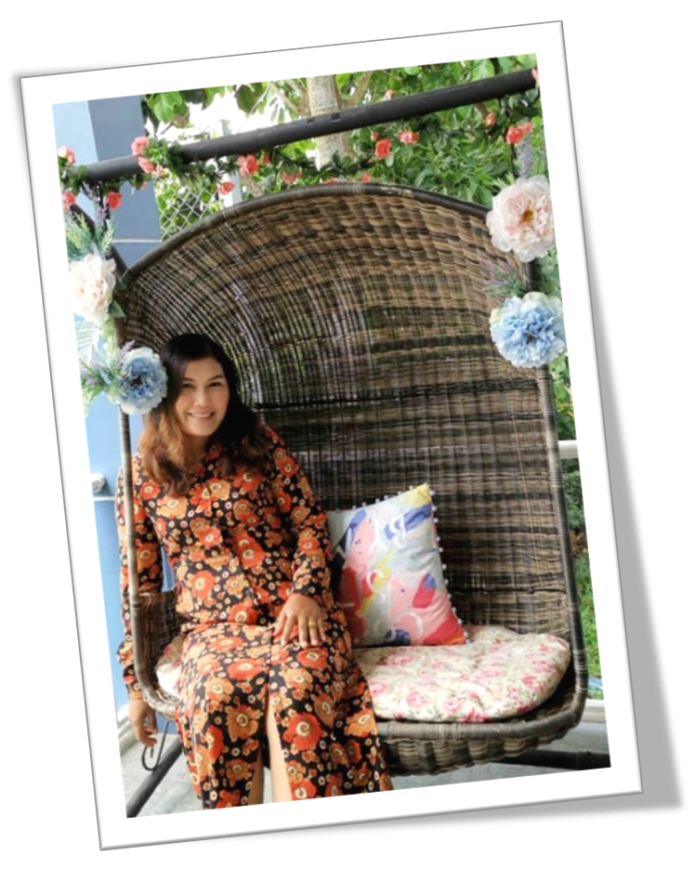
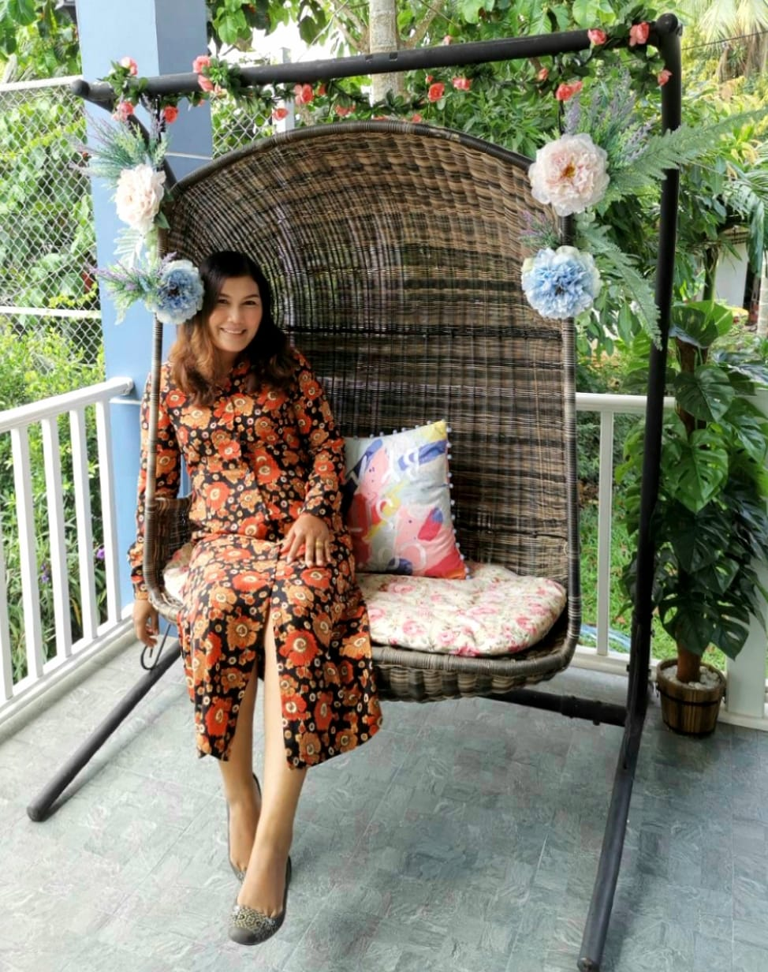
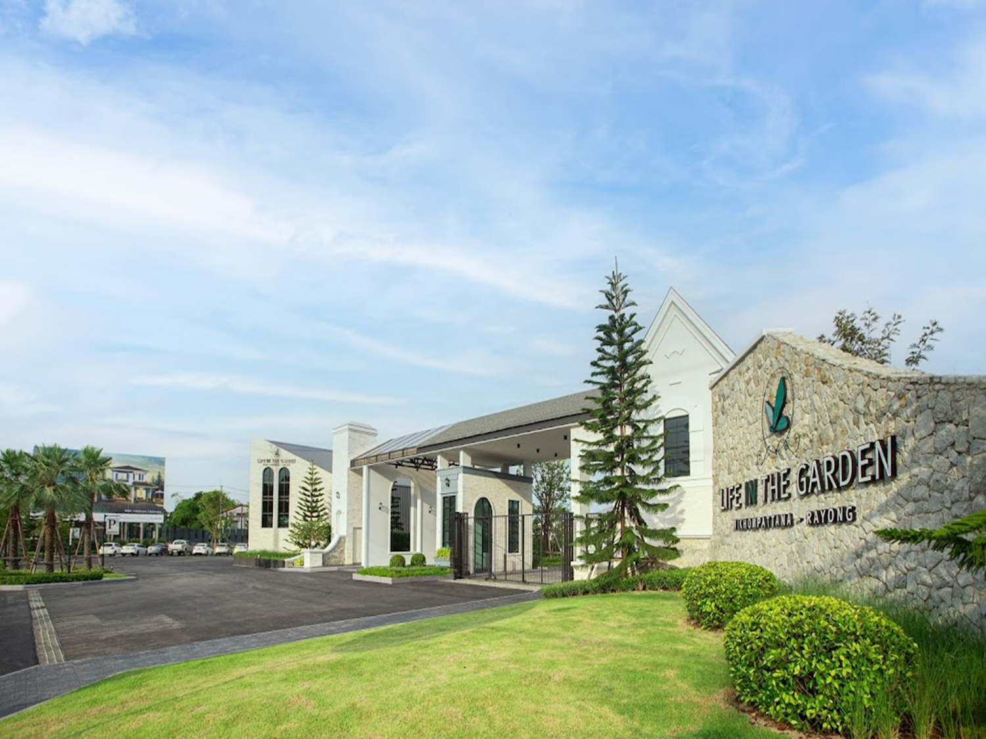
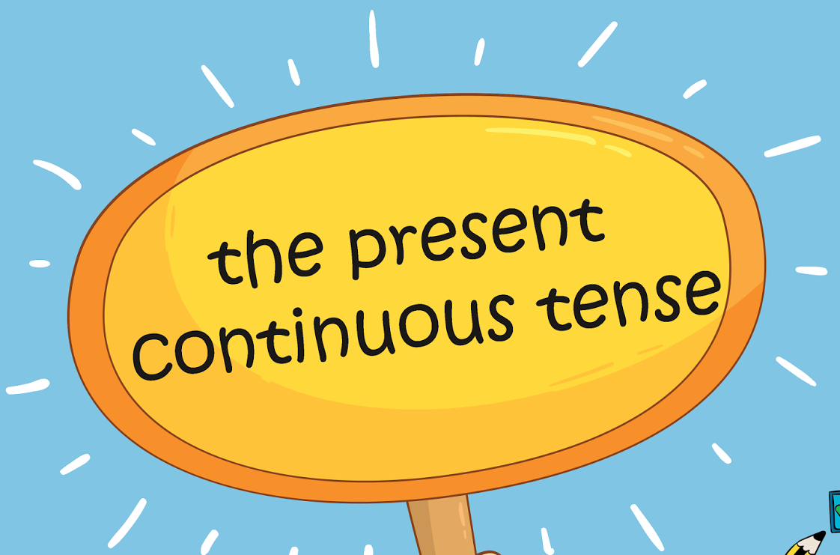


Slide 3
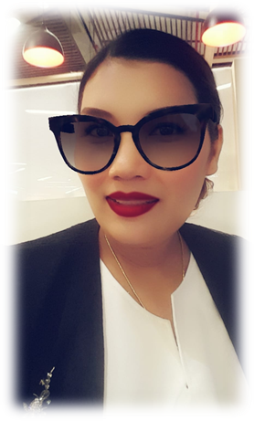
What are you doing?
I am teaching 1/10 class.
I’m …………………………..
I’m …………………………..
I’m driving a car on the way .

Slide 4

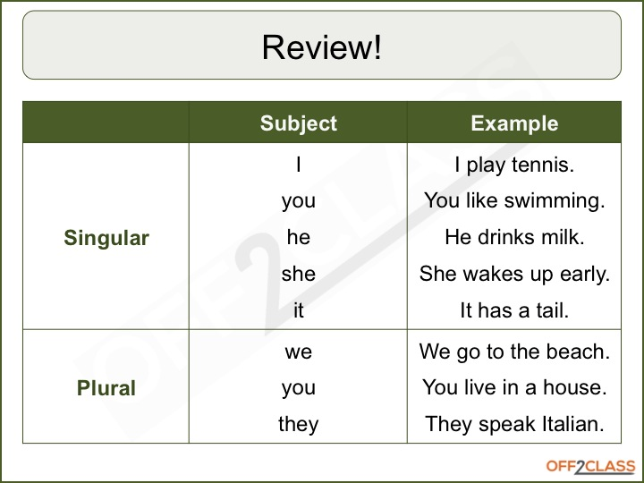

Subject pronoun

Slide 5
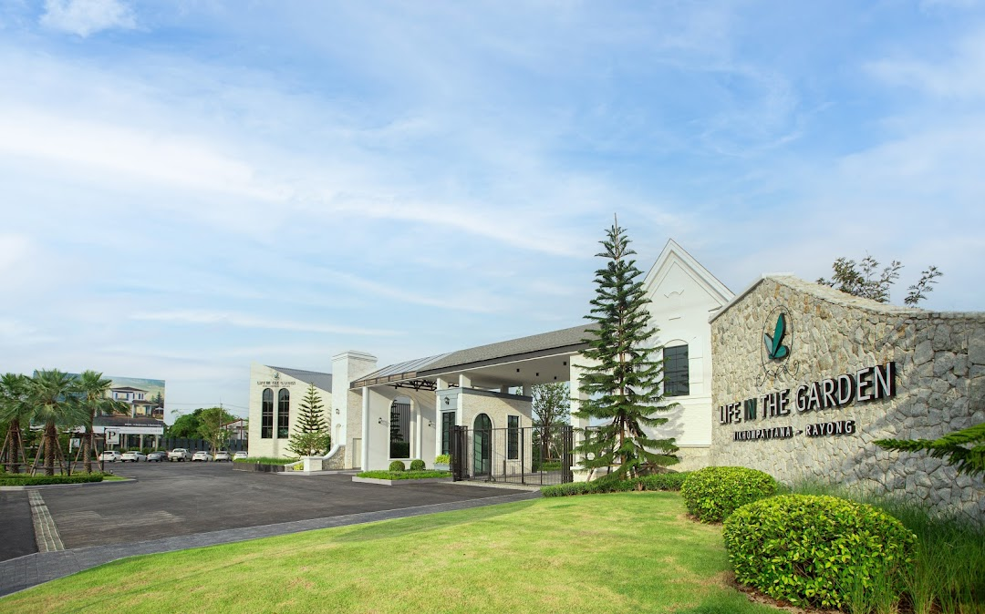

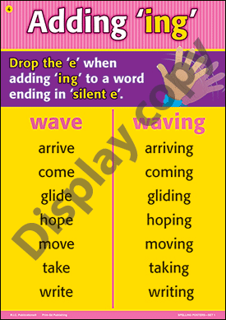


Slide 6
Consonants and Vowels
Vowels are the letters: a, e, i, o, u and sometimes y.
a
e
i
o
u
Consonants are all the other letters, such as: b, d, t, s, etc.
a b c d e f g h i j k l m n o p q r s t u v w x y z

Slide 7
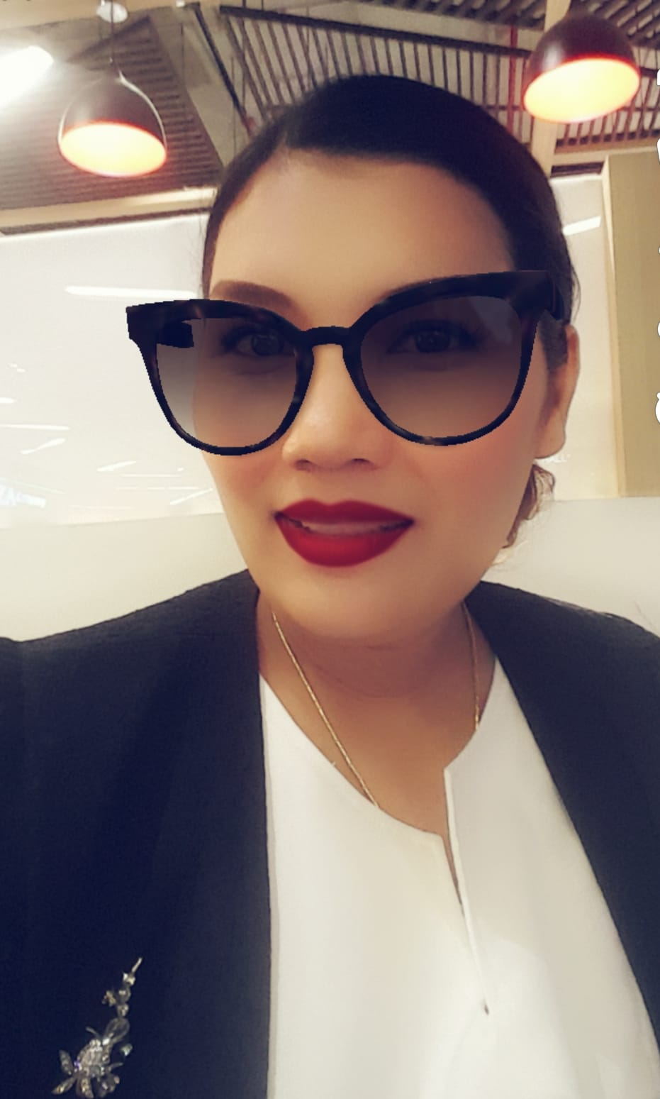
Rule
If the vowel is a short sound with only one consonant after it, then double the consonant in the spelling.

Slide 8

Short Vowel Sounds
nap
beg
hit
put
nap
p
ing
napping
begging
hitting
putting
beg
g
ing
hit
t
ing
put
t
ing

Slide 9
Rule
If the vowel is a short sound but has more than one consonant after it, then add ‘-ing’.
Can you think of any more words like these?

Slide 10
How Many Consonants Are after the Short Vowel?
back
stand
hunt
turn
jump
back
stand
hunt
turn
jump
ing
backing
standing
hunting
turning
jumping
ing
ing
ing
ing

Slide 11
Look…
come
hope
joke
fake
slide
hide
take
com
hop
jok
fak
slid
hid
tak
e
ing
ing
e
e
ing
e
ing
e
ing
e
ing
e
ing

Slide 12
Rules for Adding ‘-ing’
Short vowel sound, with one consonant – double the consonant and add ‘-ing’
hit
t
ing
Short vowel sound, with two consonants – add ‘-ing’
jump
ing
Ending in ‘e’ – drop the ‘e’ then add ‘-ing’
e
sunbath
ing
Long vowel sound – just add ‘-ing’
sail
ing

Slide 13
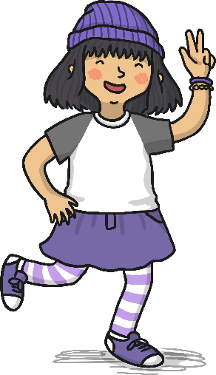
Sort these words into the grid below:
name
drink
snow
hit
skip
paint
drive
Click on a word to check
melt
wash
dive
run
Add ‘-ing’ | Double the consonant | Drop the ‘e’ and add ‘-ing’
drinking
melting
skipping
snowing
hitting
driving
painting
washing
running
diving

Slide 14

Negative form
Subject pronoun/noun + is/am/are + not + main verb + - ing
verb to be
I’m not skiing in the winter.
You aren’t swimming at the sea.
He/She/It isn’t walking a dog in a park.

Slide 15
Negative form
Subject pronoun/noun + is/am/are + not + main verb + - ing
verb to be
We aren’t making a snowman with friends outside.
You aren’t playing beach volleyball because it’s so hot.
They aren’t reading comics in the library right now.

Slide 16


Question form ?
Verb to be + noun/ subject pronoun + verb –ing ?
is, am ,are
Is she visiting the floating market?
Yes, she is.
No, she isn’t.
No, she is watching TV at home.

Slide 17


Slide 18
Form complete sentences.
Use the present continuous.
Dad/swim
ANSWER
Dad is swimming at the pool.

Slide 19

Form complete sentences.
Use the present continuous.
They/sunbathe
ANSWER
They are sunbathing on the beach.

Slide 20

Form complete sentences.
Use the present continuous.
Tony/read
ANSWER
Tony is reading comics right now.

Slide 21
Form complete sentences.
Use the present continuous.
Claire/take
ANSWER
Claire is taking photos people.

Slide 22

Form complete sentences.
Use the present continuous.
Mum/have
ANSWER
Mum is having a hot chocolate.

Slide 23


Form complete sentences.
Use the present continuous.
Mary and Phil/play football
ANSWER
Mary and Phil are playing football.

Slide 24

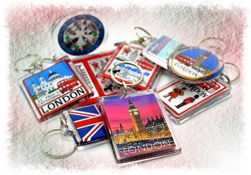
Form complete sentences.
Use the present continuous.
Bill /shop /for souvenirs
ANSWER
Bill is shopping for souvenirs.

Slide 25
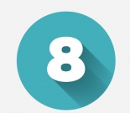
Form complete sentences.
Use the present continuous.
I/make/a sandcastle
ANSWER
I am making a sandcastle.

Slide 26
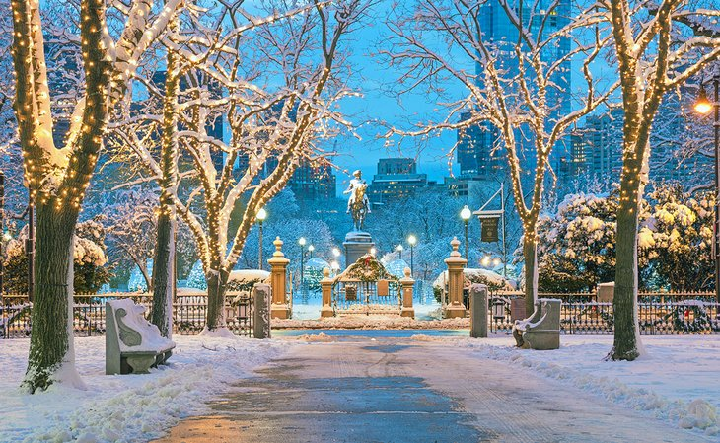


Slide 27
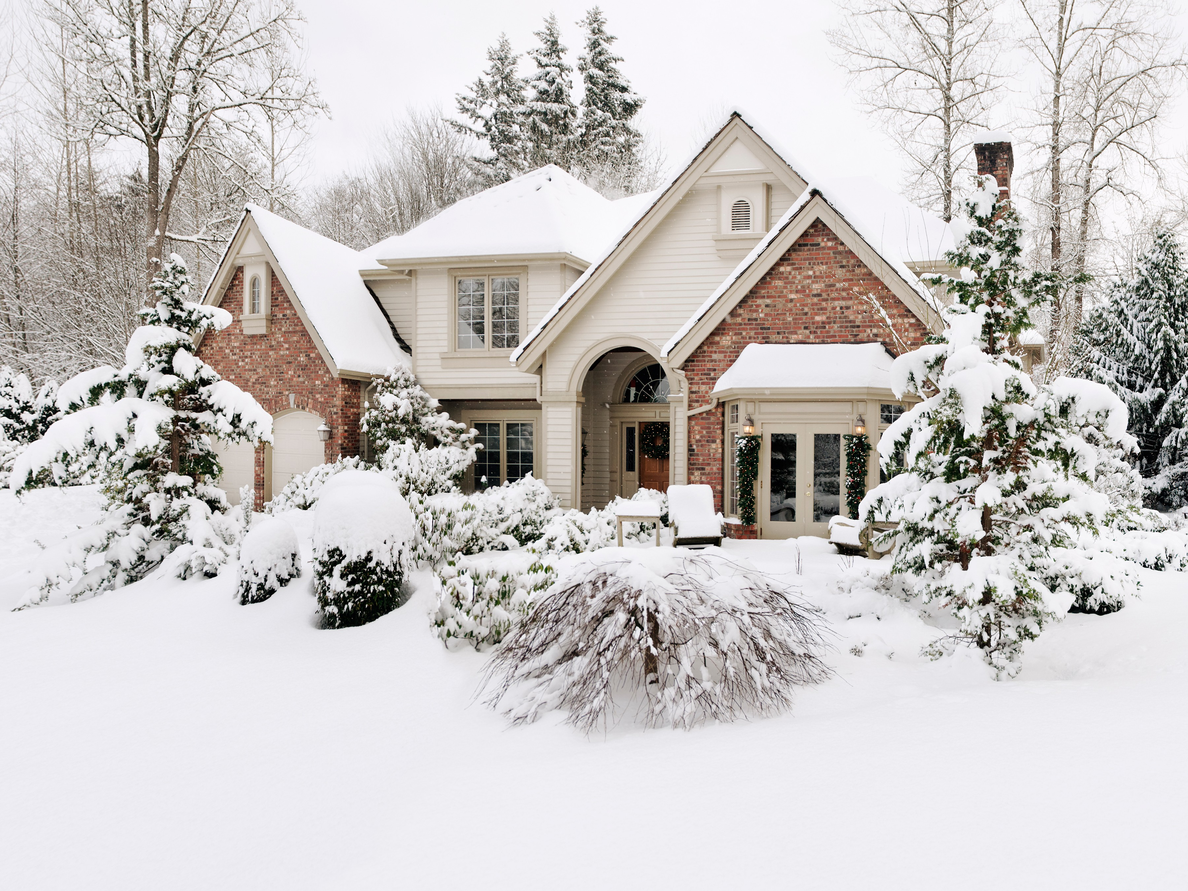
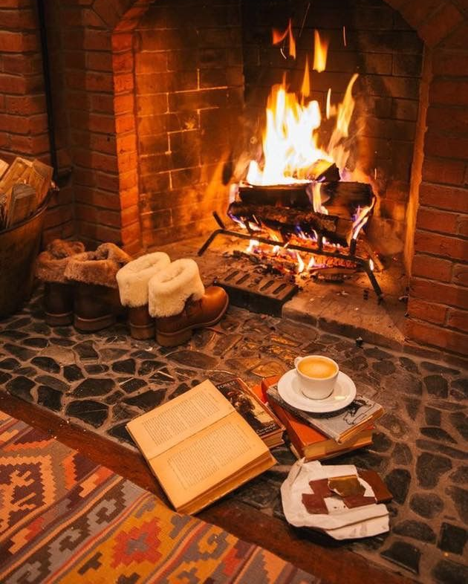
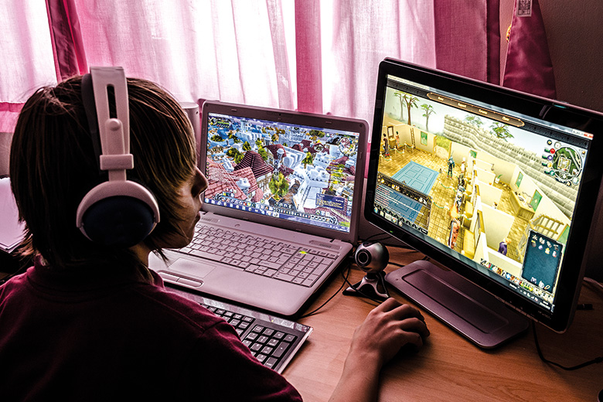
season
weather
activity
seeing a movie
having hot chocolate
making a snowman
having a coffee
eating snacks
reading a book
playing computer games

Slide 28

Make your sentences by
using present continuous

Slide 29
Season: In winter
We are having hot chocolate in the living room.
We aren’t making a snowman outside.
Are we reading books in the afternoon?
- No, we aren’t.

Slide 30
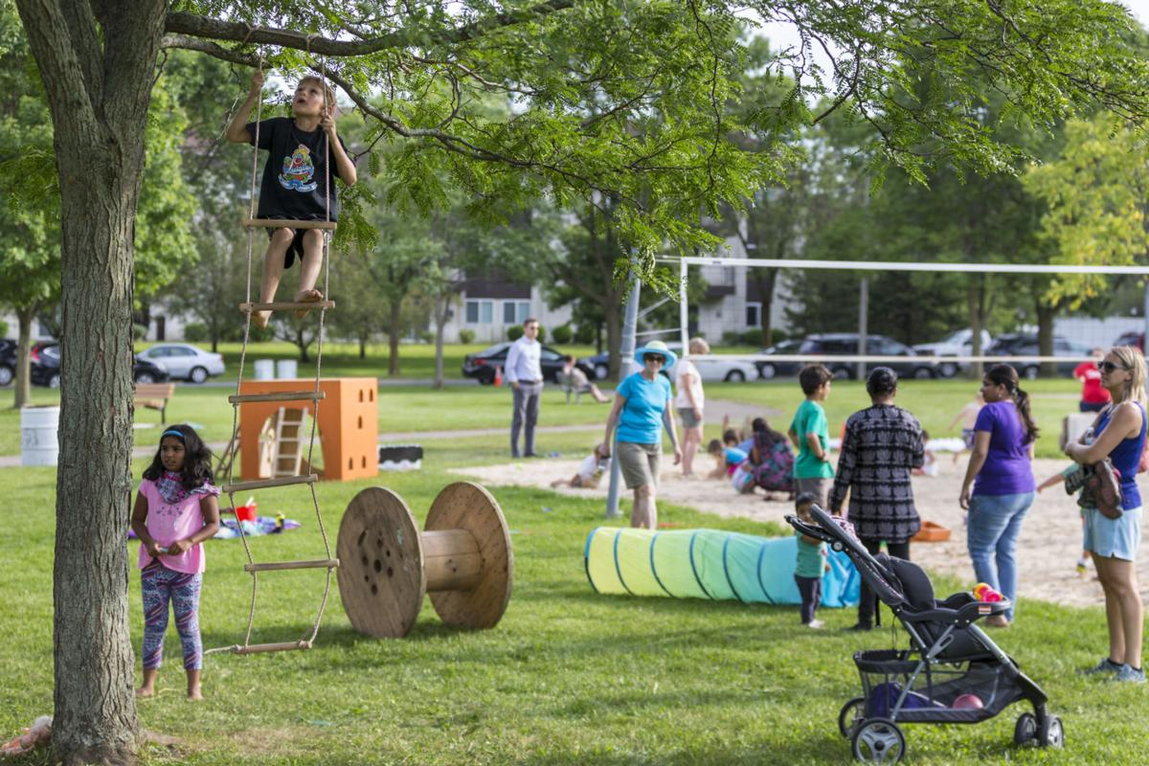
At the park
A little boy is climbing on the ladder.
He isn’t playing the toys .
Is he running with his friends?
- No, he isn't.

Slide 31
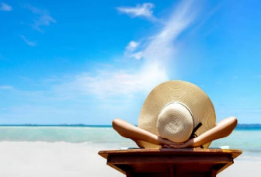
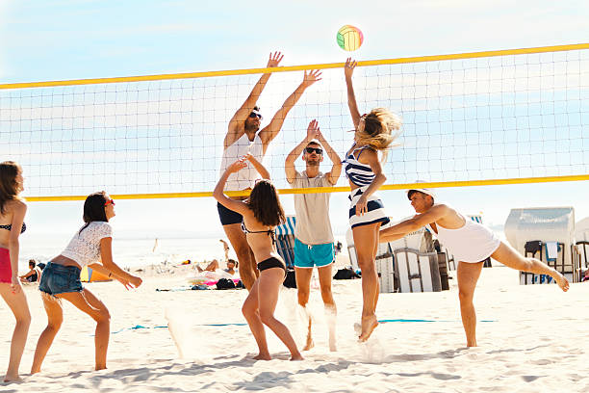

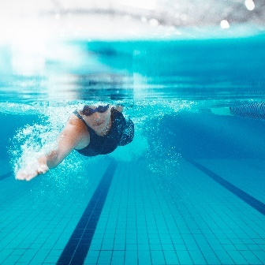
Homework (10 points)
Wednesday 27th December 2023
Make your sentences by using present continuous with season or activity in your notebook. (10 items) “in class”
*** Due Date : Thursday 28th 2023
Ex.
Massalin is sunbathing on the beach.
She isn't playing beach volleyball Is she swimming with her family?
- Yes, she is.
- No, she isn't.
At the beach

Slide 32
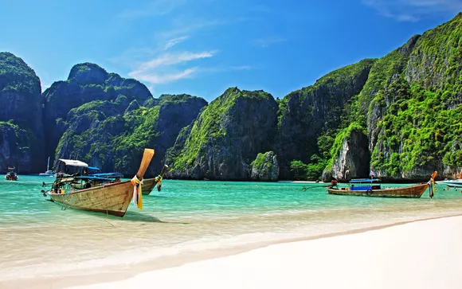

Homework
Thursday 28th December 2023
Prepare a postcard to write on Tuesday 3rd January 2024.

Slide 33
Homework (10 points)
Thursday 28th December 2023
Make your sentences by using present continuous with season or activity in your notebook. (10 items)
*** Due Date : Thursday 28th 2023 at the office room 331
Ex.
Massalin is sunbathing on the beach.
She isn't playing beach volleyball Is she swimming with her family?
- Yes, she is.
- No, she isn't.
At the beach

Slide 34
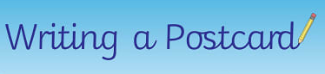
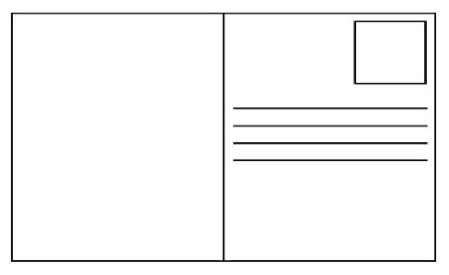

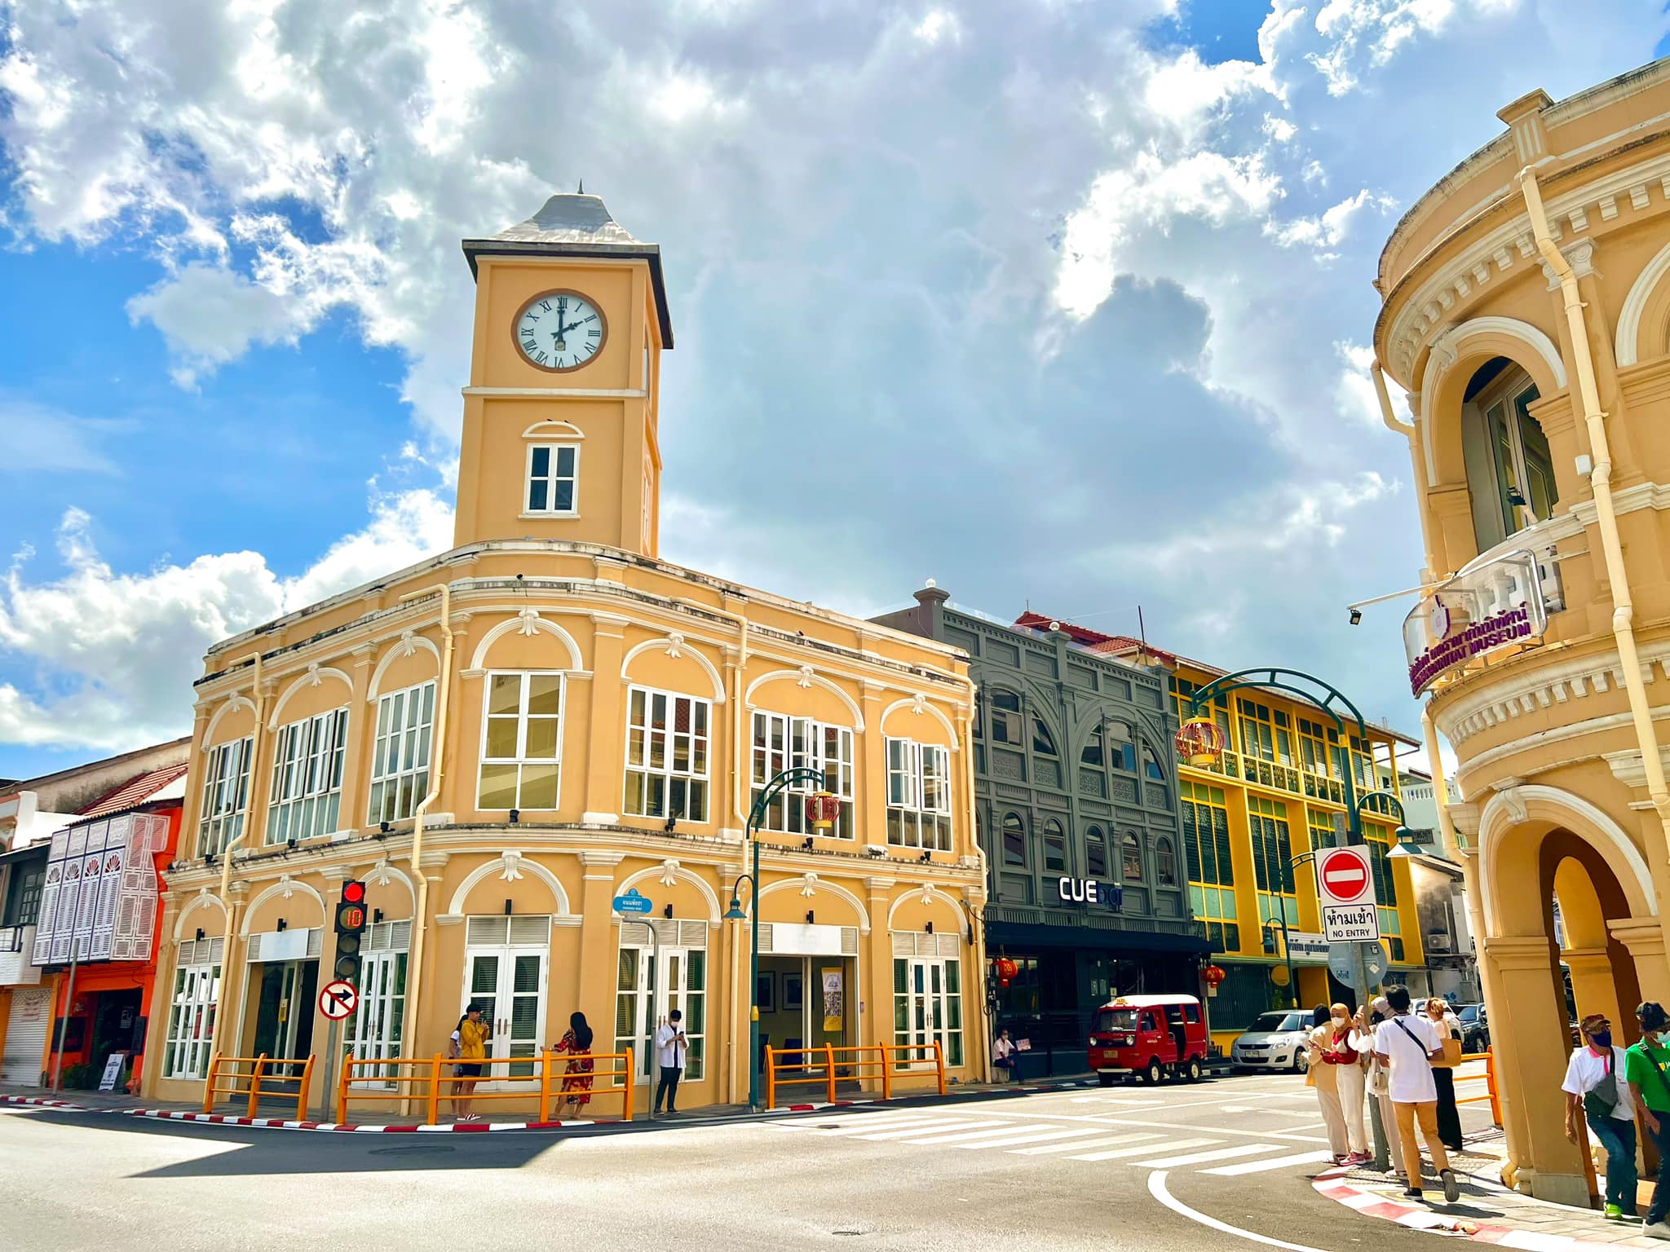
Dear Teacher Massalin
Greeting from Phuket. I’m staying in 5 stars hotel with family. It’s a wonderful holiday. The weather is sunny with clear sky, it’s pretty day. Mom and dad are exercising at a gym and my sisters are taking photos at the old town. I always go shopping at the cafe. Tomorrow, we’re buying for souvenirs at Central. We love it.
Talk to you soon.
Jida
Mrs.Massalin Makkasin
388 Taladmai Road
Suratthani
Thailand 84000

Slide 35
Homework (10 points)
Wednesday 3rd January 2024
-Imagine you and your family are on a holiday.
-Write a postcard to your teacher
-Use the plan 50-60 words.
Focus on : 1. Weathers / Season
2. Activities
3. Using Present Continuous Tense
4.Adverb of frequency
***Due Date : Thursday 4th January 2024 “in class”

