Slide 1
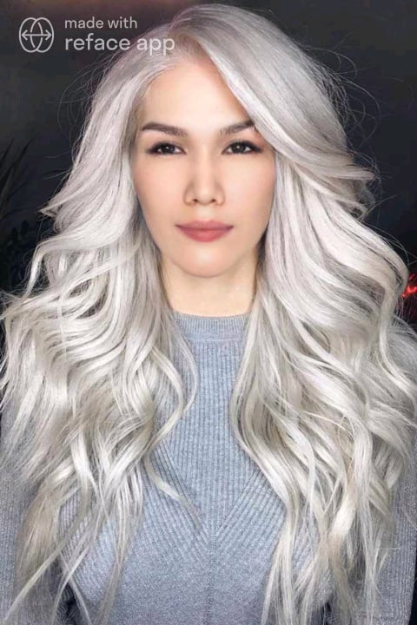



Slide 2




Slide 3


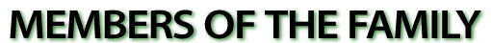

Slide 4
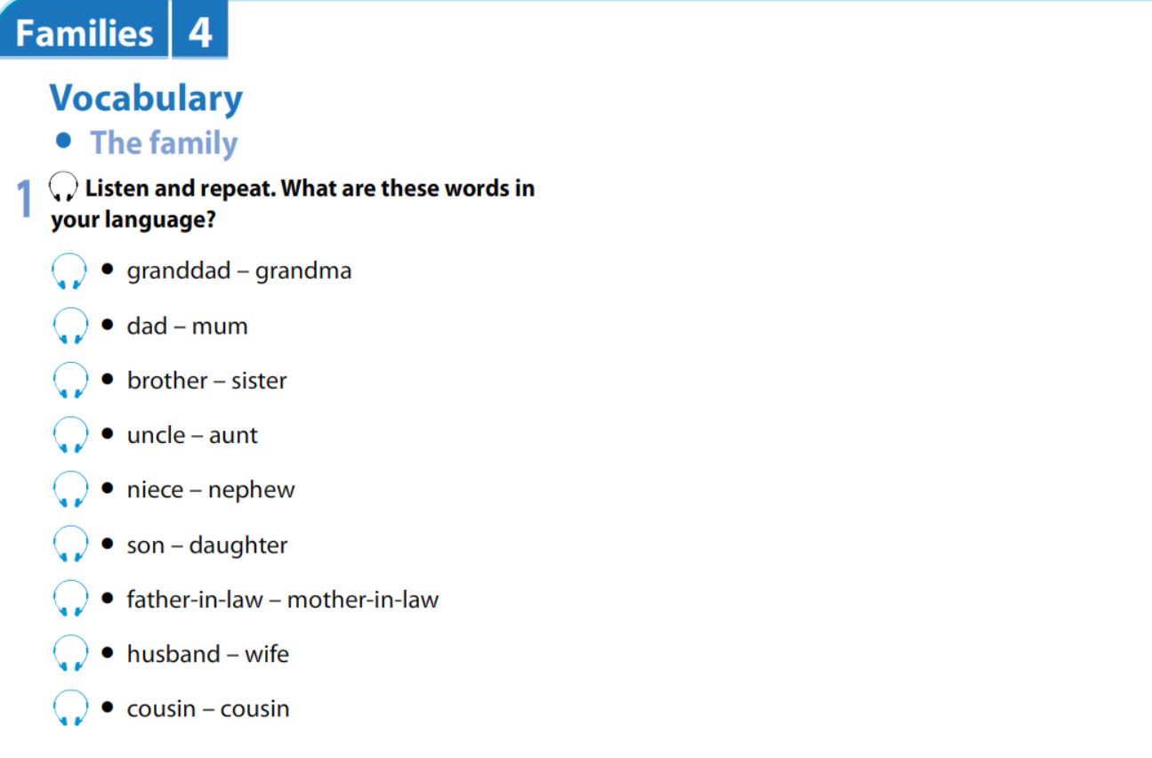

Slide 5
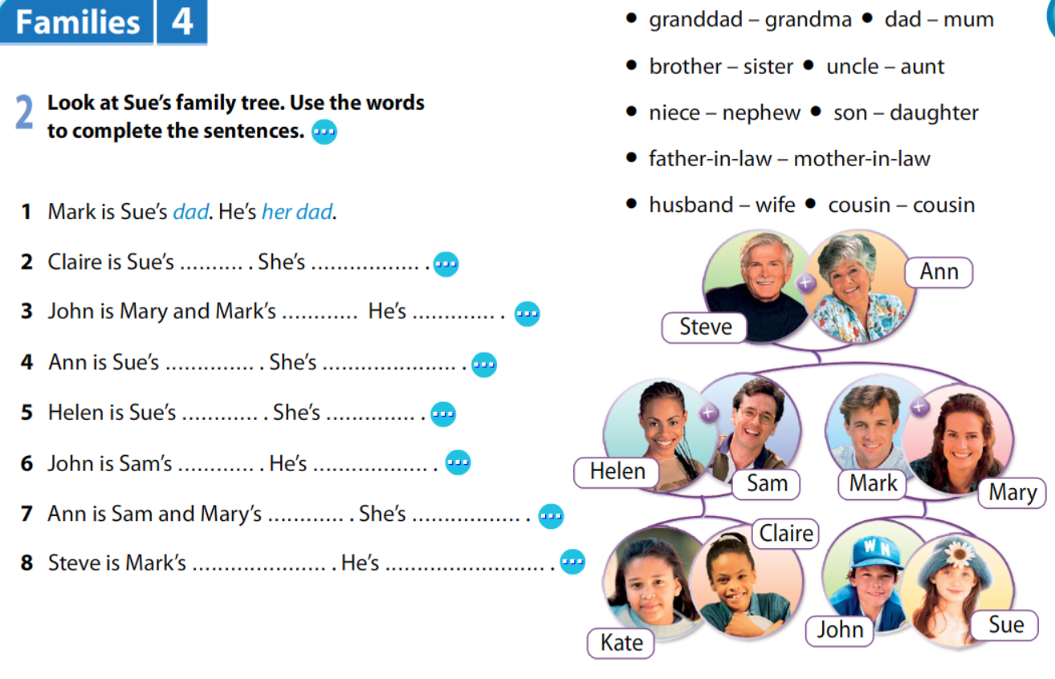
cousin
her cousin
son
their son
grandma
her grandma
aunt
her aunt
nephew
his nephew
mum
their mum
father-in-law
his father-in-law

Slide 6
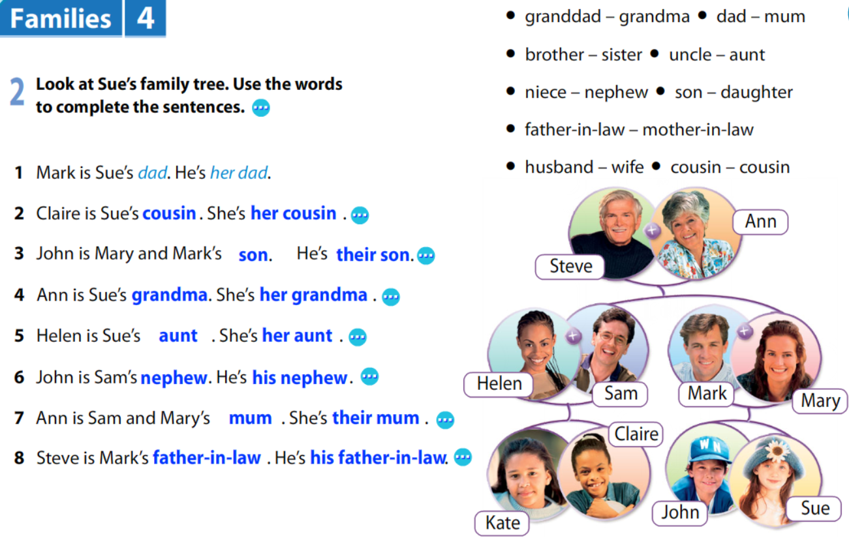

Slide 7
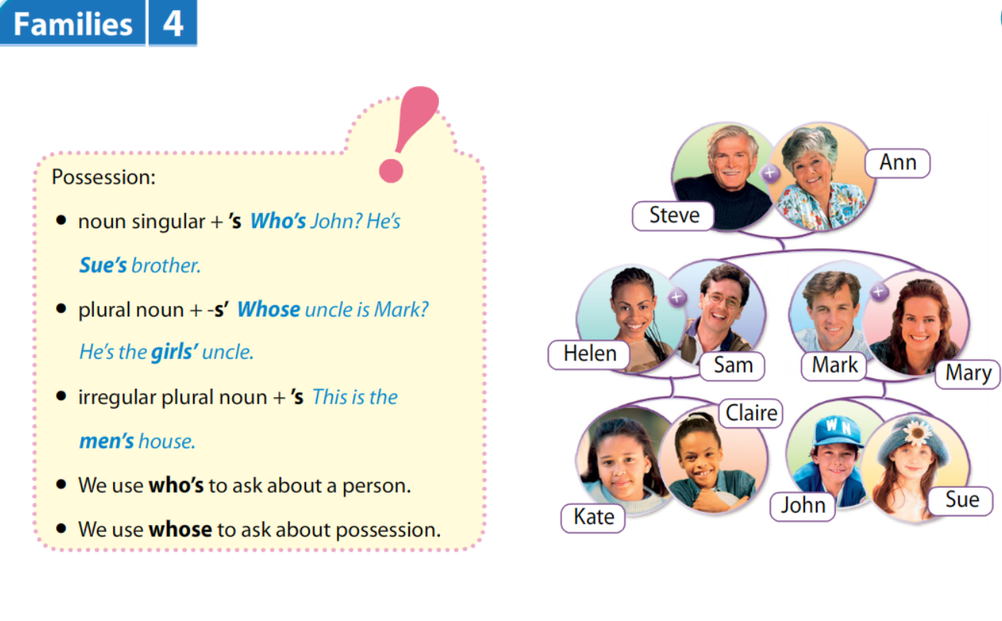

Slide 8
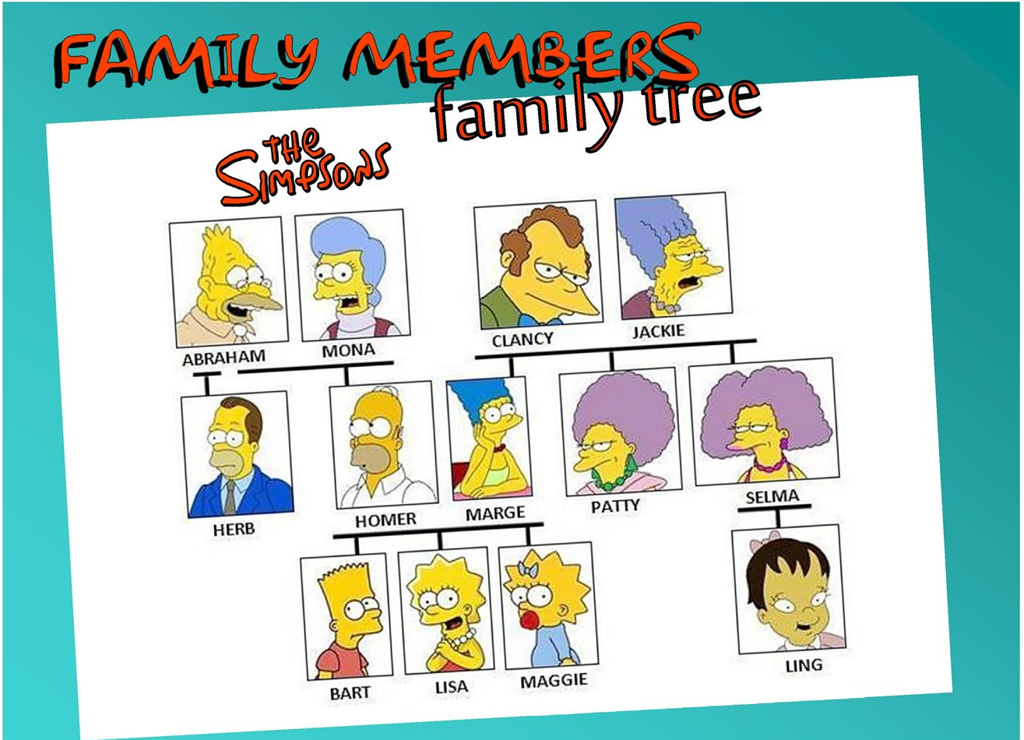


Slide 9
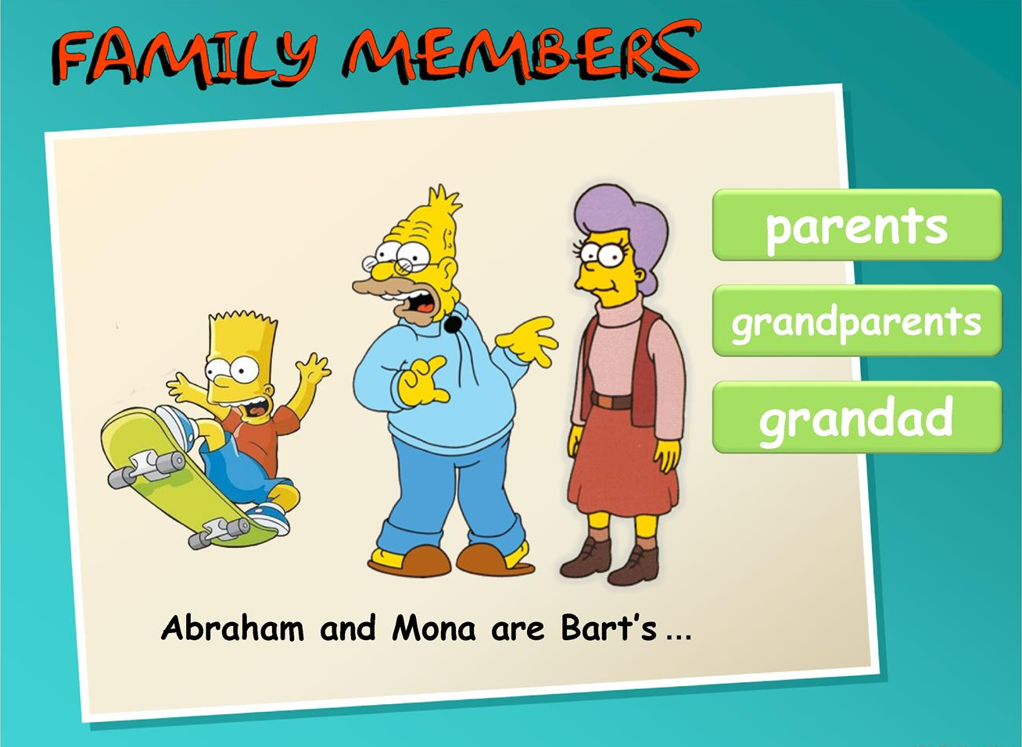


Slide 10
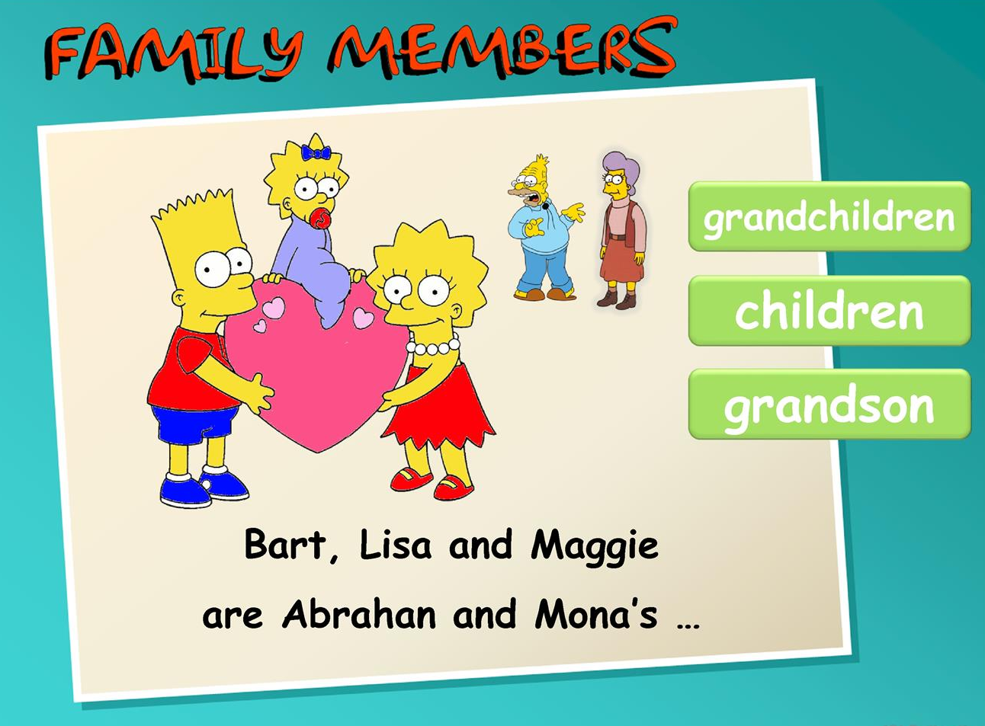

Slide 11
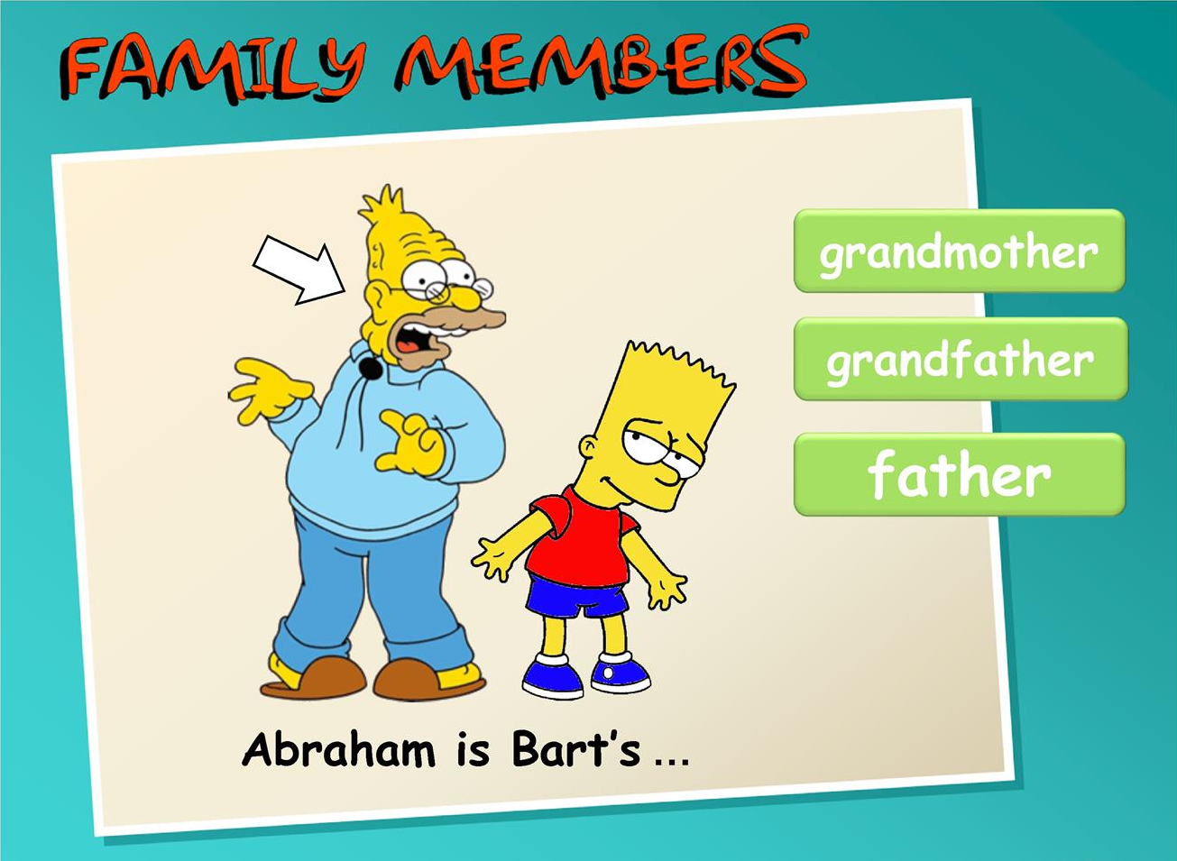

Slide 12
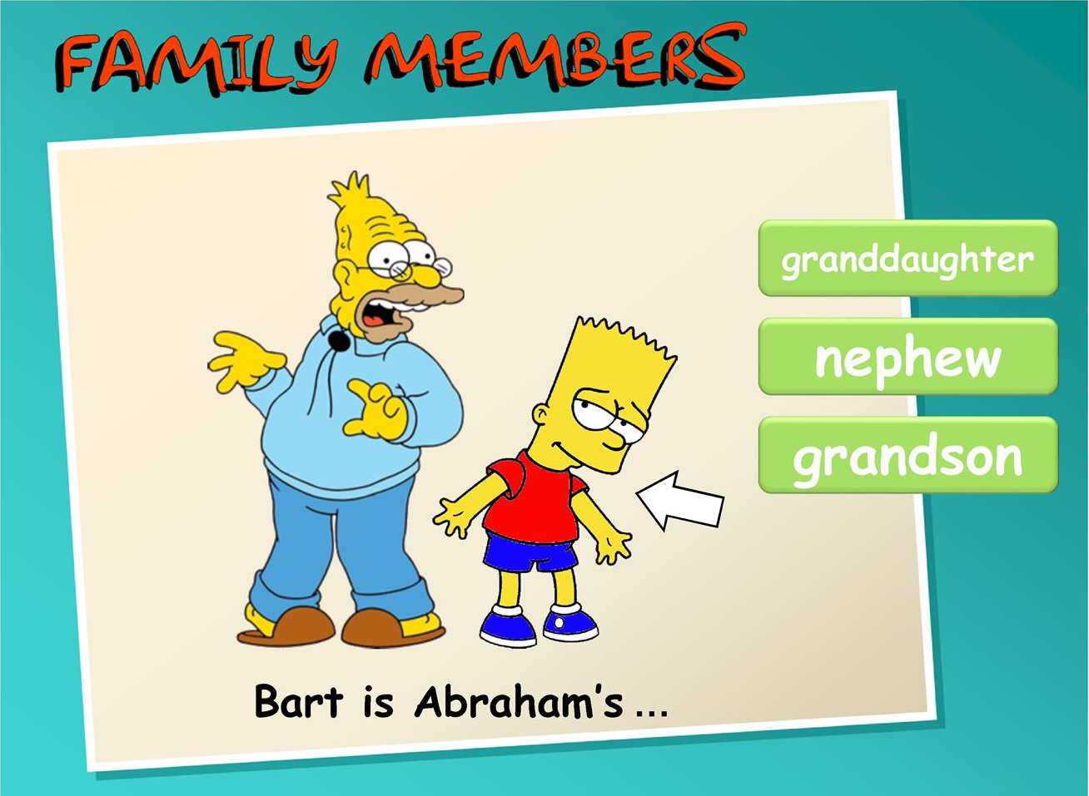

Slide 13
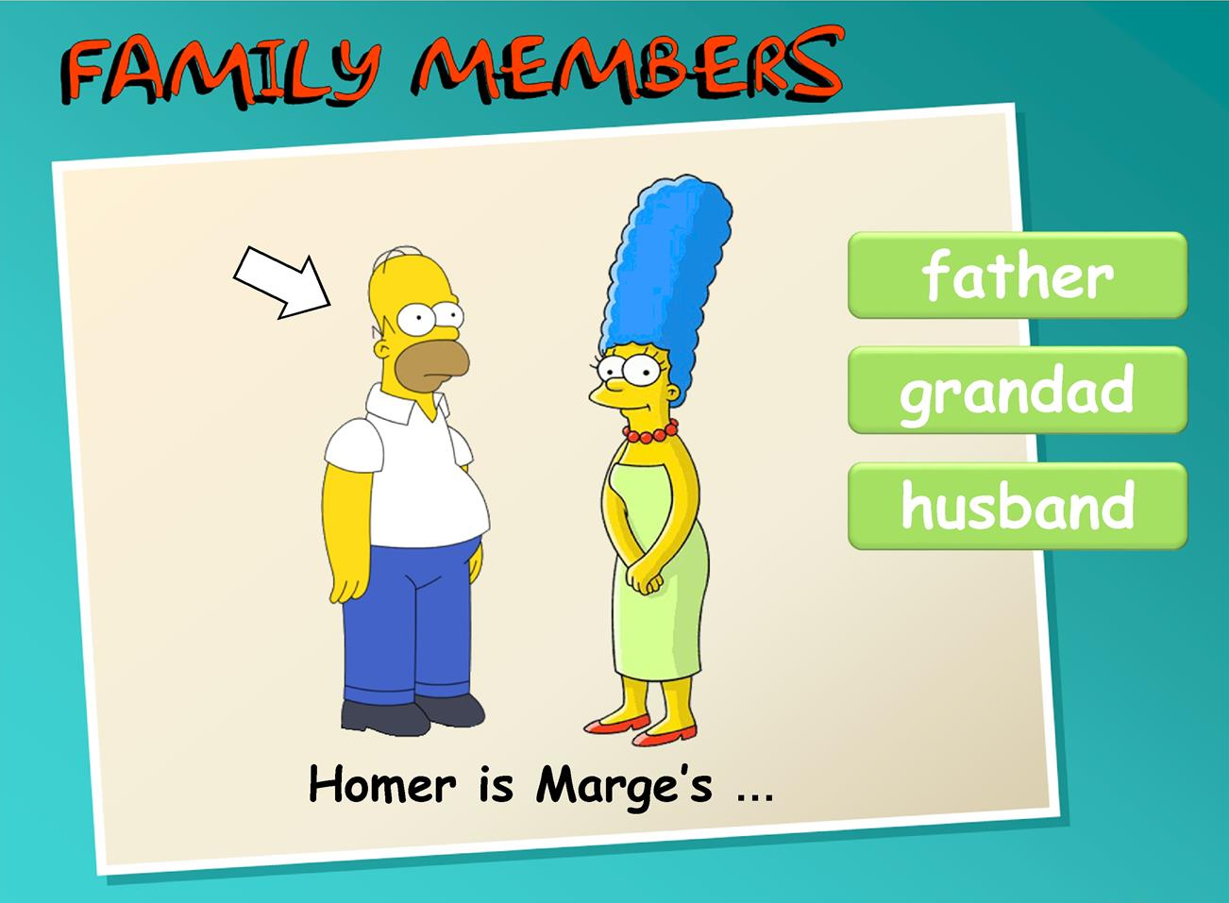

Slide 14
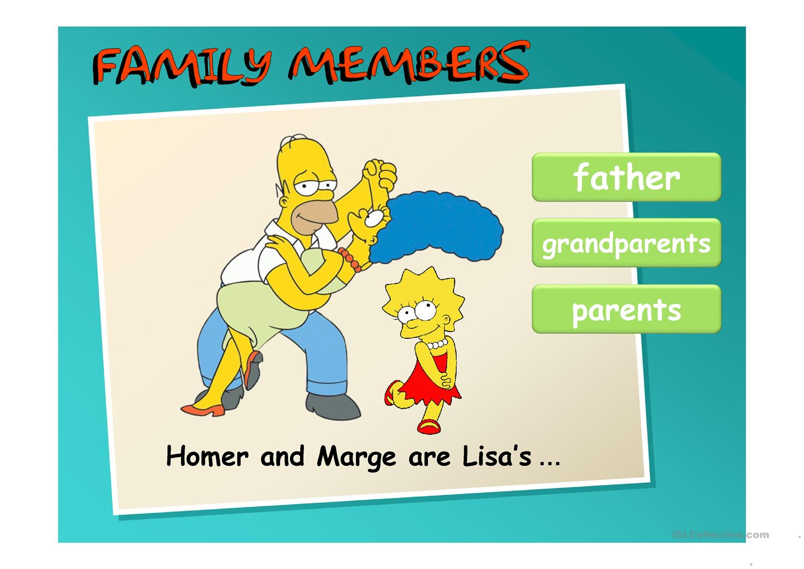

Slide 15


Slide 18
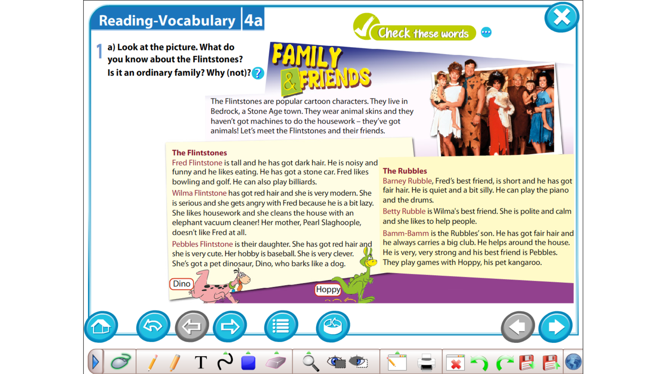
Answer the questions

Slide 19
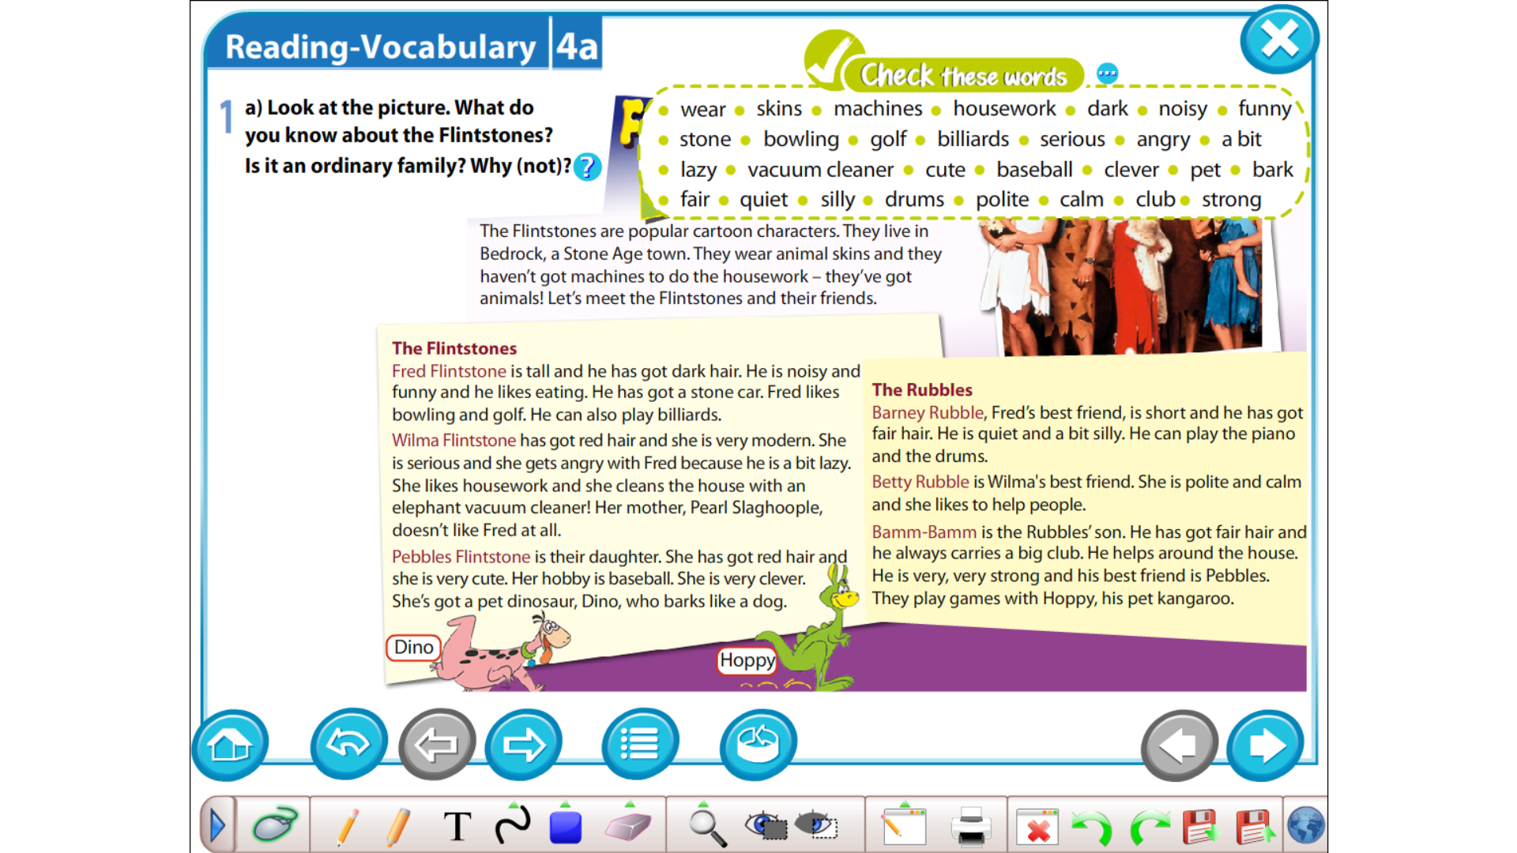

Slide 20
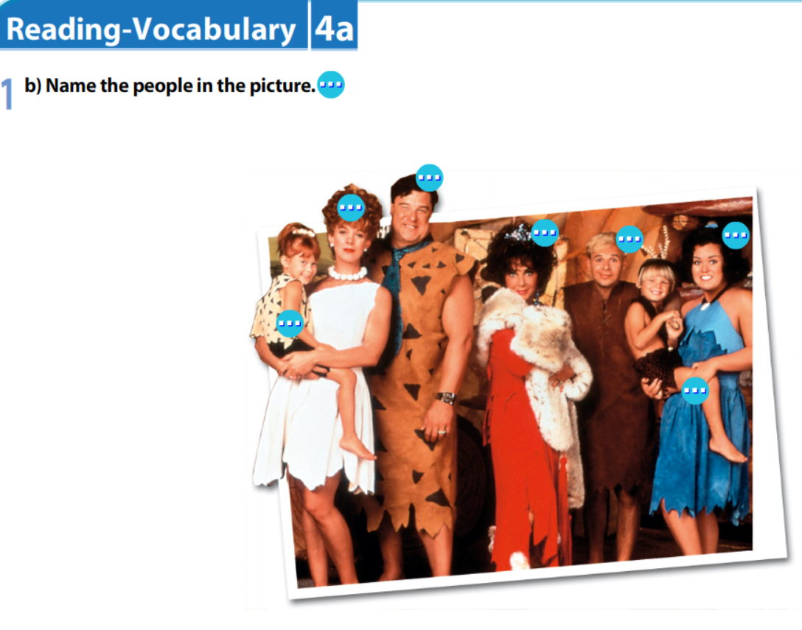

Betty Rubble

Slide 21
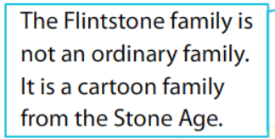

Slide 22

Answer the questions

Slide 23
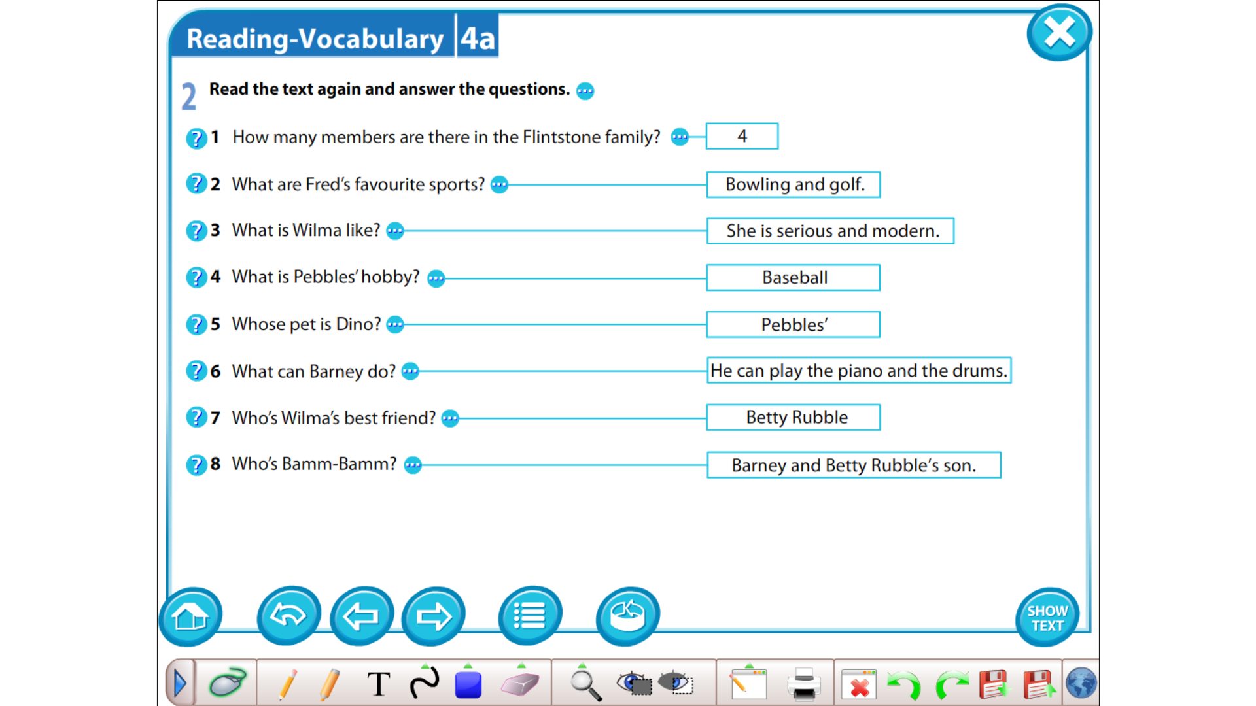
There are 4 members.
Pebbles’ hobby is baseball.
Fred’s favorite sports are bowling and golf.
Dino is Pebbles’ pet.
Barney and Betty Rubble’s son.
She is serious and modern.
Wilma’s best friend is Betty Rubble.
He can play the piano and drums.

Slide 25

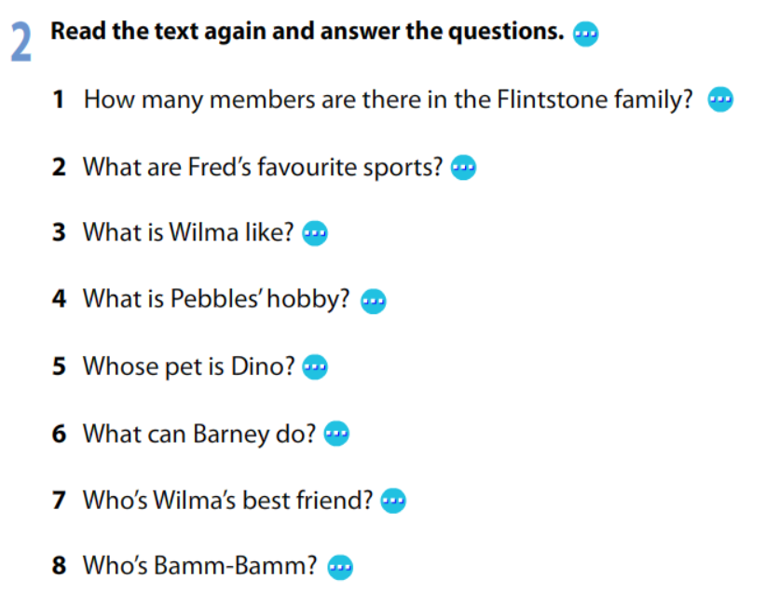
Monday 9th September 2024
Read the text and answer the questions.

Slide 26


Slide 27
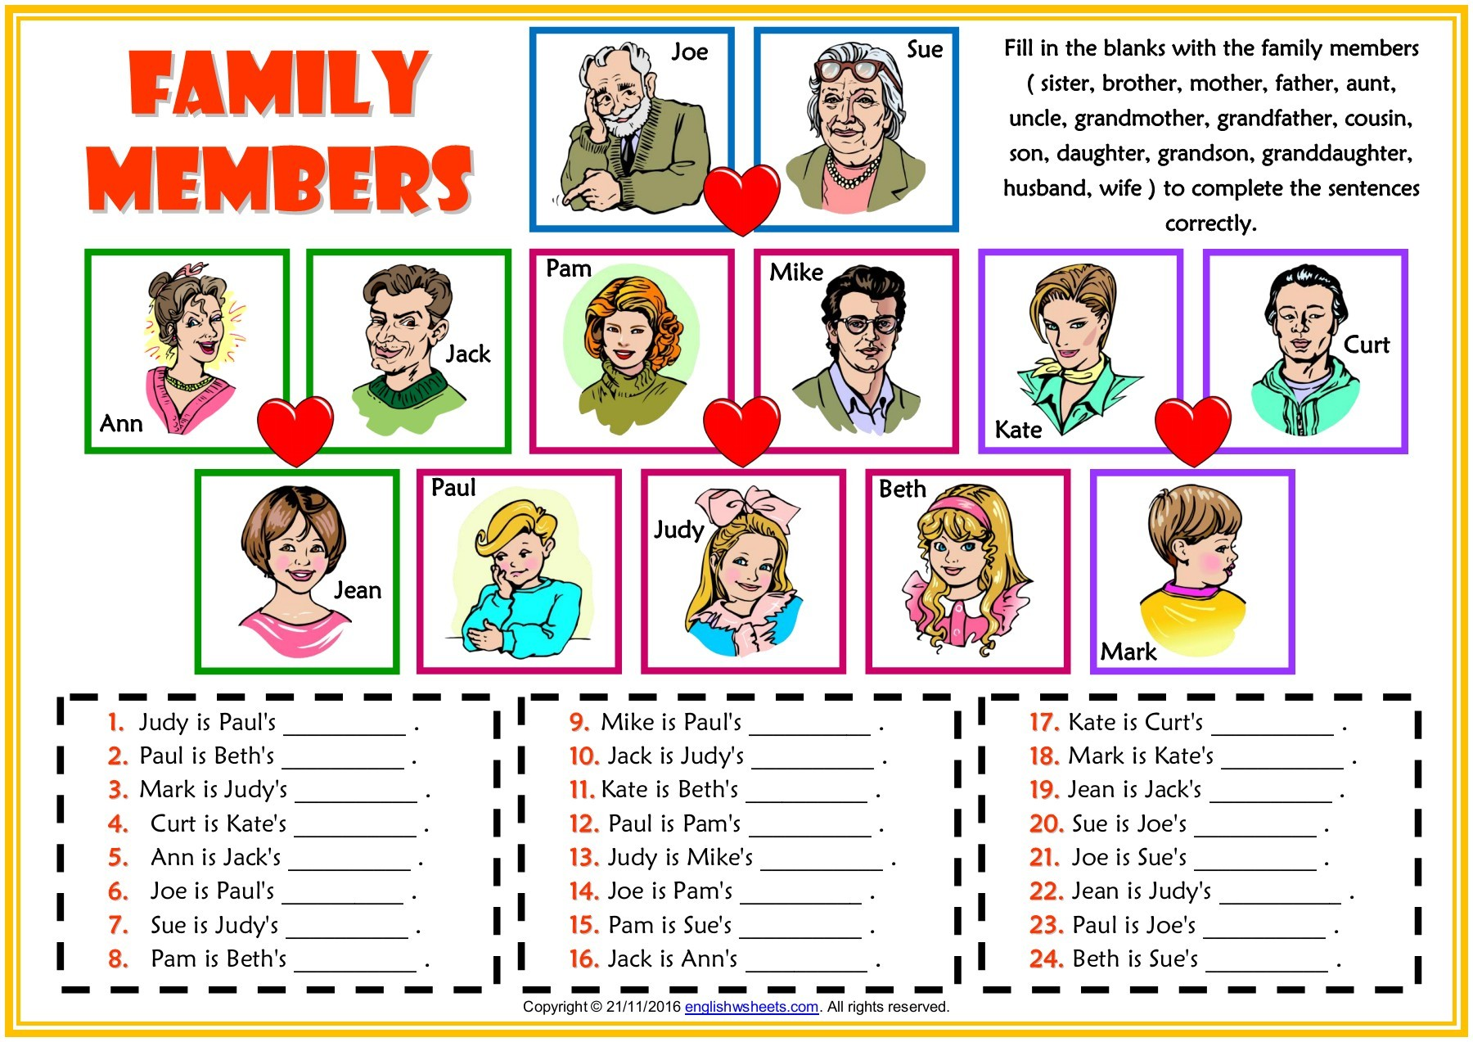
Monday 6th September 2021
Copy 1-24 in your notebook and fill in the blanks with the family members.

Slide 28


Slide 29
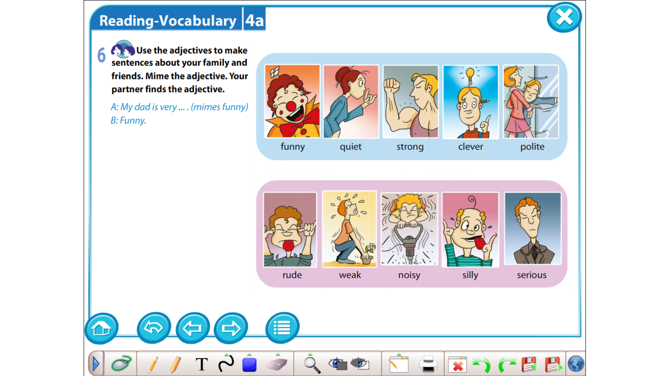

Slide 30
