Slide 1



Slide 2
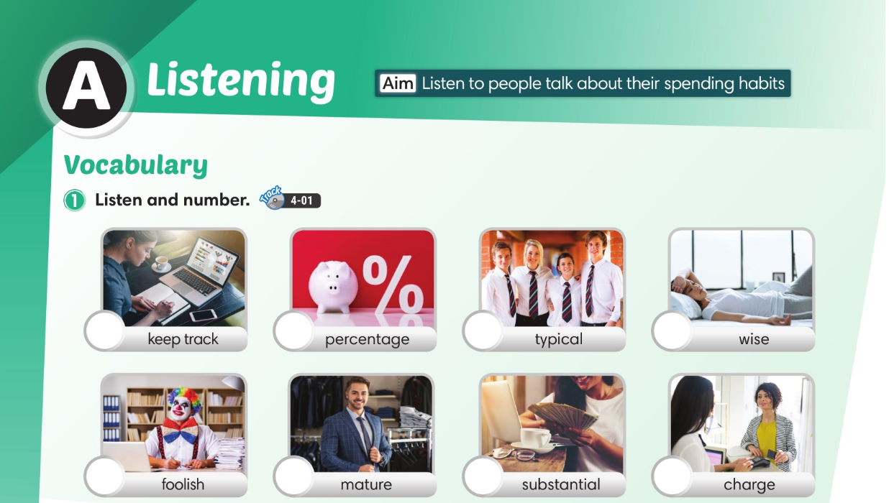

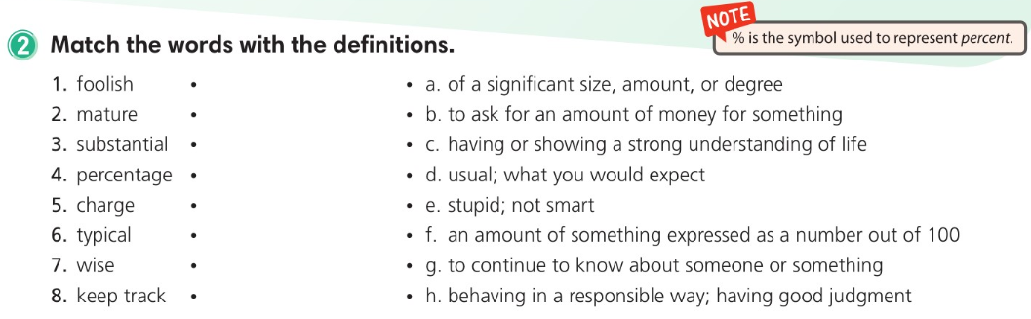
4
7
3
5
8
2
6
1

Slide 4
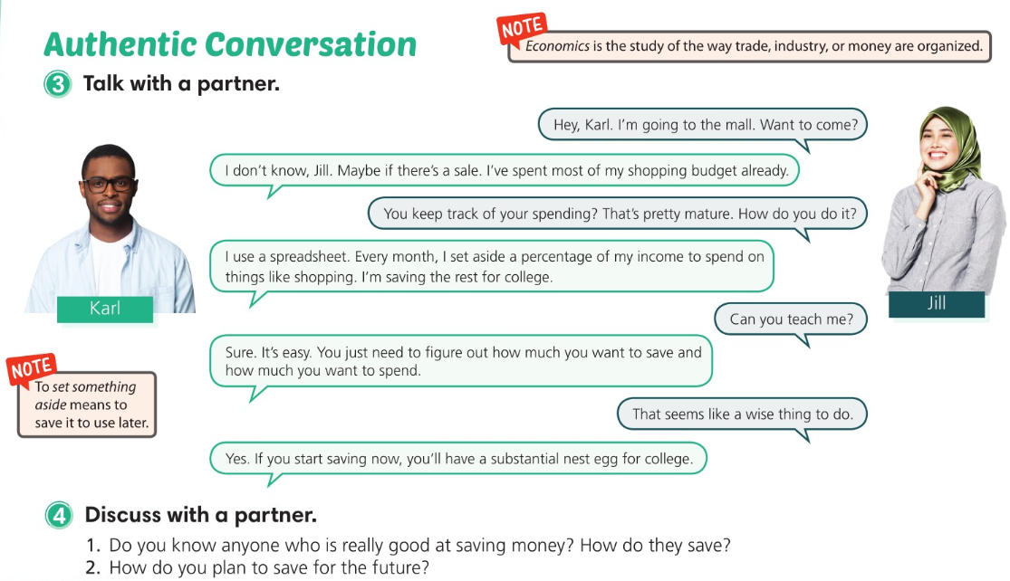

Slide 5
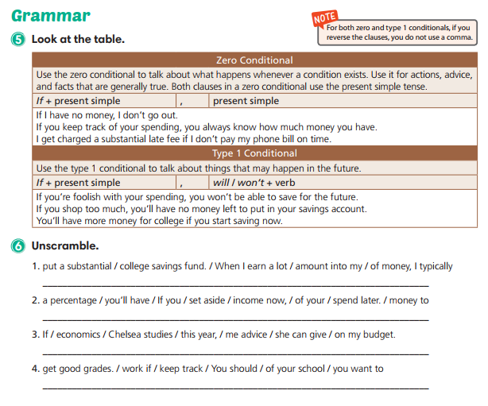
When I earn a lot of money, I typically put a substantial amount into my college savings fund.
If you set aside a percentage of your income now, you’ll have money to spend later.
If Chelsea studies economics this year, she can give me advice on my budget.
You should keep track of your schoolwork if you want to get good grades.

Slide 6
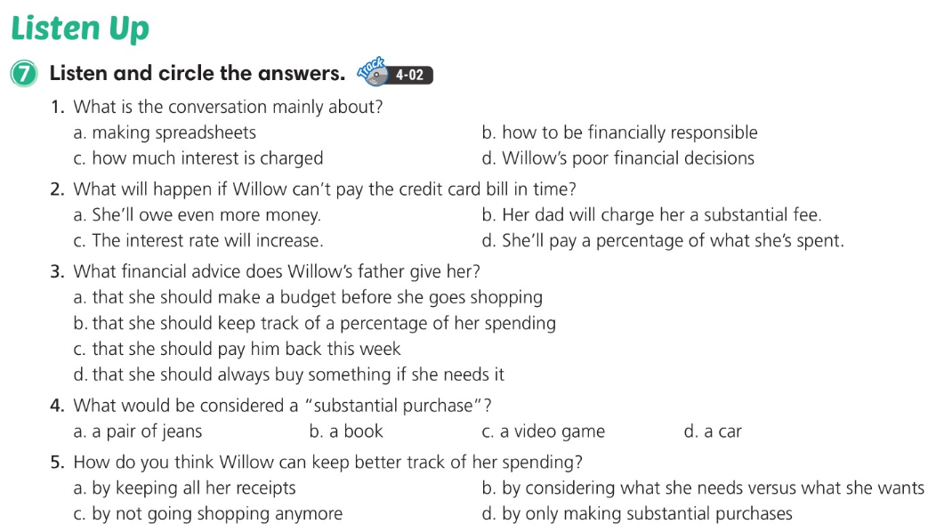

Slide 7
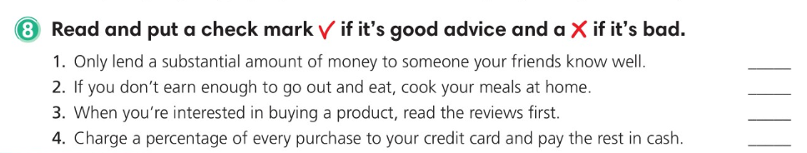



Slide 8
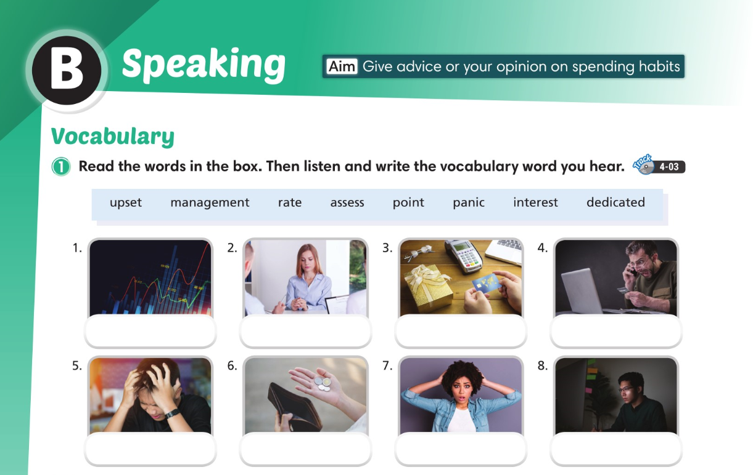
rate
assess
point
interest
upset
management
panic
dedicated

Slide 9
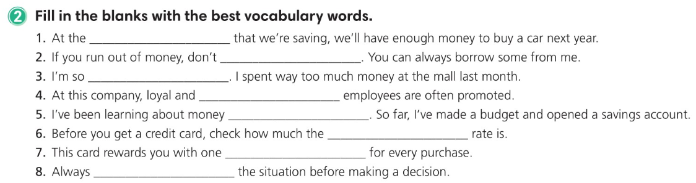
rate
panic
upset
dedicated
management
interest
point
assess

Slide 10
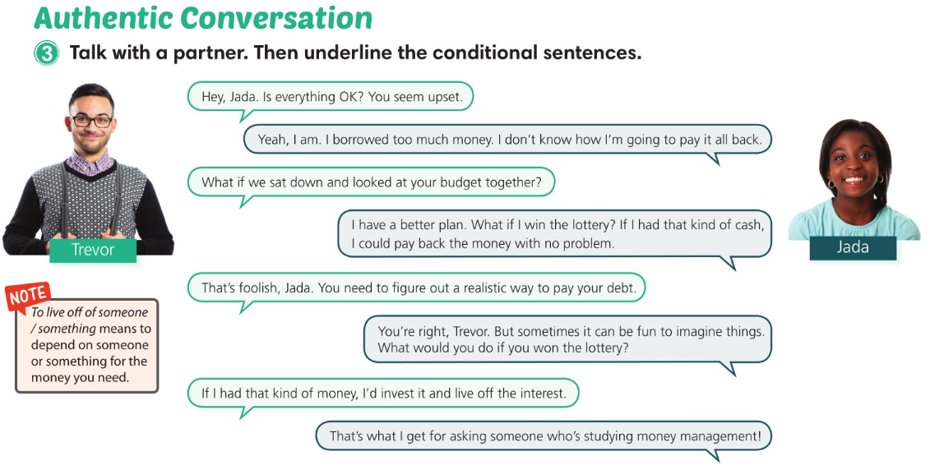

Slide 11
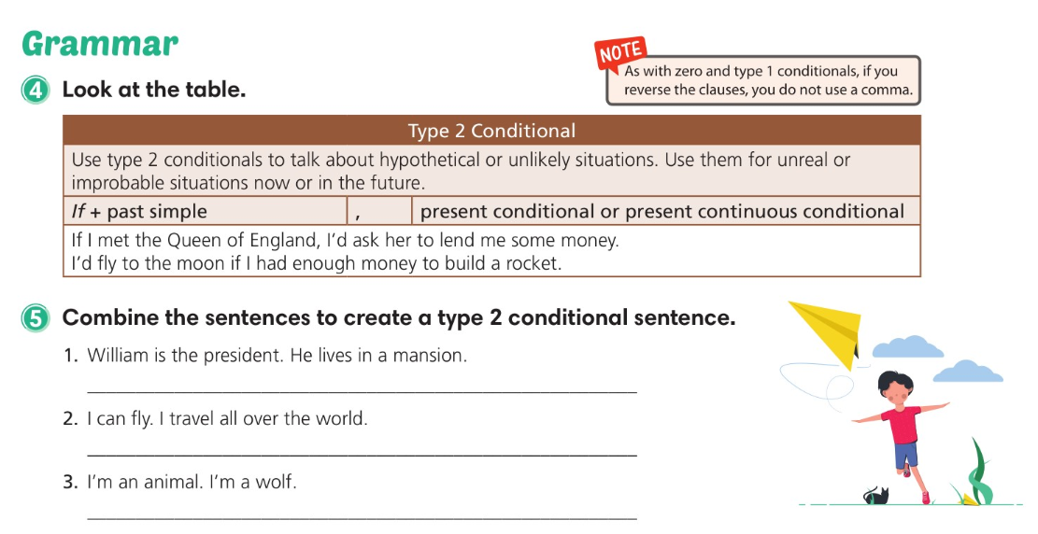
If William was / were the president, he would live in a mansion.
If I could fly, I would travel all over the world.
If I was / were an animal, I would be a wolf.

Slide 12
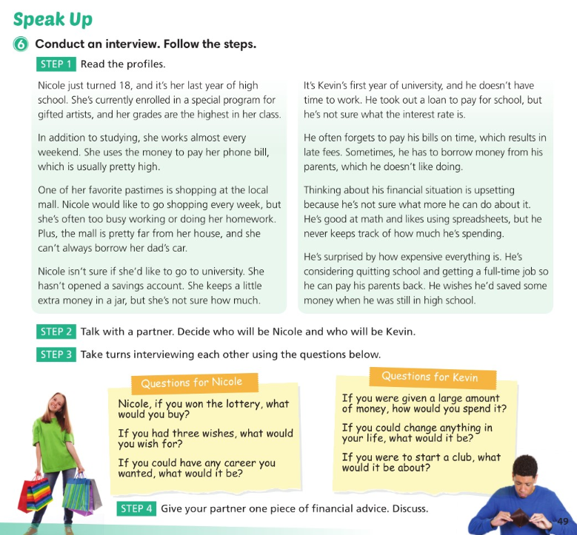

Slide 13
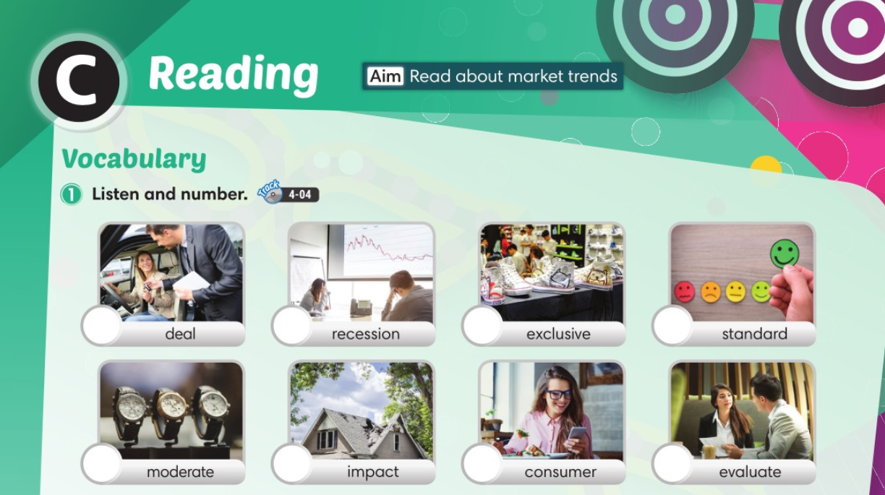
6
5
8
3
1
7
2
4

Slide 14
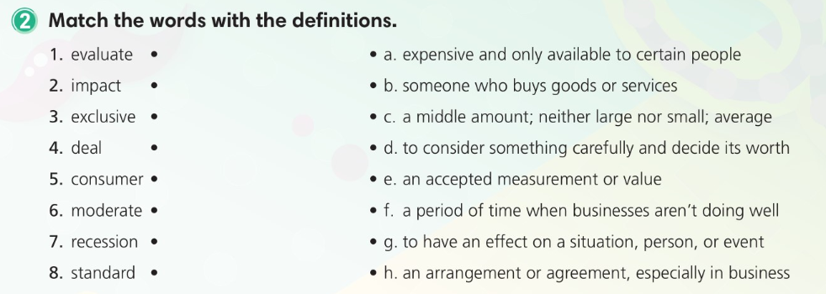

Slide 15
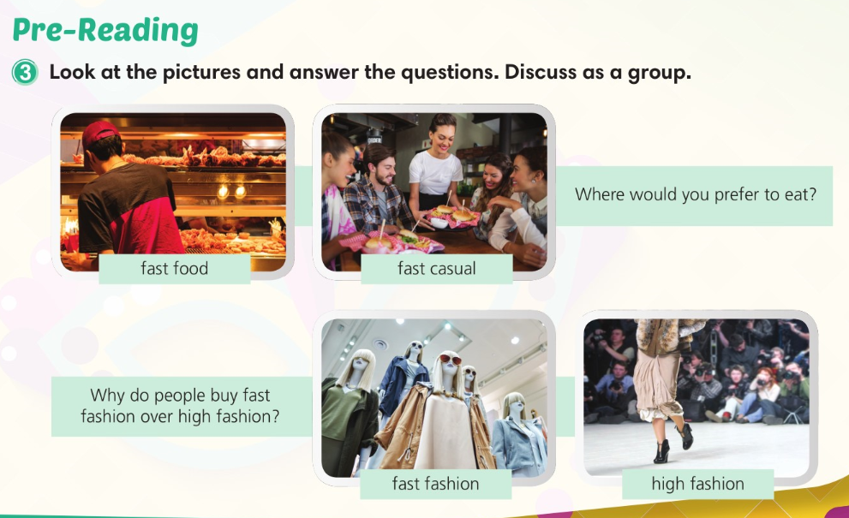

Slide 16
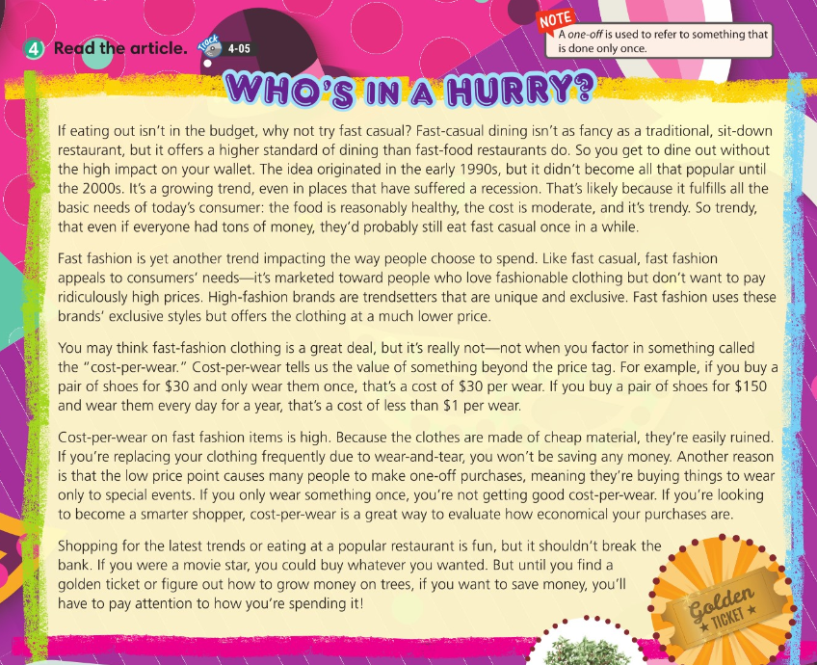
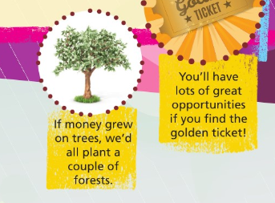

Slide 17
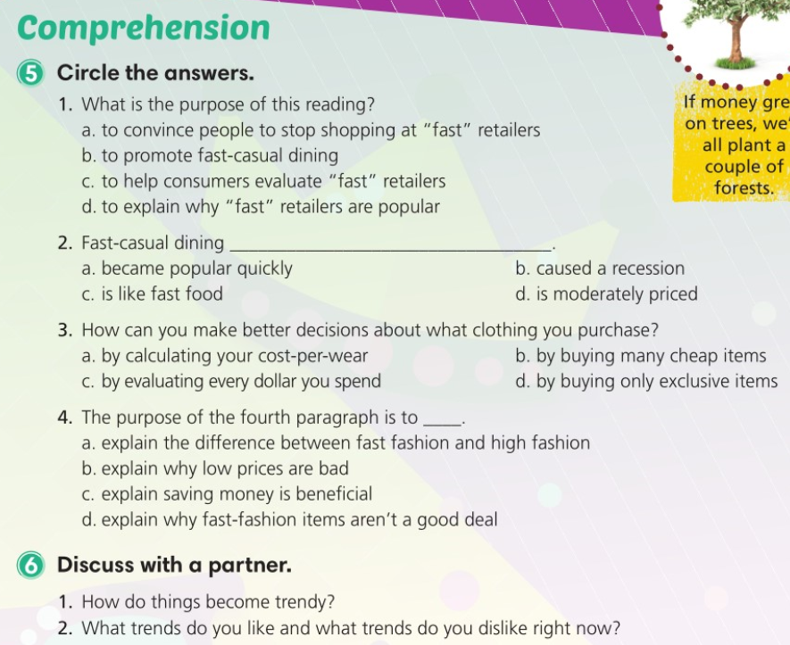

Slide 18
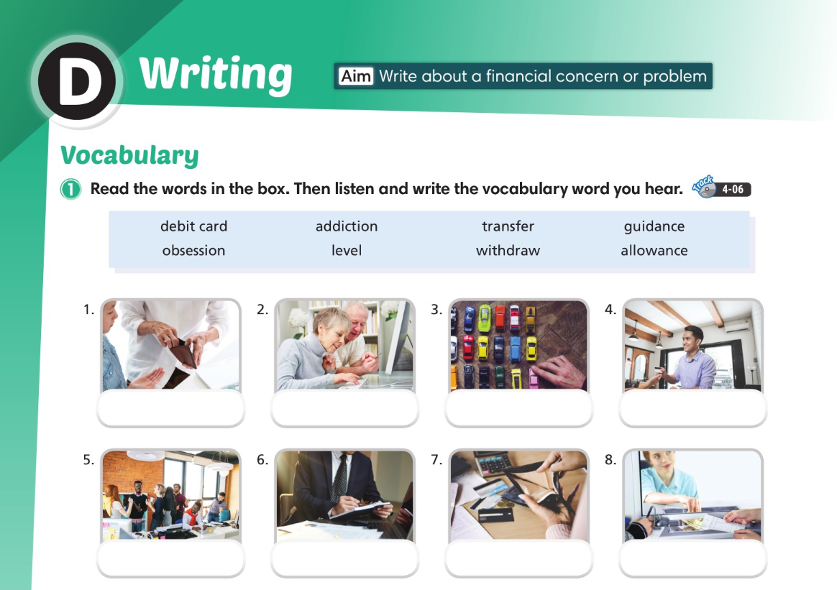
allowance
transfer
obsession
debit card
level
guidance
addiction
withdraw

Slide 19
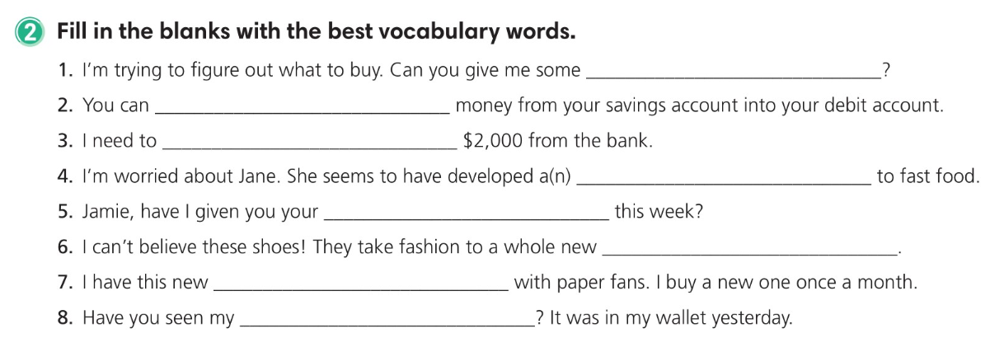
guidance
transfer
withdraw
addiction
allowance
level
obsession
debit card

Slide 20
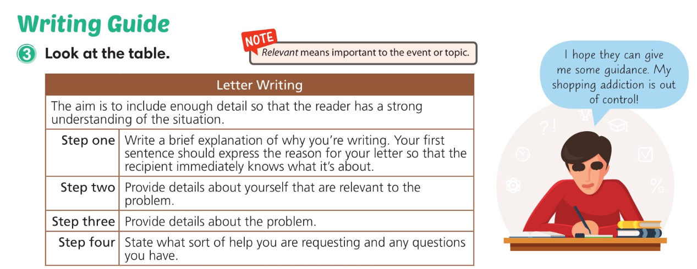

Slide 21
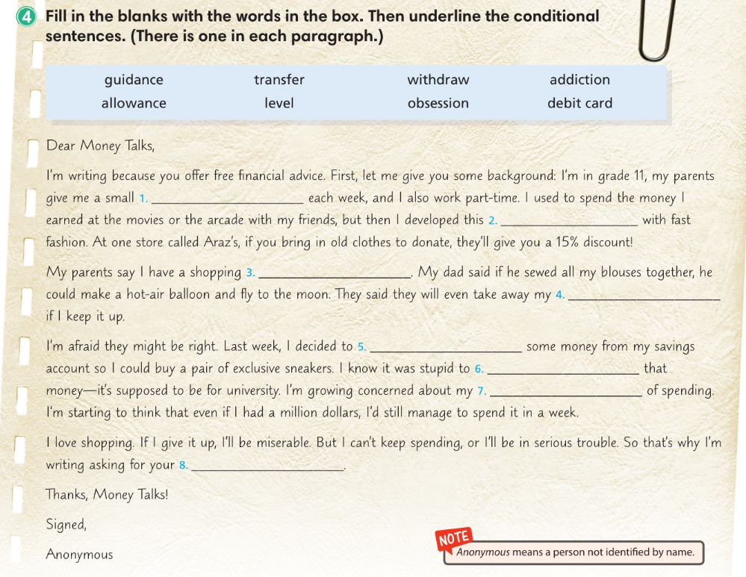
allowance
obsession
addiction
debit card
transfer
withdraw
level
guidance

Slide 22
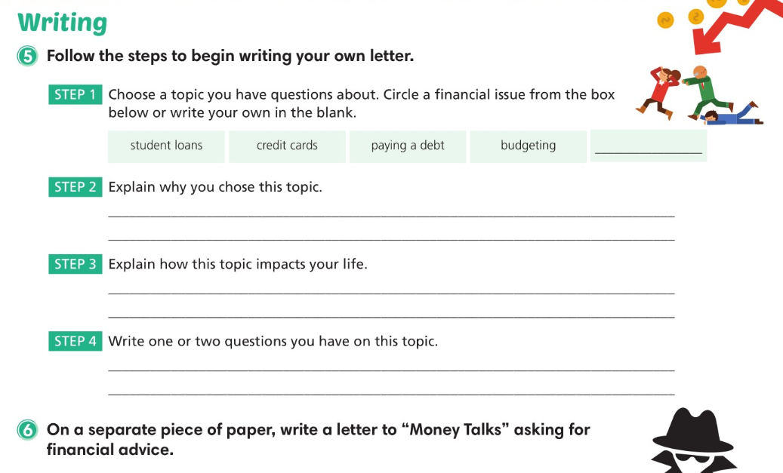

Slide 23
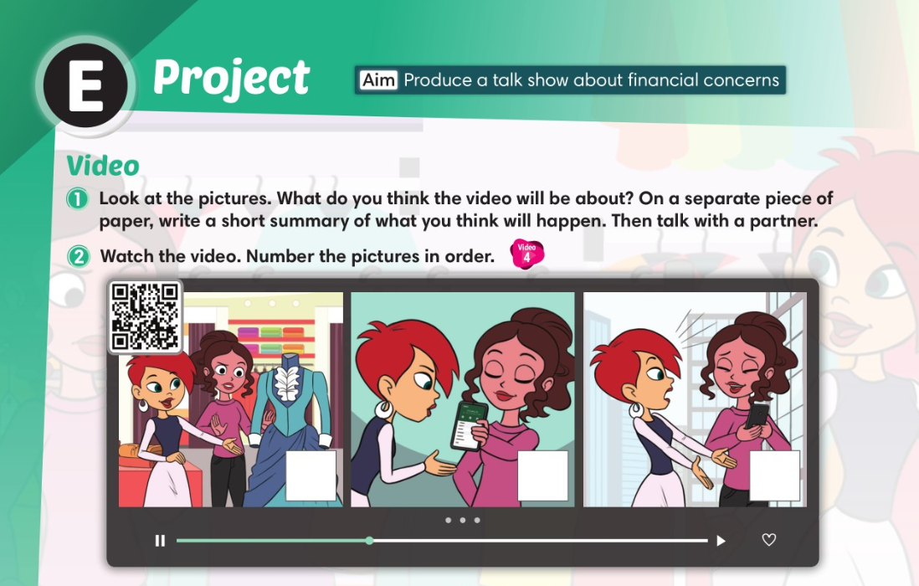
2
3
1

Slide 24
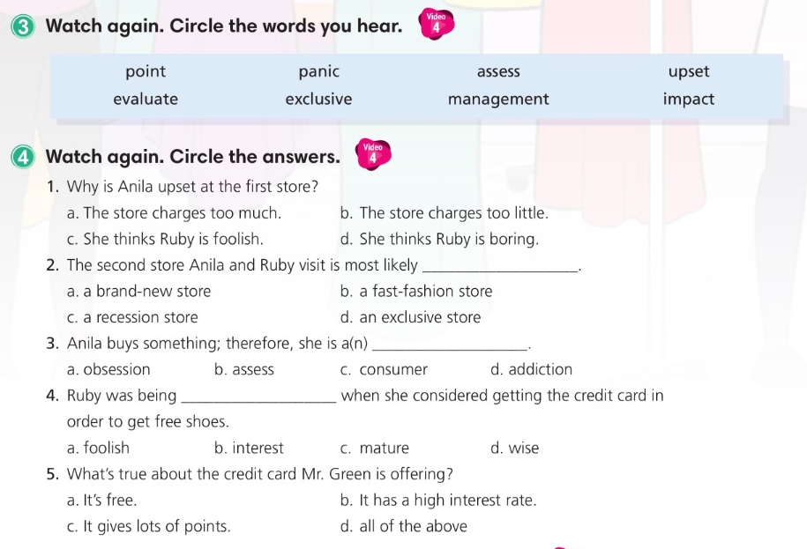

Slide 25
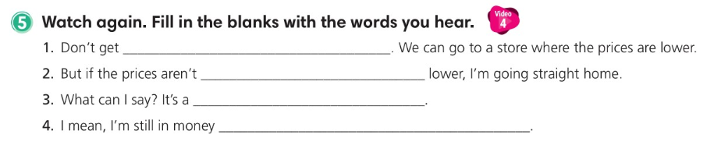
upset
substantially
recession
management

Slide 26
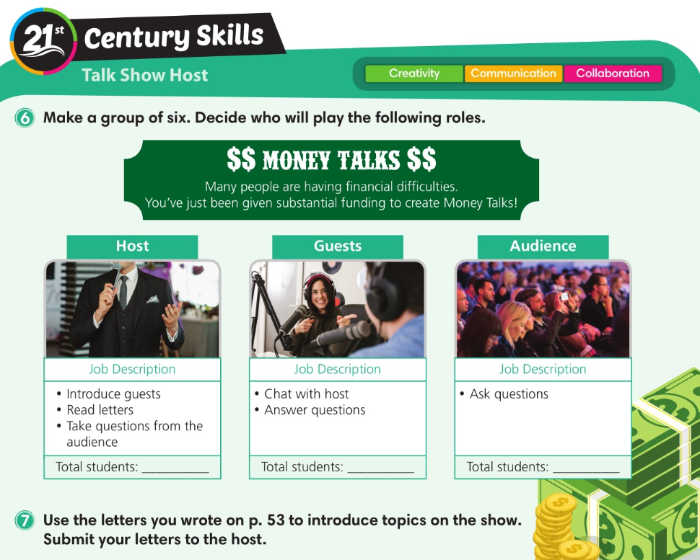

Slide 27
