Slide 1
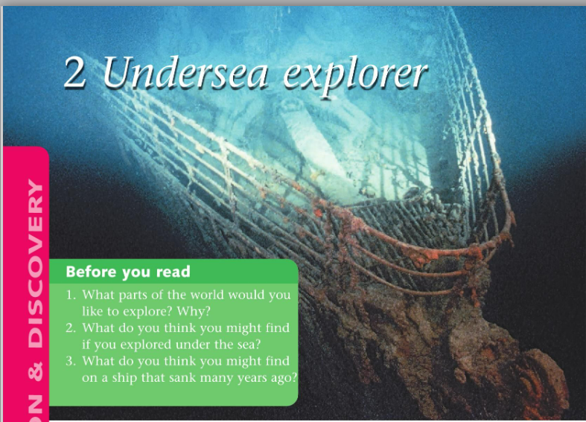

Slide 2
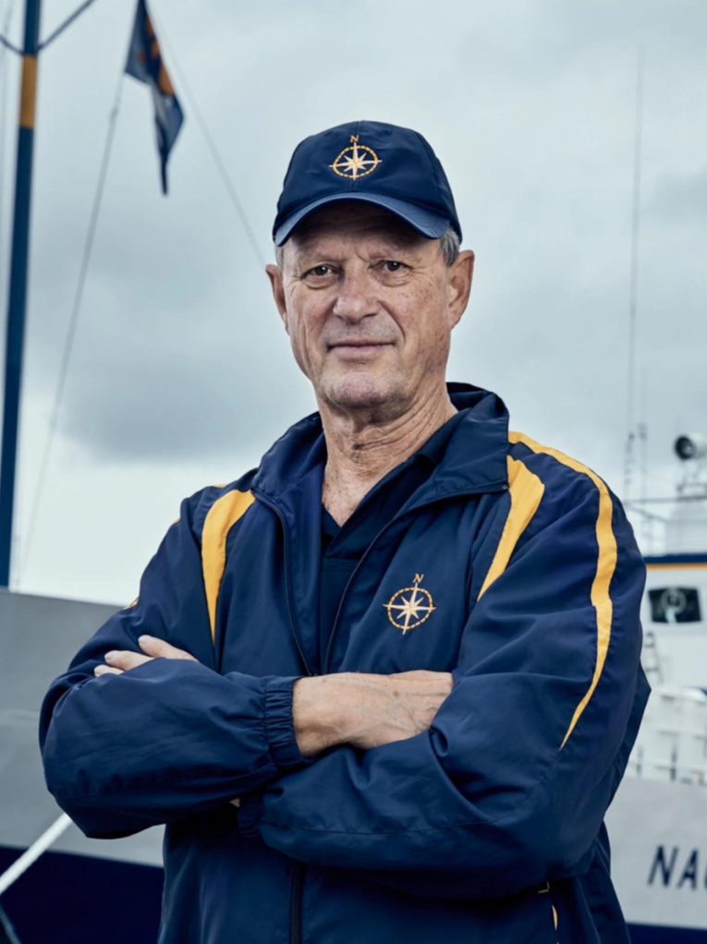
Robert D. Ballard Dared

Slide 3
Guess the meaning
explore
When you go to a new place, it’s fun to explore.
submersible
We can travel underwater by submersible.
mystery
This movie is a mystery. We don’t know who is the murderer.
give up
You should give up smoking. It’s not good.
pioneer
Thomas Edison was a pioneer in the use of electricity.
transmit
Music is transmitted all around the world by radio.
voyage
I travelled from Australia to New Zealand by boat. It was a very relaxing voyage.
passenger
There are many passengers on the train today. I can’t find the place to sit.

Slide 4
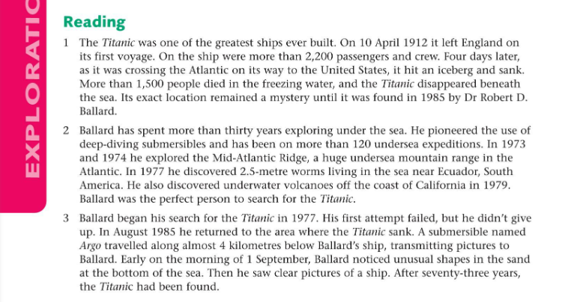

Slide 5
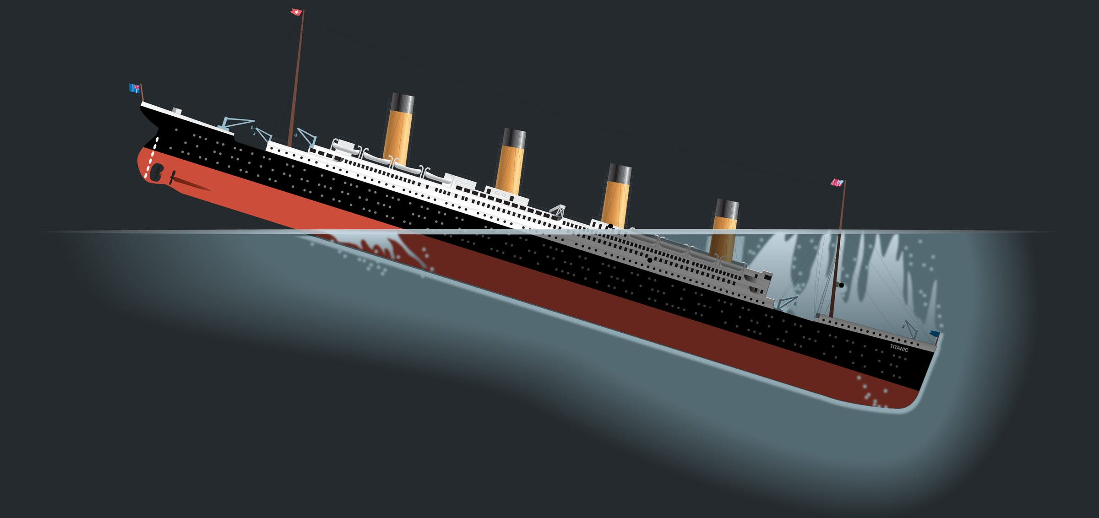
Who What When Where Why

