Slide 1
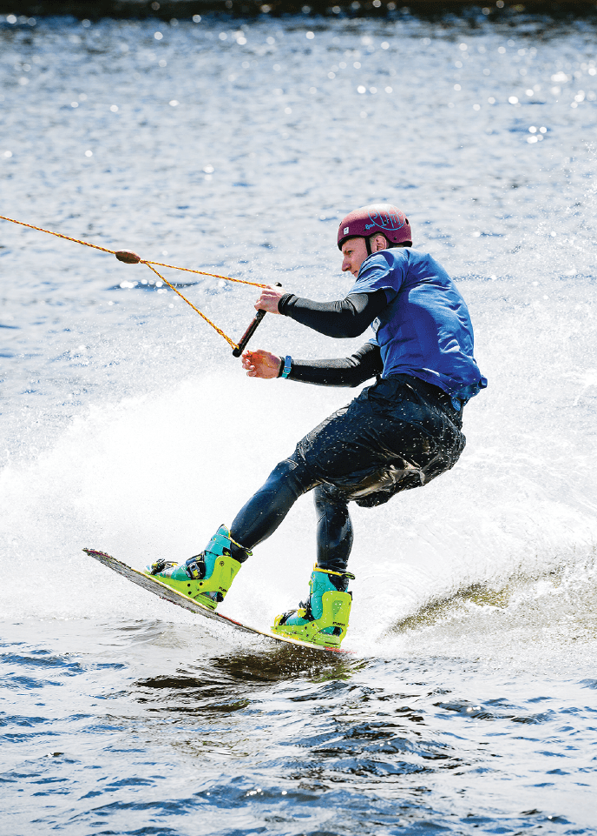




Slide 2


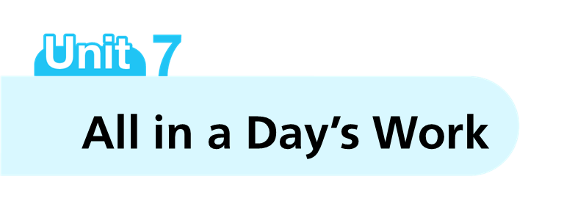






Slide 3



Slide 4
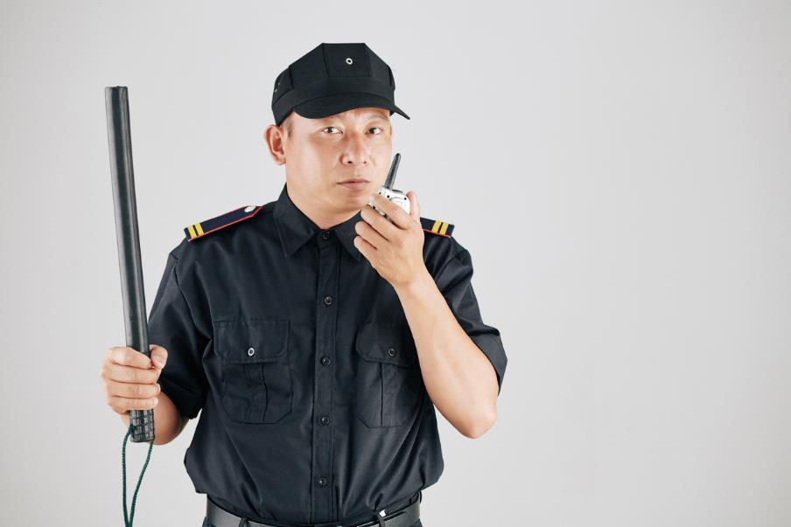


Slide 5



Slide 6



Slide 7



Slide 8



Slide 9



Slide 10



Slide 11
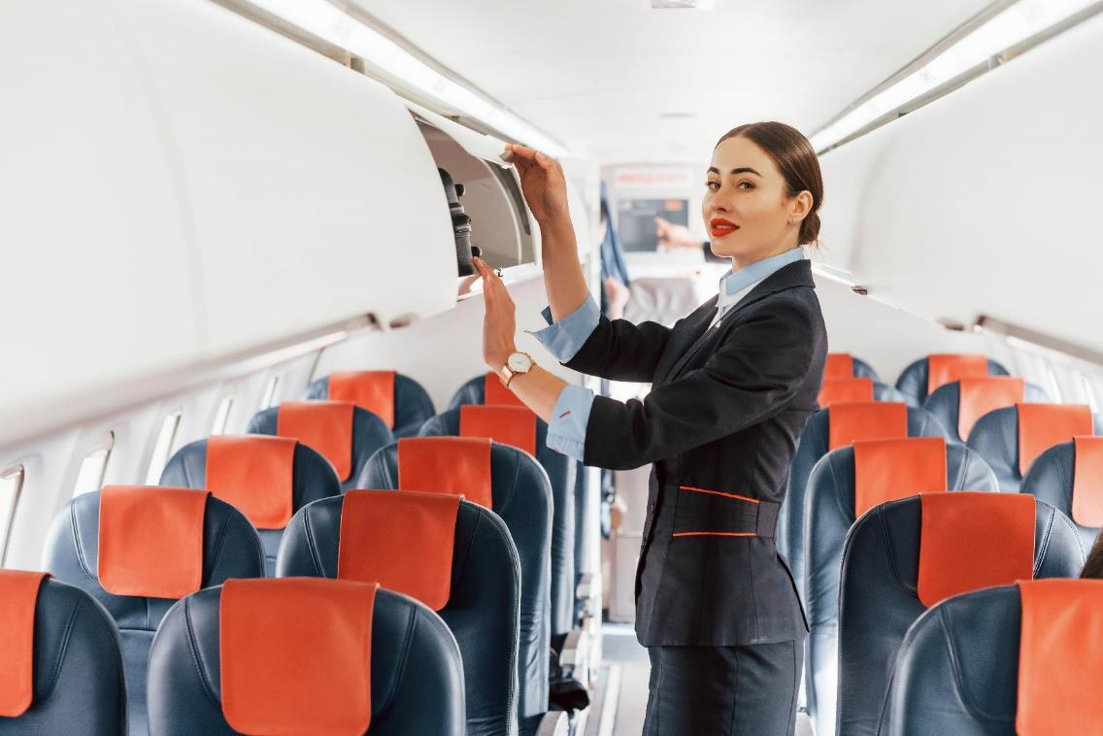


Slide 12



Slide 13



Slide 14
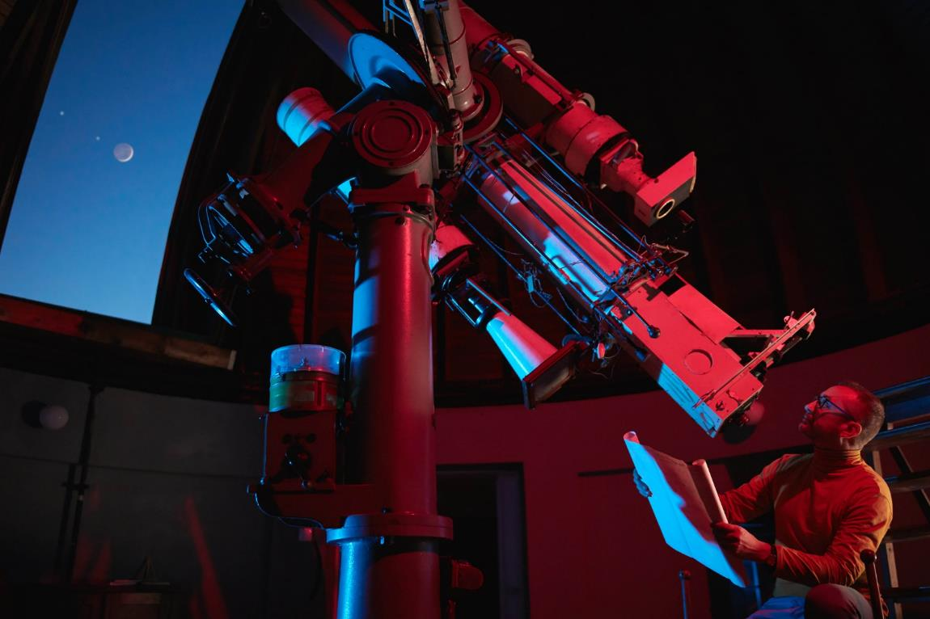


Slide 15



Slide 16



Slide 17
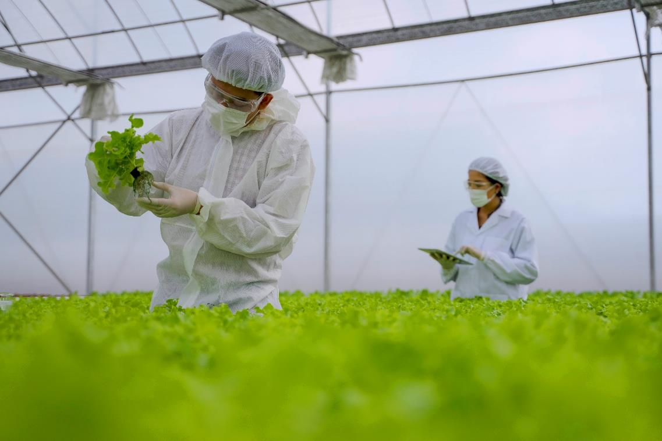


Slide 18





















Slide 19






















Slide 20























Slide 21






















Slide 22





















Slide 23



















Slide 24





















Slide 25






















Slide 26

















Slide 27

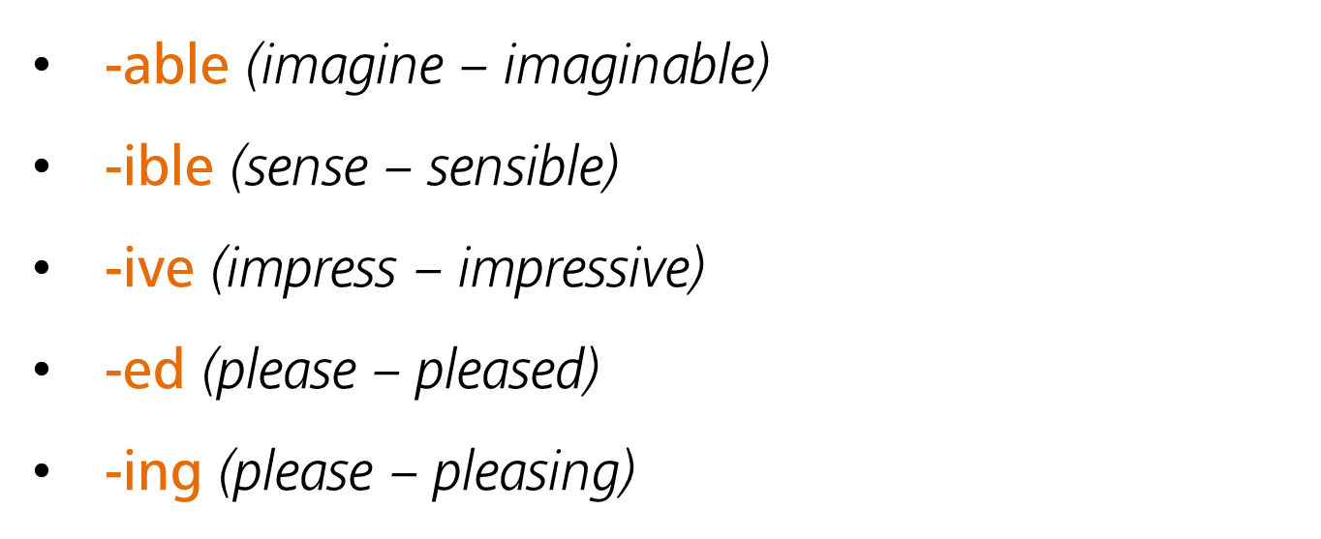

Slide 28
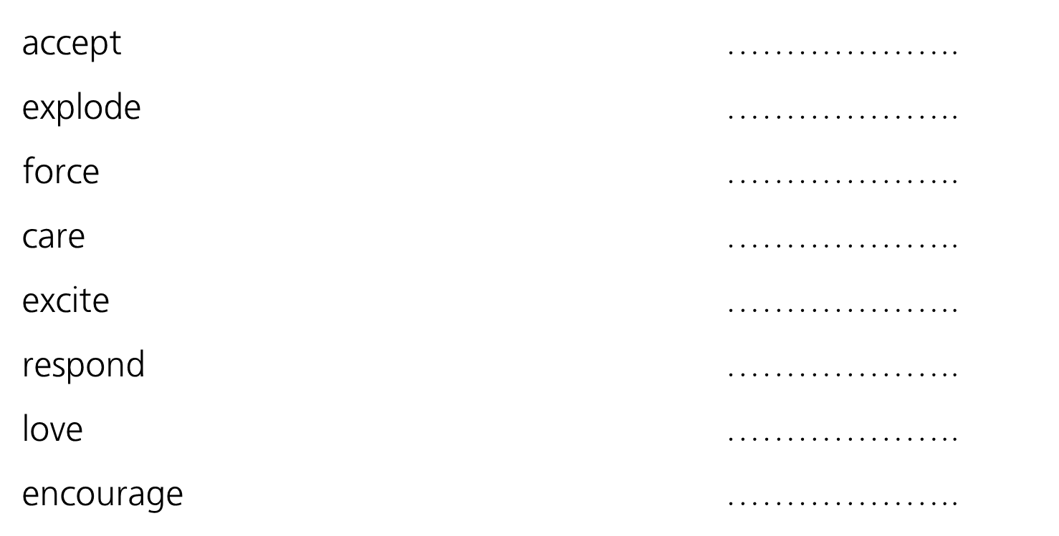









Slide 29







Slide 30






Slide 31


Slide 32



Slide 33



Slide 34

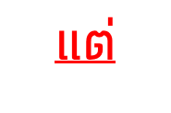


Slide 35


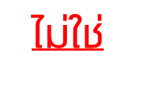



Slide 36
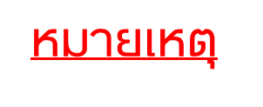




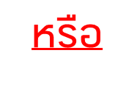

Slide 37



Slide 38




Slide 39


Slide 40



Slide 41


Slide 42

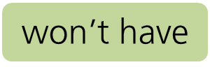


Slide 43



Slide 44



Slide 45



Slide 46



Slide 47





Slide 48



Slide 49



Slide 50


Slide 52


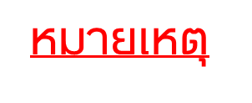


Slide 53


Slide 54


Slide 55



Slide 56





Slide 57


Slide 58












Slide 59








Slide 60




Slide 61



Slide 62
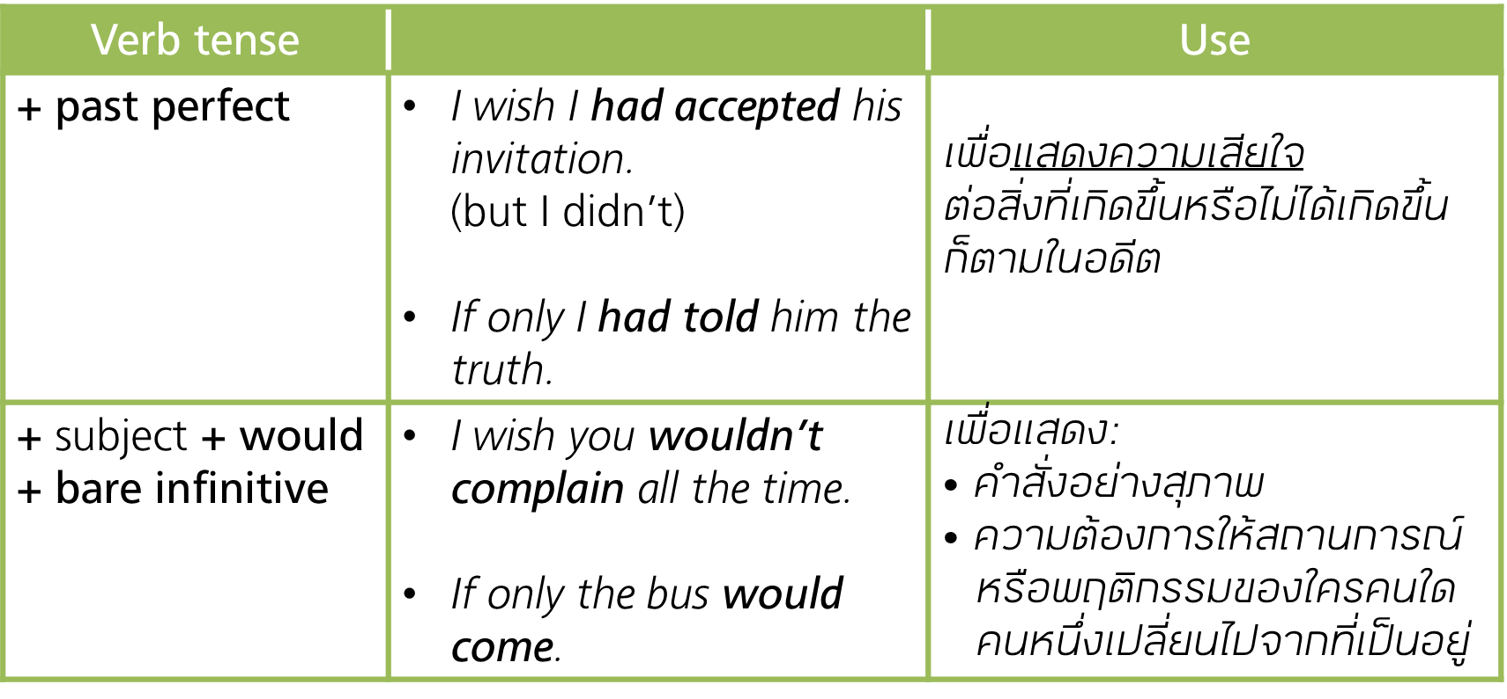

Slide 63







Slide 64






Slide 65



Slide 66


Slide 67

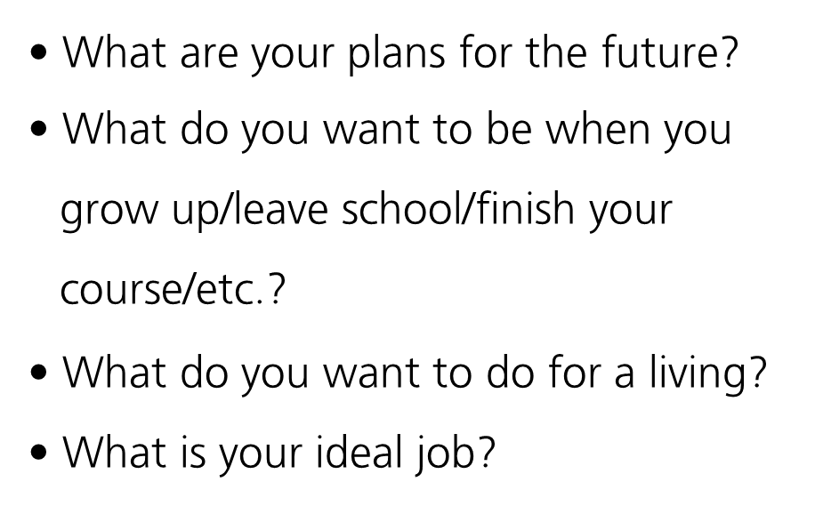


Slide 68







Slide 69





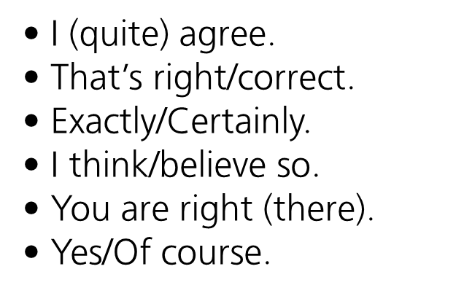
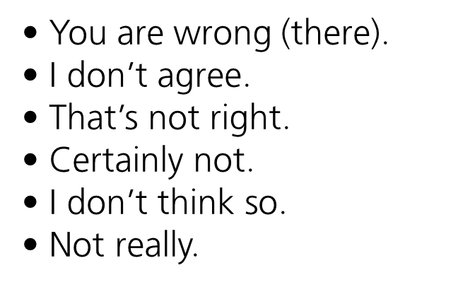
Replies

Slide 70



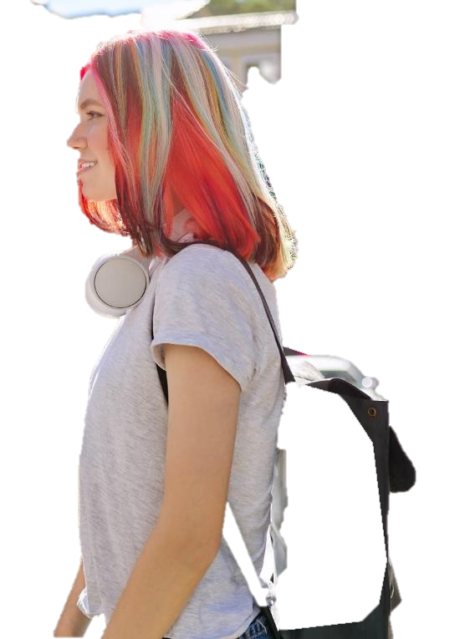


Slide 71





Slide 72

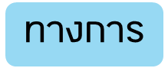






Slide 73
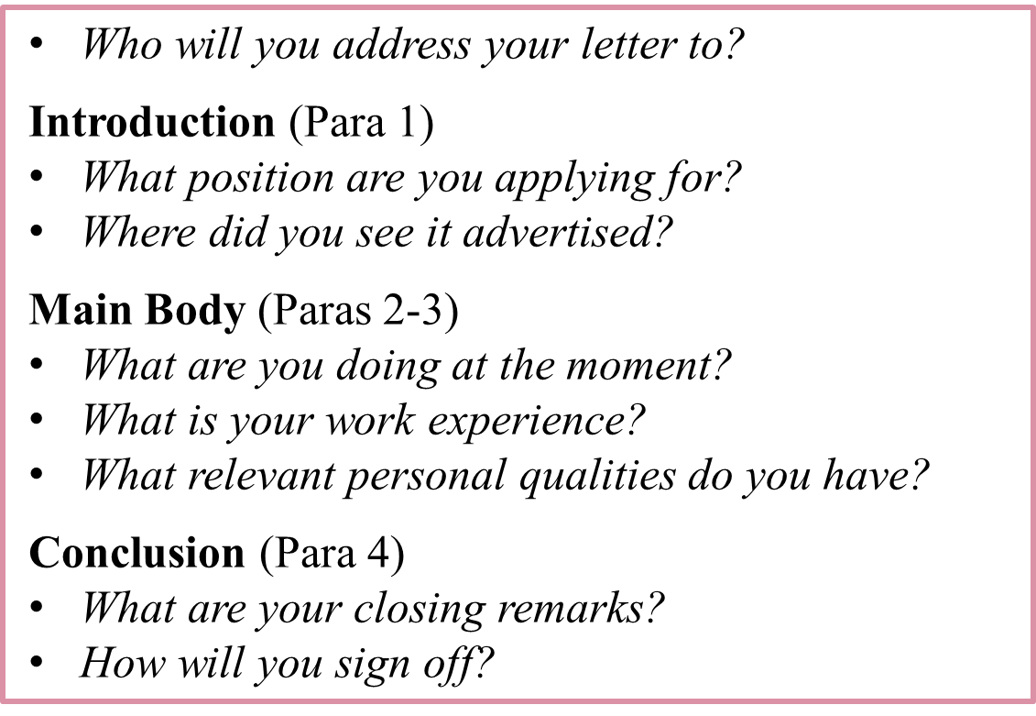

Slide 74


